Slide 1
Waste Management Association of B.C., 4th Annual AGM Conference January 29, 2015 Surrey, BC
Guideline 9.1-1: EXCLUSIONS
Presented by:
Richard Duguay, BSc, MHSc, CIH, CRSP, ROH
Senior Regional Officer
WorkSafeBC
Kamloops Office

Slide 2
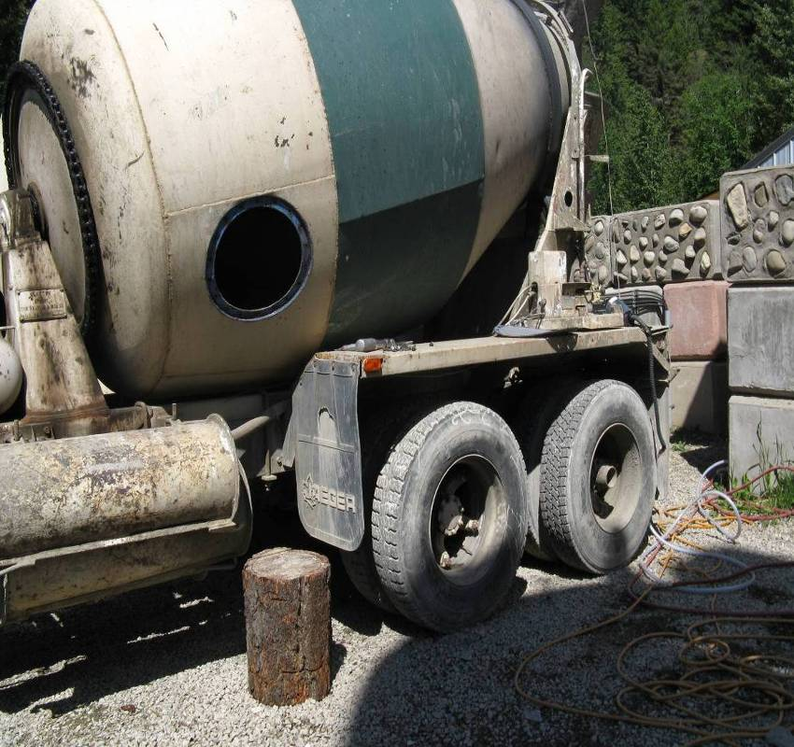
Guideline 9.1-1: Exclusion Process
Introduction:
BC’s Experience
Confined Spaces definition
Hazard Assessment
Verification and Testing
Ventilation
Standby Persons
Rescue
Hazard Assessment Summary
Guideline 9.1-1

Slide 3
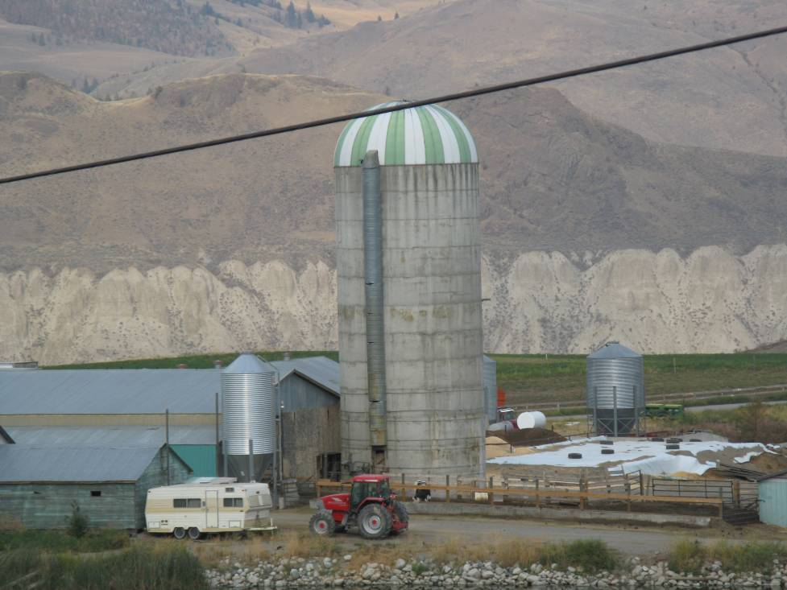
Guideline 9.1-1: Exclusion Process
BC’s Experience , Confined Spaces Fatalities:
1985-2003 (estimated)
Hydrogen Sulfide----2
Flammable/explosive atmosphere----2
Oxygen deficiency----15
Entrapment 1
(COHSN: 18 deaths between 1989-2004, including 5 would be rescuers)
3
3
Notes:
Part 9: Confined Spaces Part 9, Confined Space Richard Duguay
Part 9: Confines Spaces, n-POD 2008J:/OD2000/Basic Classroom/Hygiene topics for OHOs/BioOHO/3-reg-long/Confined Space/Confined Space OHO.ppt
3
Part 9, Confined Space Richard Duguay
May 2000
J:/OD2000/Basic Classroom/Hygiene topics for OHOs/BioOHO/3-reg-long/Confined Space/Confined Space OHO.ppt

Slide 4
Guideline 9.1-1: Exclusion Process
9.1 Confined space definition
…except as otherwise determined by the board…
Is enclosed or partially enclosed
Is not designed or intended for continuous human occupancy
Has limited or restricted means of entry or exit
Is large enough and so configured…

Slide 5
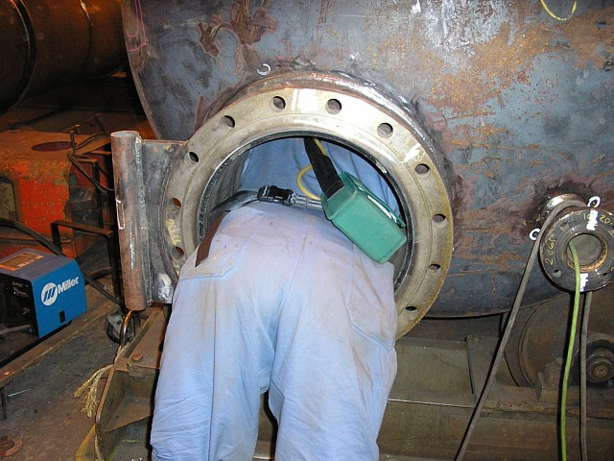
Guideline 9.1-1: Exclusion Process
Hazard assessment, basis for:
Hazard identification
Hazard control
Written program
Written procedures
Permit
Supervisory responsibilities
Instruction and training given to persons
The regulation considers confined spaces to be hazardous.
5
5
Notes:
Part 9: Confined SpacesPart 9, Confined Space Richard Duguay
Part 9: Confines Spaces, n-POD 2008J:/OD2000/Basic Classroom/Hygiene topics for OHOs/BioOHO/3-reg-long/Confined Space/Confined Space OHO.ppt
5
Part 9, Confined Space Richard Duguay
May 2000
J:/OD2000/Basic Classroom/Hygiene topics for OHOs/BioOHO/3-reg-long/Confined Space/Confined Space OHO.ppt

Slide 6
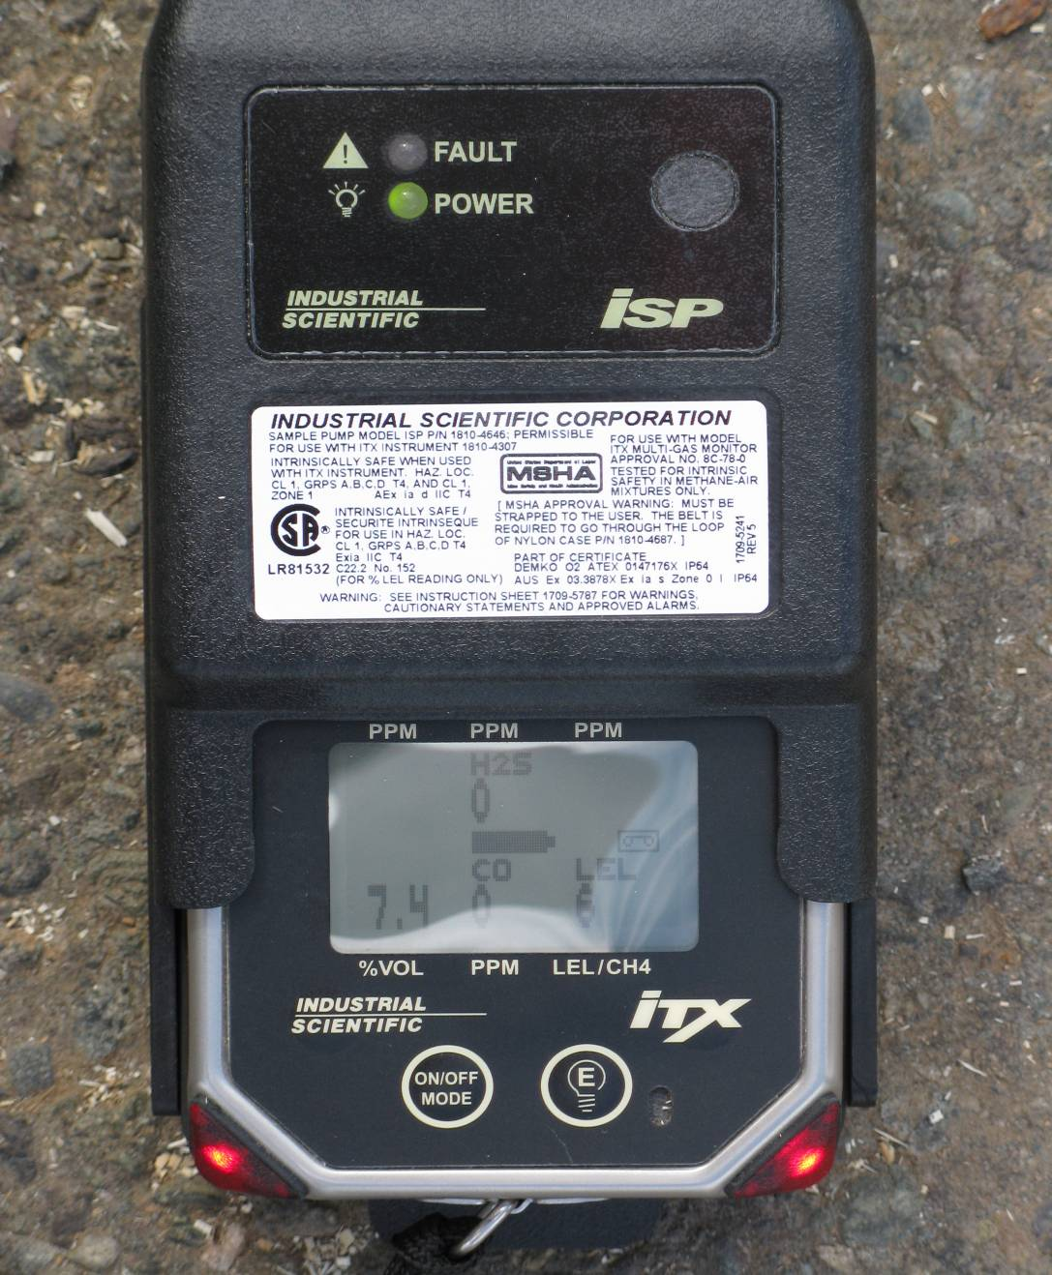
Guideline 9.1-1: Exclusion Process
Hazard assessment:
Oxygen deficiency /enrichment
Flammable gas, vapor or mist
Combustible dust
Other hazardous atmospheres
Lock-out and isolation
Engulfment and entrapment
Other hazardous conditions
6
6
Notes:
Part 9: Confined Spaces Part 9, Confined Space Richard Duguay
Part 9: Confines Spaces, n-POD 2008J:/OD2000/Basic Classroom/Hygiene topics for OHOs/BioOHO/3-reg-long/Confined Space/Confined Space OHO.ppt
6
Part 9, Confined Space Richard Duguay
May 2000
J:/OD2000/Basic Classroom/Hygiene topics for OHOs/BioOHO/3-reg-long/Confined Space/Confined Space OHO.ppt
H₂S, 0 ppm
CO, 0 ppm
O₂, 7.4 %
LEL, 6%
CO₂,
~100,000 ppm
Methane, ~1600 ppm

Slide 7
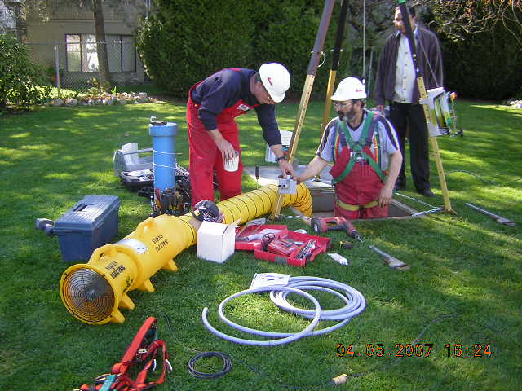
Guideline 9.1-1: Exclusion Process
All confined spaces must be tested; have continuous ventilation; have standby/rescue
9.24-9.26: Verification and testing
9.30-9.33: Ventilation
9.34-9.36: Standby persons
9.37-9.41: Rescue
Compliance with 9.25, 9.30, 9.34-9.36, and 9.37.

Slide 8
Guideline 9.1-1: Exclusion Process
Hazard assessment summary:
Atmospheric
Lockout
Isolation
Engulfment
Entrapment
Hazard assessment
Standby/rescue
Ventilation
Testing
An exclusion submission must address these.

Slide 9
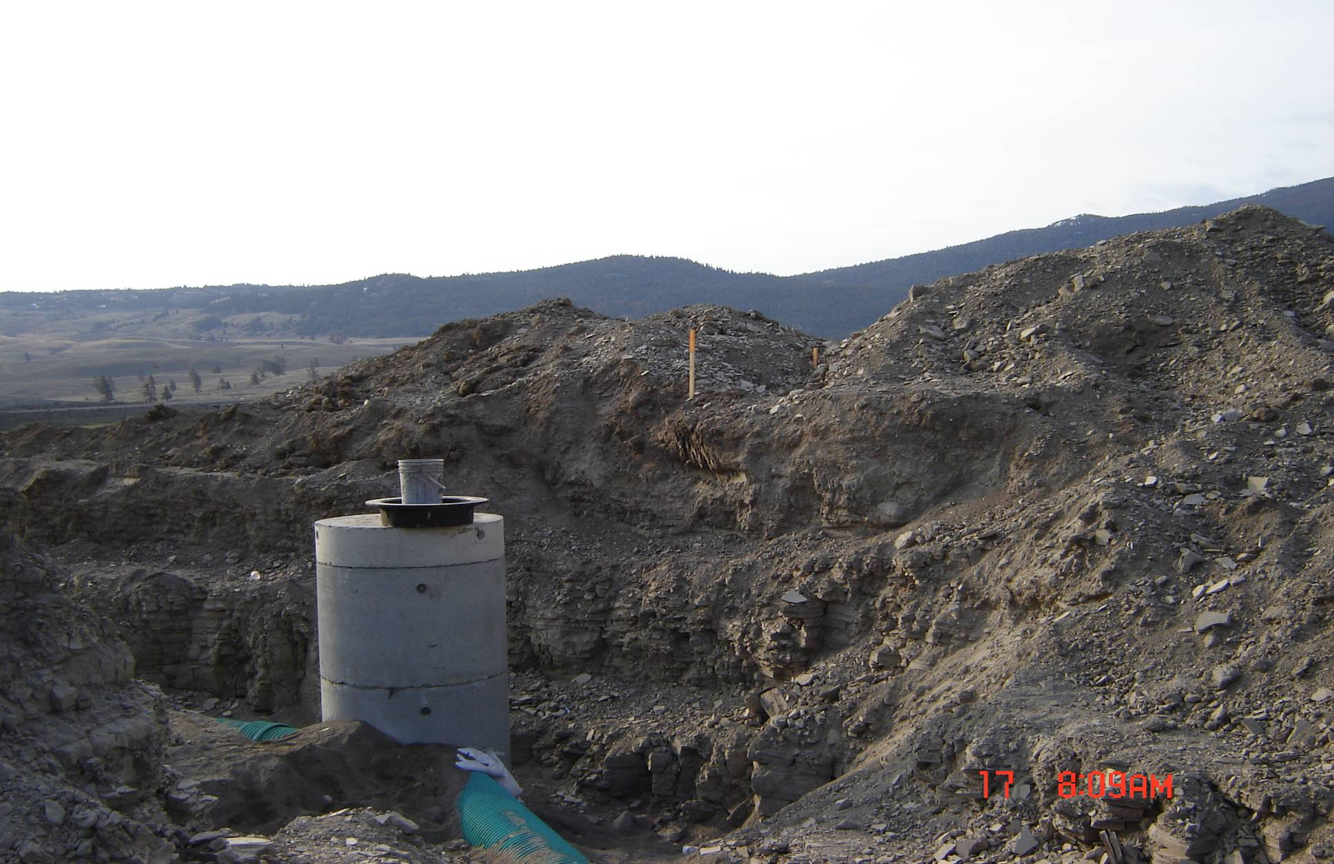
Guideline 9.1-1: Exclusion Process
Guideline 9.1-1:
No engulfment hazards
No entrapment hazards
Clean respirable air at all times

Slide 10
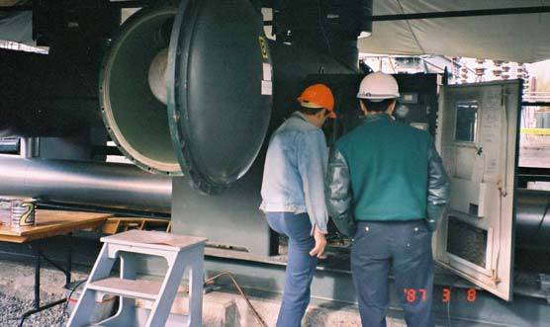
Guideline 9.1-1: Exclusion Process
Guideline 9.1-1
EMPLOYERS HAZARD
ASSESSMENT MUST CONSIDER:
What did/does the space contain?
Is the space ventilated?
Adjacent piping?
Material conveyances?
Other?

Slide 11
Guideline 9.1-1: Exclusion Process
Guideline 9.1-1
Employer submits to WorkSafeBC
Committee reviews the submission
Recommendation forwarded to Regulatory Practices
Employer notified in writing

Slide 12
Guideline 9.1-1: Exclusion Process
Guideline 9.1-1:
Front loading garbage trucks
Confined space?
Does the hopper contain clean respirable air?

Slide 13
Guideline 9.1-1: Exclusion Process
THANK YOU!

