Slide 1
What’s in your wallet?
Canadian taxpayers federation

Slide 2
canadian taxpayers federation
26th year fighting for less waste, lower taxes & more government accountability
Offices across the country
$4M/year, powered by 33,000 individual donors
100,000+ supporters

Slide 3
Federal Income Tax: $2.63 saved
TOTAL Tax hike since 2009 (per week): + $2.63

Slide 4
TOTAL Tax hike since 2009 (per week): $0
Federal GST: $2.63

Slide 5
TOTAL Tax hike since 2009 (per week): - $8.17
Federal CPP: $8.17

Slide 6
TOTAL Tax hike since 2009 (per week): - $12.47
Federal EI: $4.30

Slide 7
TOTAL Tax hike since 2009 (per week): - $30.20
Municipal Taxes $17.73

Slide 8
TOTAL Tax hike since 2009 (per week): - $30.83
Provincial Taxes $0.63

Slide 9
TOTAL Tax hike since 2009 (per week): - $40.19
BC Hydro $9.36

Slide 10
TOTAL Tax hike since 2009 (per week): - $46.32
ICBC $6.13

Slide 11
TOTAL Tax hike since 2009 (per week): - $46.32
Total Weekly Tax Bill
Up $46.32
Total Monthly Tax Bill
Up $200.72
Total Annual Tax Bill
Up $2,409

Slide 14
BUT It’s even worse…
Highest housing costs in Canada
Highest mortgage debt in Canada
Highest credit card debt in Canada
Highest gasoline prices in Canada
42% of income disappears in taxes (Fraser Institute)

Slide 17
What does it mean?
Must be competitive, price-wise

Slide 18
What does it mean?
Must be competitive, price-wise
Cities will demand from you what they won’t demand from themselves

Slide 19
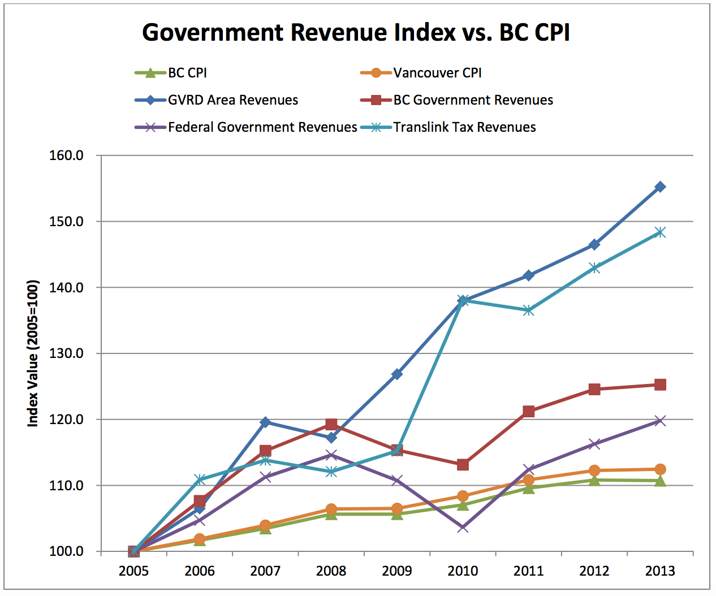

Slide 21
What does it mean?
Must be competitive, price-wise
Cities will demand from you what they won’t demand from themselves
Must support the push for lower taxes and less red tape

