Slide 1
Construction & Demolition Waste Management Policy Initiatives
Presentation to WMABC
January 29, 2015
Presented by Gil Yaron

Slide 2
Total Non-Hazardous Waste Generated in Canada
Notes:
Begin this presentation by providing a bit of context regarding construction and demolition waste management in Canada.
Construction, land clearing and demolition waste represents approximately 25% of all non-hazardous waste in Canada’s landfills.

Slide 3
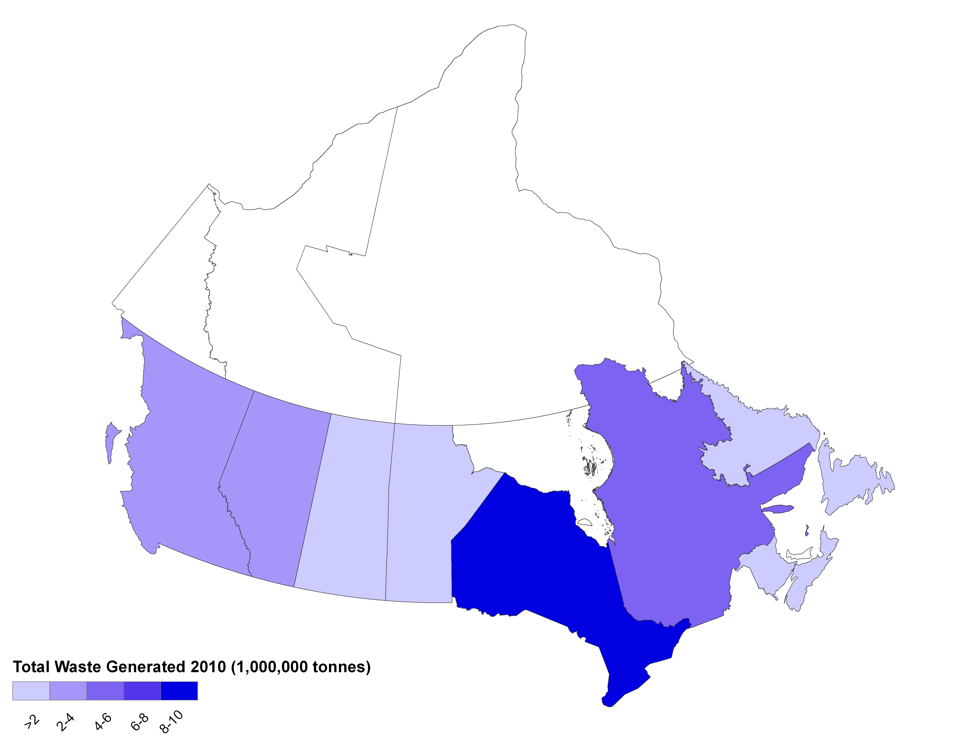
Total Waste Generated by Province
Source: StatsCan Waste Management Industry Survey 2010
Notes:
Looking at total waste generated broken down by Province. Ontario is the largest generator of waste.

Slide 4
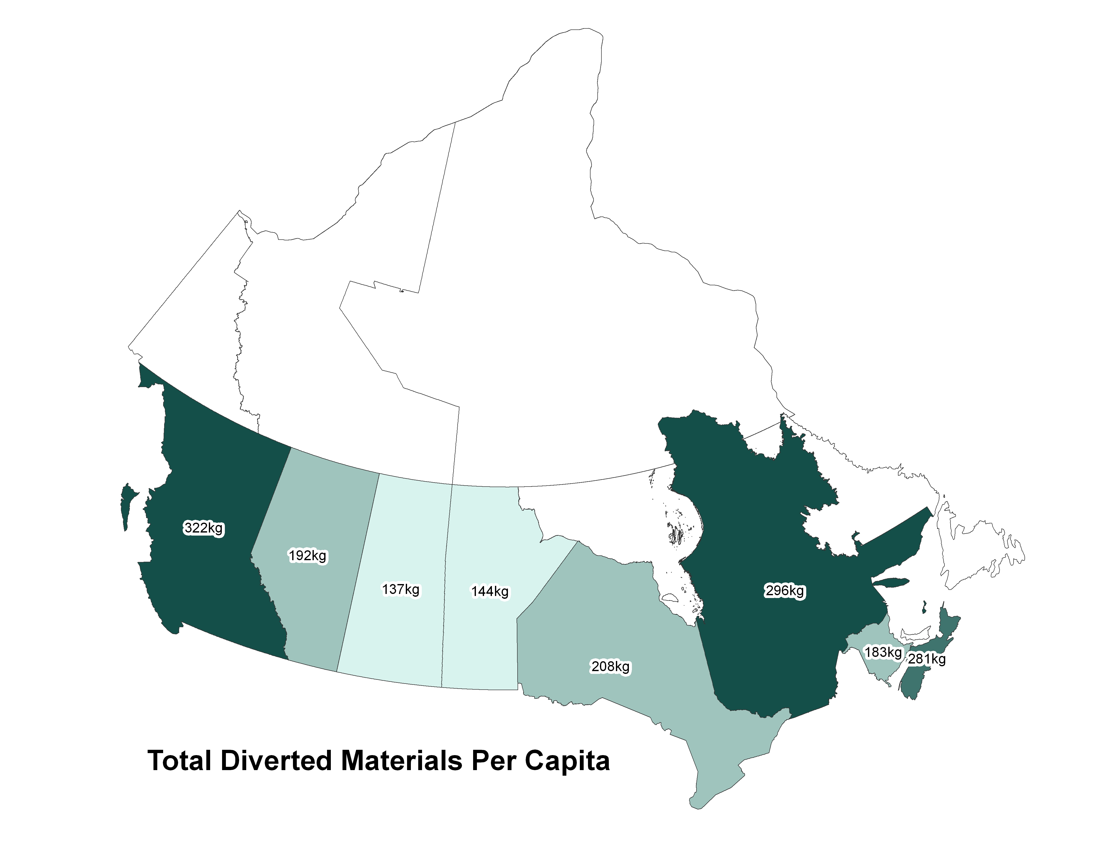
Total Materials Diverted per Capita
Source: StatsCan Waste Management Industry Survey 2010
Notes:
BC has the highest level of waste diverted per capita.

Slide 5
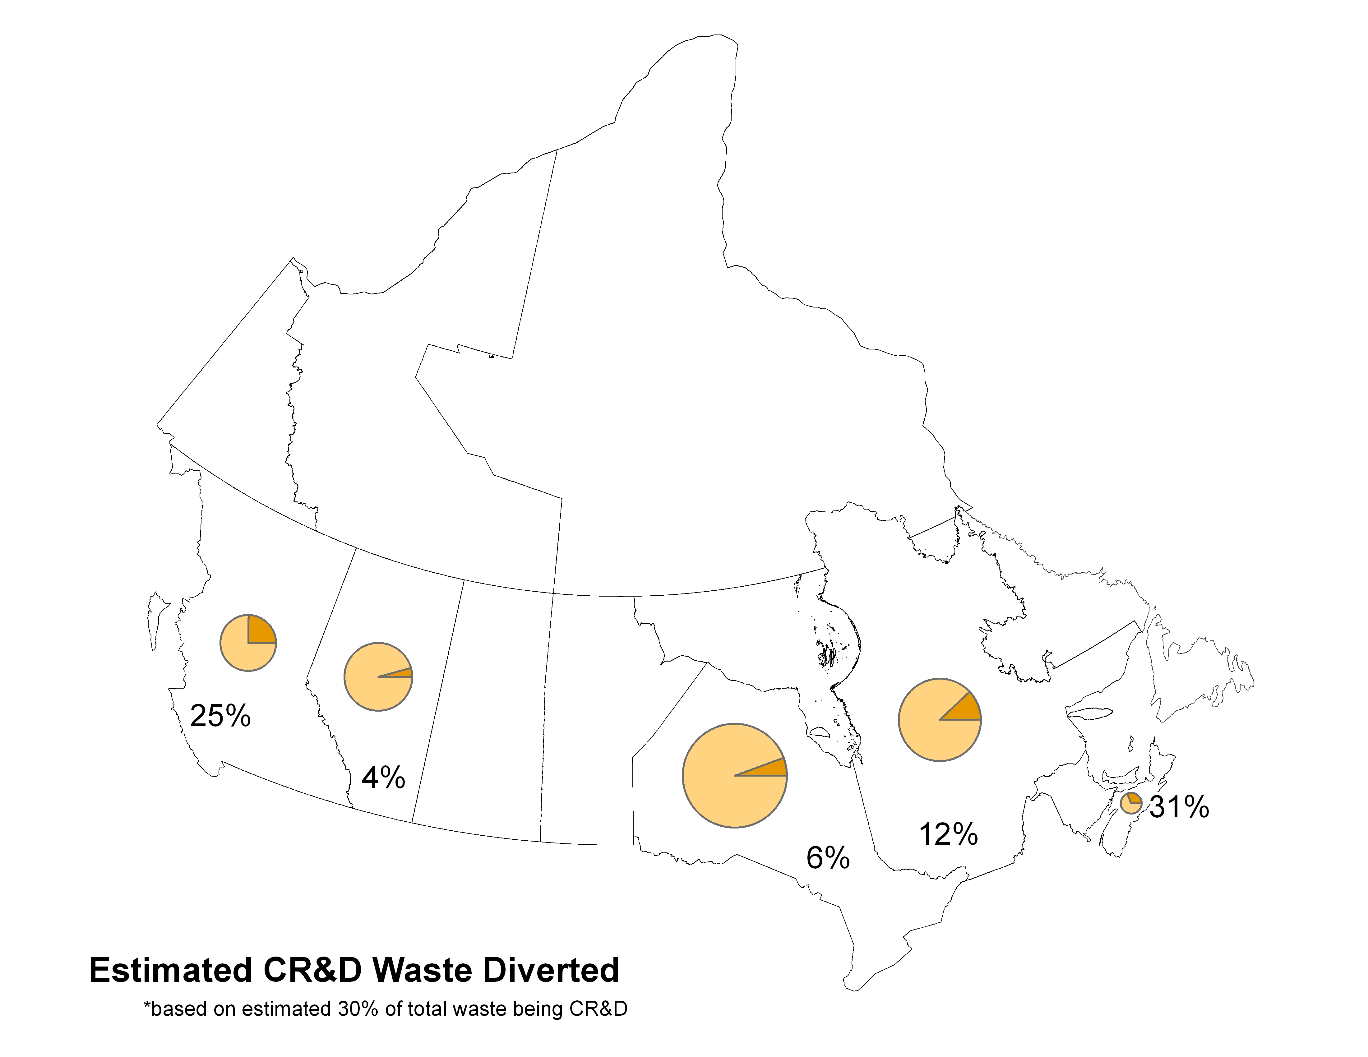
Estimated Percentage of C&D Waste Diverted
*Based on estimated 25% of all non-hazardous waste being C&D waste.
Source: StatsCan Waste Management Industry Survey 2010
Notes:
BUT Nova Scotia leads in Total C&D waste diverted as a percentage of total C&D waste generated.
Still there is a long way to go when you realize that anywhere between 75% - 90% of C&D waste can be reused or recycled.
Calculated by dividing total C&D waste diverted (stats can) and dividing by the percentage of total waste that is C&D (total waste generated multiplied by 25% (estimated percentage of waste that is C&D).)

Slide 6
Notes:
Our North American policy scan revealed 26 different policy instruments to addressing C&D waste diversion.
- Will address a number of them here. You can contact me directly to explore other instruments. I will mention some of the more common approaches and focus on four other emerging strategies with detailed case studies.

Slide 7
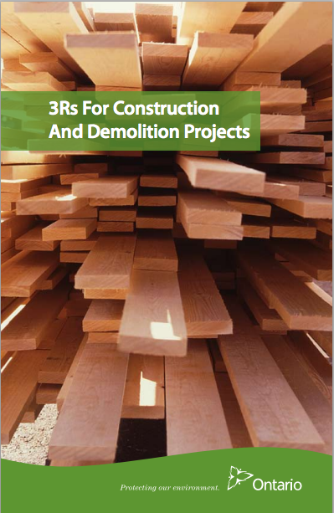
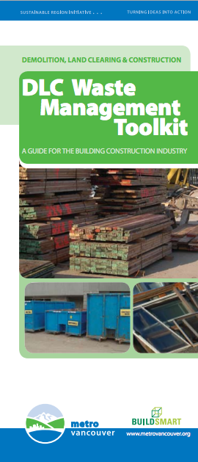
Common Policies & Strategies
Setting
Diversion Targets
Material
Disposal Bans
Increase/Tier
Tipping Fees
Industry Education

Slide 8
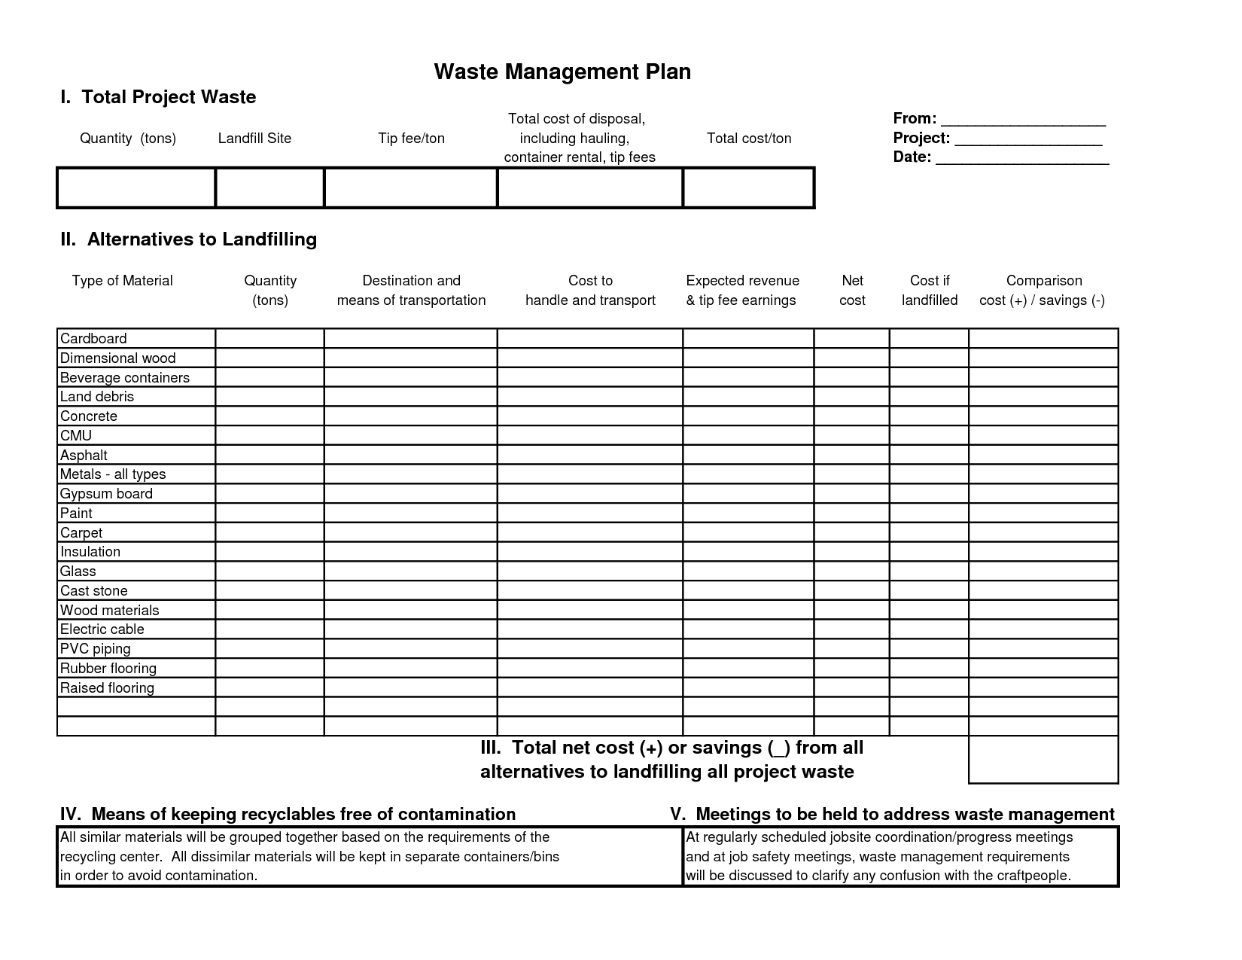
Policy Instrument 1: Mandatory Waste Management Plans
Projects are required to submit waste management plans identifying how specific materials are to be handled and how diversion rates are to be met.
1
2
3
4

Slide 9
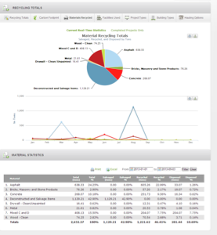
Policy Instrument 2: Mandate Tracking and Reporting of Waste Data
Follow through on mandatory waste management plans
Contractors track materials and report final diversion rates
Compare actual rates against estimated diversion rates in WMP
1
2
3
4

Slide 10
Mandated in Port Moody (BC), Ontario, California, Cook County (IL), Austin (TX), Seattle
Also eligible for credit under LEED® and industry practice for many larger projects
Generally part of larger framework involving targets and tracking
Manual or electronic
Compliance and enforcement ideally at local level through permitting process
1
2
3
4
Notes:
Tying to permiting process is critical because it provides mechanisms for enforcement (e.g. fines or withholding occupancy permits).

Slide 11
Robust Tracking Framework (Chain of Custody)
Quantities and types of materials
Who is handling them (hauler)
Where they are going (facility)
Diversion rates on site and at waste facility
Ability to audit and verify data
1
2
3
4
Notes:
Tying to permiting process is critical because it provides mechanisms for enforcement (e.g. fines or withholding occupancy permits).

Slide 12
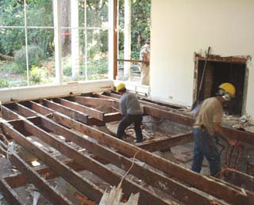
Policy Instrument 3: Residential Deconstruction Permits
Deconstruction is permitted or required in advance of issuing building permit
Can be voluntary (incentive based) or mandated
1
2
3
4
Notes:
Example of mandatory deconstruction days – salvage days

Slide 13
Introduced March 2009
Modest uptake: 14 permits since inception – 12 in first year (6 met goal); 2 recently
In response to economic downturn, Land Use Code amendment in 2010/11 allowed residential buildings vacant more than one year to be demolished.
Program launched February 2012
12 permits since inception (7-8 recently as condition of building permit issuance)
Subsequently mandated for pre-1940 homes
1
2
3
4

Slide 14
Requirements
Submit Waste Diversion Plan
Submit a Waste Diversion Report identifying actual rates of salvaged and recycled materials
Reuse 20% of building
materials by weight*
Recycle or reuse 50% of building materials
by weight*
Recycle or reuse 100% of asphalt, brick, and concrete
*Excluding asphalt, brick, and concrete
Submit Recycling & Reuse Plan (Sept 1, 2014) and $15,000 Deposit (March 1, 2015)
Submit Compliance Report identifying actual rates of salvaged and recycled materials
Divert 75% of materials by weight, excluding hazardous wastes and materials banned from landfill
*Incentive: 50% off tipping fees for first 15 tonnes (max. 2 loads)
1
2
3
4
Notes:
Deconstruction permit program will be reinforced in future by additional initiatives:
Mandatory salvage assessment for new construction above certain size
Mandatory waste management plans
Material bans
Lessons learned:
Permit concept has merit
Threshold requirements for program impact uptake
Policy is vulnerable to economic conditions
Marketing is important (tied to permitting process, educating municipal staff), but double-edged sword where staff resources are limited
Ensure alignment of code changes

Slide 15
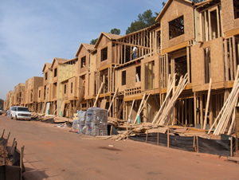
Policy Instrument 4: Refundable Deposit
Contractor pays a deposit based on percentage of permit value, tonnage, square footage or a set amount.
Deposit is refunded upon submission of proof of compliance with diversion requirements.
1
2
3
4

Slide 16
C&D Diversion Program
Part of voluntary two-component framework: facilities and permits
Recently overshadowed by State level mandatory 50% diversion requirement
1
2
3
4

Slide 17
Waste tonnage estimated based on project type and size
Projects can submit waste receipts (90% diversion required*)
Deposit refunded, withheld or partially refunded
Deposit calculated based on total estimated tonnage
City discusses discrepancies with contractor
Authorized facilities must achieve 75% diversion rate
1
2
3
4

Slide 18
Building Segment | Deposit Per Sq. Ft. | Minimum Valuation | Maximum Sq. Ft. Subject to Deposit
Residential new construction (high rise) | $0.20 | $115,000 | 125,000 detached 100,000 attached
Residential Alterations | $1.16 | $2,000 | None
Non-Residential Alterations (not subject to CALGreen) | $0.35 | $5,000 | None
Residential Demolition | $0.35 | None | None
Non-Residential Demolition | $0.10 | None | None
Notes:
Other communities
Lynwood: Similar to San Jose - Rebate = deposit x diversion rate
Orinda: 2% of project value or $5,000 whichever is less
Lafayette: 1% of project cost or $1,000 whichever is less

Slide 19
Emerging Trends
Government waste management strategies recognizing C&D waste
Recognition that tracking and reporting is first step
Appreciation that waste = material resource
National C&D waste strategy -- Construction Resource Initiatives Council and Mission 2030
Notes:
Solid waste management plans and sustainability strategies are increasingly focusing on and prioritizing C&D waste diversion
Construction Resource Initiatives Council working to bring stakeholders together around a common objective: Mission 2030
Local governments and industry starting to view waste as a material resource – some municipalities assigning staff to supply and procurement positions to identify markets; competition between local governments and waste industry to capture diverted materials
Experience with other reduction strategies (GHG, energy, residential wastes) point to benchmarking and tracking as essential first steps

