Slide 1
Organics Disposal Ban
Workshop 2
Communications Discussion
David Hocking
Corporate Communications Manager

Slide 2
We’re all in this together
A web of services and messages
We all need each other to deliver part of the solution
We all need generators to separate without contamination

Slide 3
Behaviour change
People who haven’t been separating organics, need to start doing it
How can communications help?
If people just knew…
Notes:
3

Slide 4
Communications can’t solve
Space and access
Dark, uninviting or unsafe recycling rooms
Disconnected tenants
Poor and inflexible contracts that don’t meet recycling needs adequately
Lack of enough bins to collect recycling, combined with too infrequent collection

Slide 5
Communications can address barriers to behaviour change
I’m the only one who cares
I don’t see others doing it
Autopilot habit
I don’t know how
Notes:
5

Slide 6
Me vs. Others
Why Canadians don’t act more sustainably…
 | Canadians
Costs too much | 43%
Poorly designed cities and work places
Not really concerned | 31%

Slide 7
Me vs. Others
Why Canadians/you personally don’t act more sustainably…
 | Canadians | Me
Costs too much | 43%
Poorly designed cities and work places |  | 37%
Not really concerned | 31% | 7%
Notes:
7

Slide 8
Communications can address barriers to behaviour change
I’m the only one who cares
I don’t see others doing it
Autopilot habit
I don’t know how
Notes:
8

Slide 9
Behaviour change:
Communications principles
Build community
Model desired behaviour
Make it simple
And…
Notes:
9

Slide 10


The one word we hear,
over, and over is…
CONSISTENCY

Slide 11
Multi-family Unit
Tool Kit
Online, decision tree tool launching this spring
Built for property managers
Municipality-specific
Tools for clear communication

Slide 12
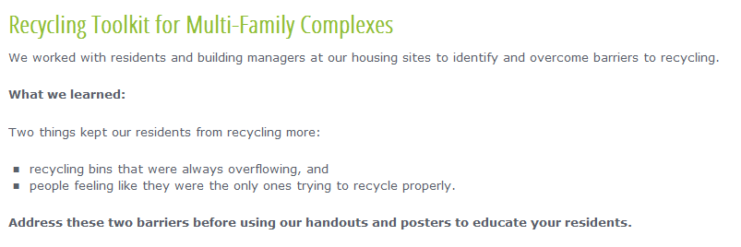
Pilot projects to improve recycling at our housing sites identified two consistent barriers.
Tools to Help
Notes:
12

Slide 13
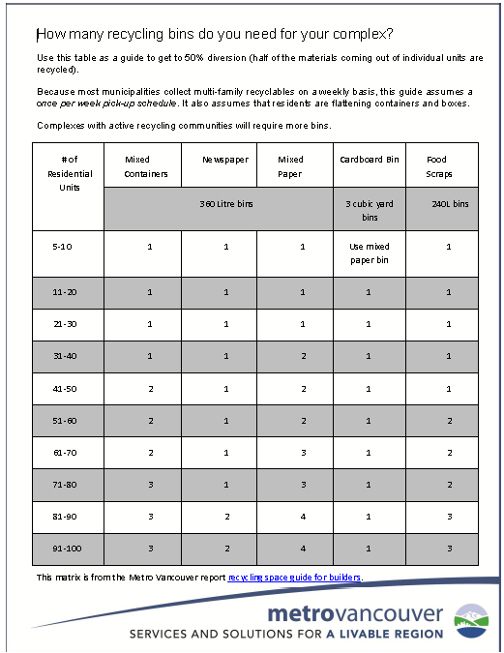
Step 1: Capacity
This guide helps identify how many recycling bins you may need for each material stream.
Notes:
13

Slide 14
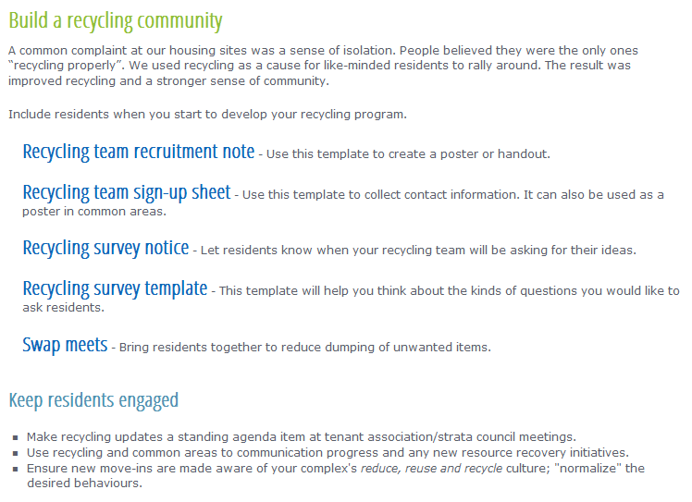
Step 2: Community
Go to the experts – survey residents for their ideas on how to improve recycling.
This engages your residents and helps foster commitment.
Notes:
14

Slide 15
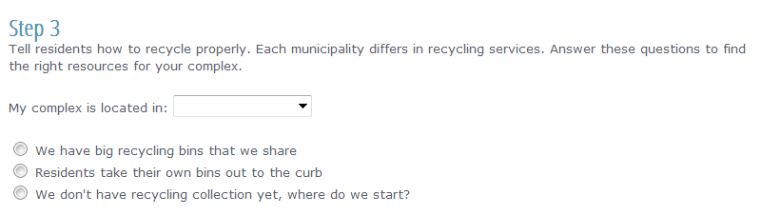
Step 3: Education and Outreach
Filters help building managers find the right resources for their complex
Notes:
15

Slide 16
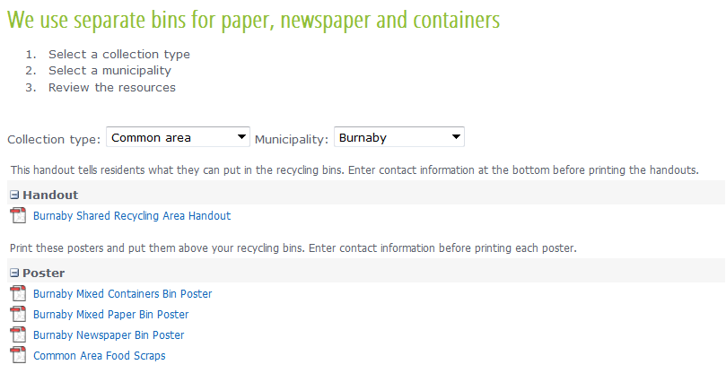
Step 3: Find the right materials
Handouts for residents to use within their households – where recycling happens, and corresponding posters to go above recycling bins.
Notes:
16

Slide 17
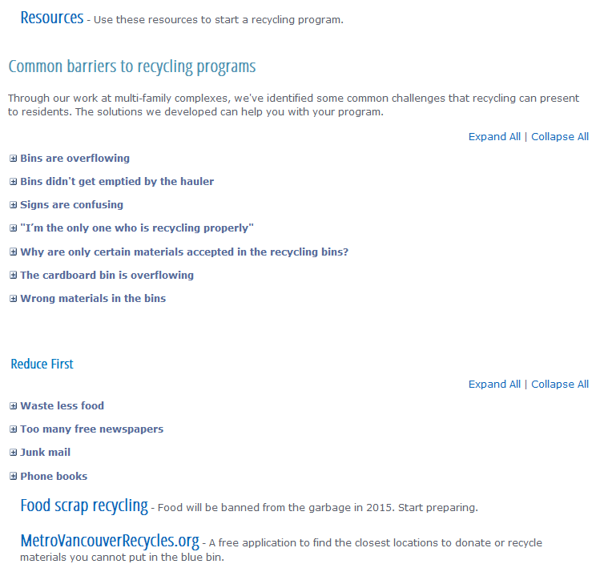
Overcoming other barriers
Surveys and observations will identify other barriers.
These resources helped at our housing sites.
Notes:
17

Slide 18
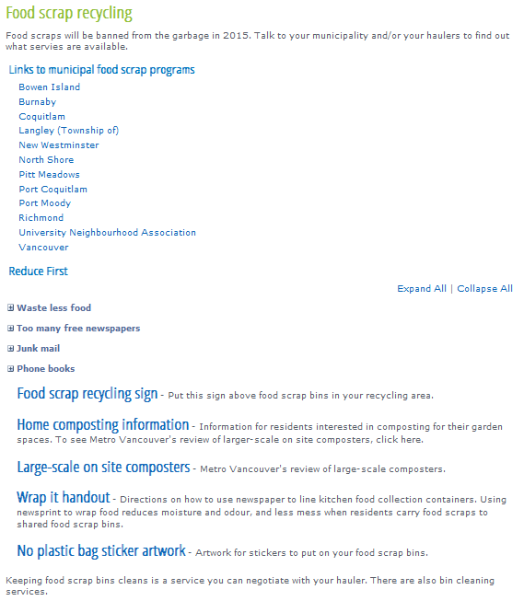
Food Scraps Recycling
How to get food scraps to the bins without creating a mess?
How to prevent contamination in the food scraps bins?
These resources will help.
Notes:
18

Slide 19
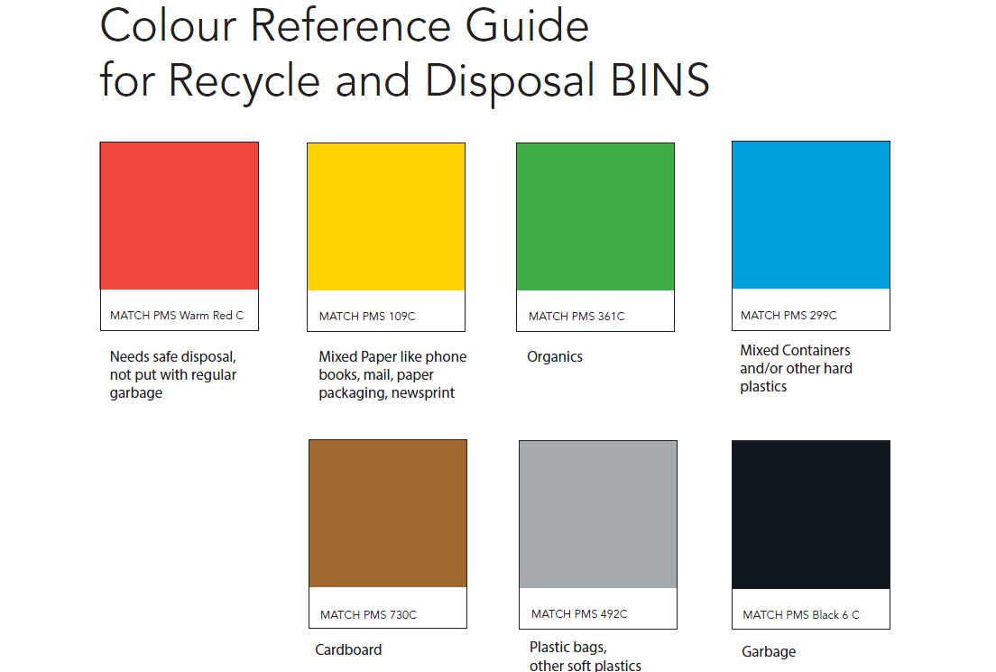

Slide 20
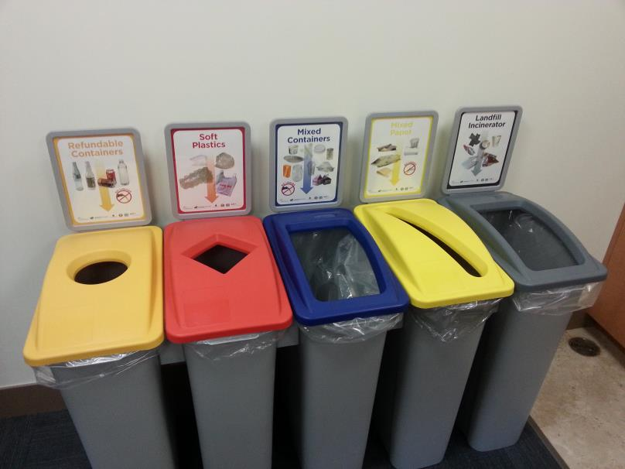
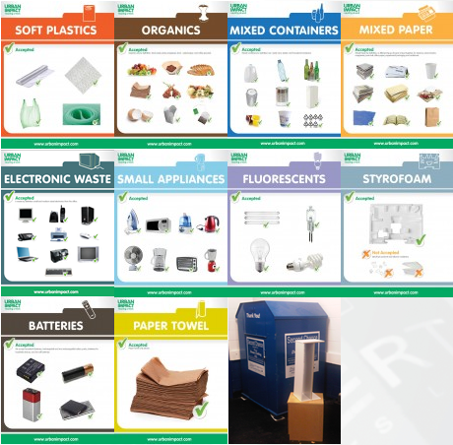
Opportunity: Don’t reinvent the wheel
Use the same scheme everywhere

Slide 21
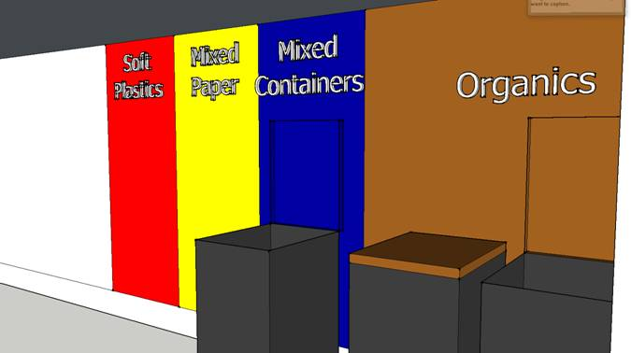
Painting walls makes decisions easier

Slide 22
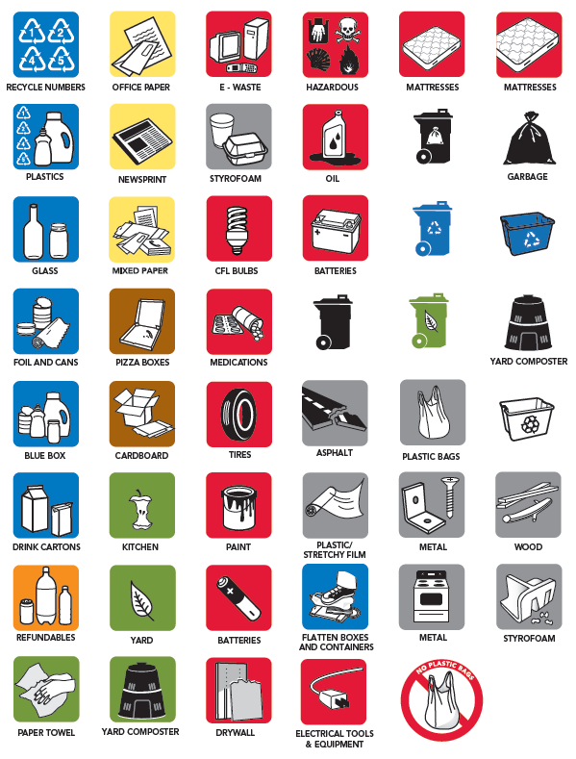

Icons – Recycling and Compost

Slide 23

Banned Materials
Commercial Bin Sticker

Slide 24

Yes/No Kitchen Catcher Stickers

Slide 25

Stomp it!

Slide 26
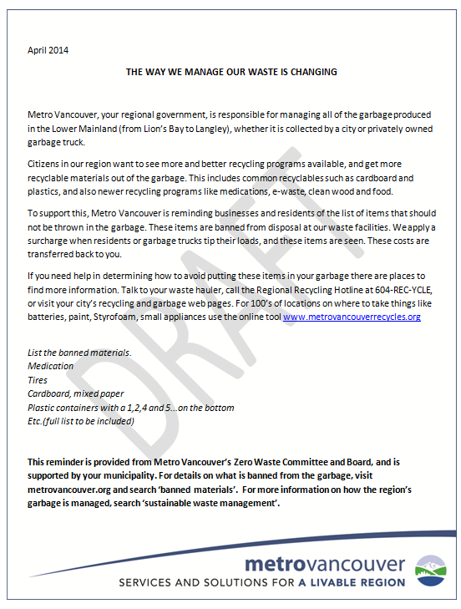
Disposal Ban
Reminder Notice

Slide 27
Role of Advertising
Profile the issue, top of mind
Model desired behaviour
Start a conversation

Slide 28



Slide 29
How can I get them…
Download from website
As is, or alter (EPS format)
Hard copy on request

Slide 30
Discussion today
To meet needs of the audiences you work with.
What’s missing?
What needs altering?
What should be dropped?
What’s most important?

