Slide 1


Construction & Demolition
Waste Diversion Strategy
4TH Annual Conference / AGM Agenda
Sharon Horsburgh, MA, RPP
Senior Solid Waste Planner
Regional District of Nanaimo
Notes:
We don’t expect

Slide 2
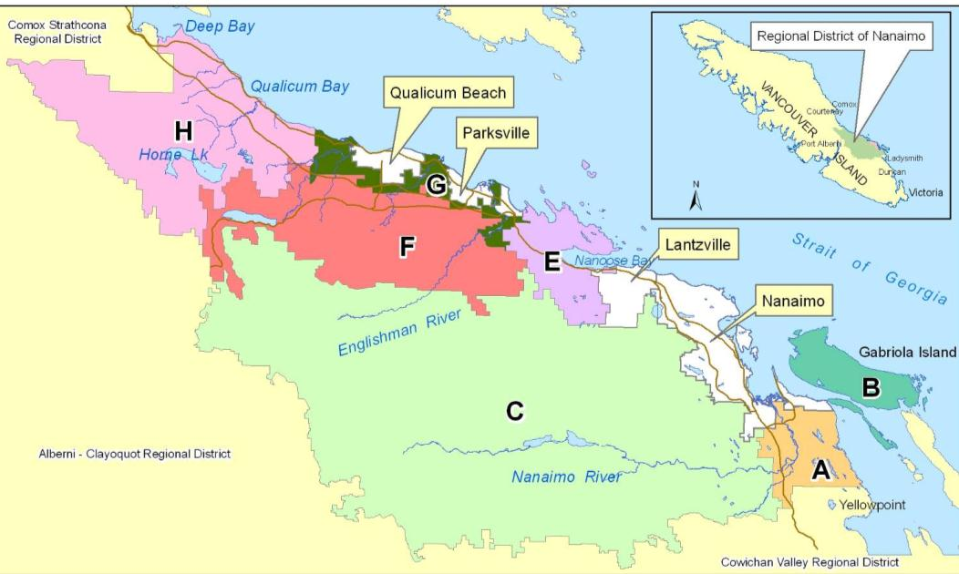
Location
Population: 150,000+/-
52,000h/h
Notes:
We don’t expect

Slide 3
Overview
Why divert CD waste from disposal
The Plan
Economic & infrastructure Development
Current & Future Situation
Notes:
We don’t expect

Slide 4
C/D is the Second Largest Component of Solid Waste
C/D comprises 16% of all waste landfilled in the RDN, and next to compostable organics, C/D is the largest component of landfilled waste in the RDN.
Notes:
We don’t expect

Slide 5
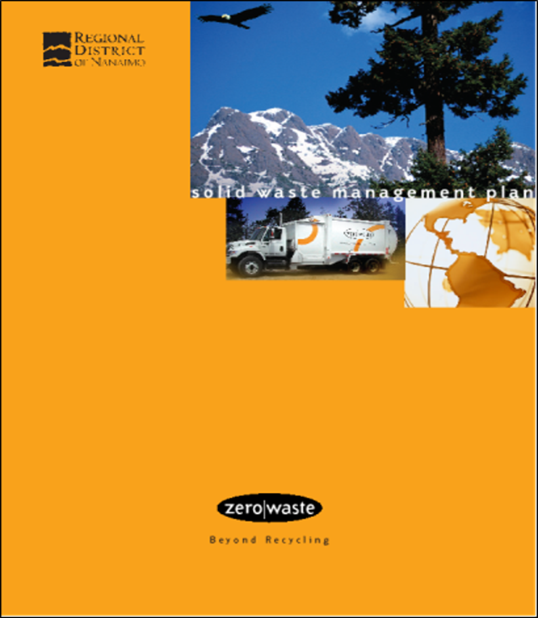
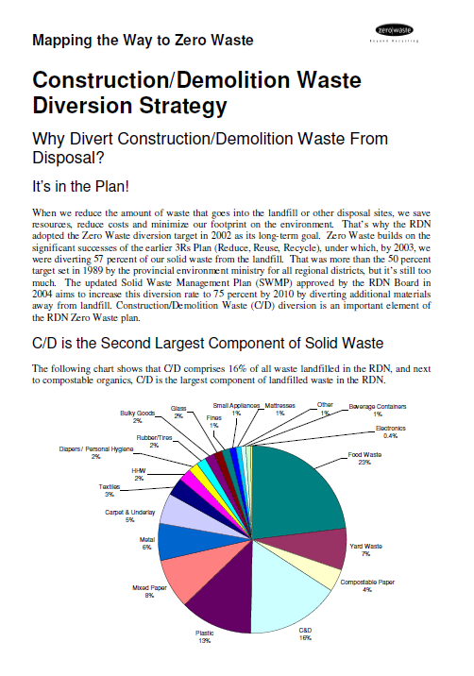
Part of the Plan
Notes:
We don’t expect

Slide 6
Economic and Infrastructure Development
CD Strategy – turns waste into a feedstock
Beneficial products create wealth
WSML Bylaw regulates waste facilities and has created private sector infrastructure
Economic opportunities as public sector has directed waste to private sector facilities
Notes:
We don’t expect

Slide 7
Key Policy Drivers
“Zero Waste” diversion target
Ensuring that the landfill is designed and operated to maximize environmental protection
Banning waste materials from disposal in the landfill once an alternative has been established
Organics diversion strategy & CD Waste Diversion Strategy
Waste stream management licensing
User pay (collection, disposal)
Notes:
We don’t expect

Slide 8
Policy Framework
WSML Regulation
Private Sector
Level Playing Field
Disposal Bans
Commercial Organics
C/D Waste
SF Organics Collection
Pilot Study
Full Scale
“…continuously strive to reduce the amount of waste requiring disposal.”
Notes:
We don’t expect

Slide 9
How Recycling is Incentivized

Slide 10
System Characteristics
Source
SF Residential
Collection
Municipal
Transfer Facilities
Public
Disposal or Diversion Facilities
Landfill
MF Residential
ICI
DLC
Self-Haul
Private
Private
Recycling MRF
Composting
WTE Pulp Mills
170,000 tpy

Slide 11
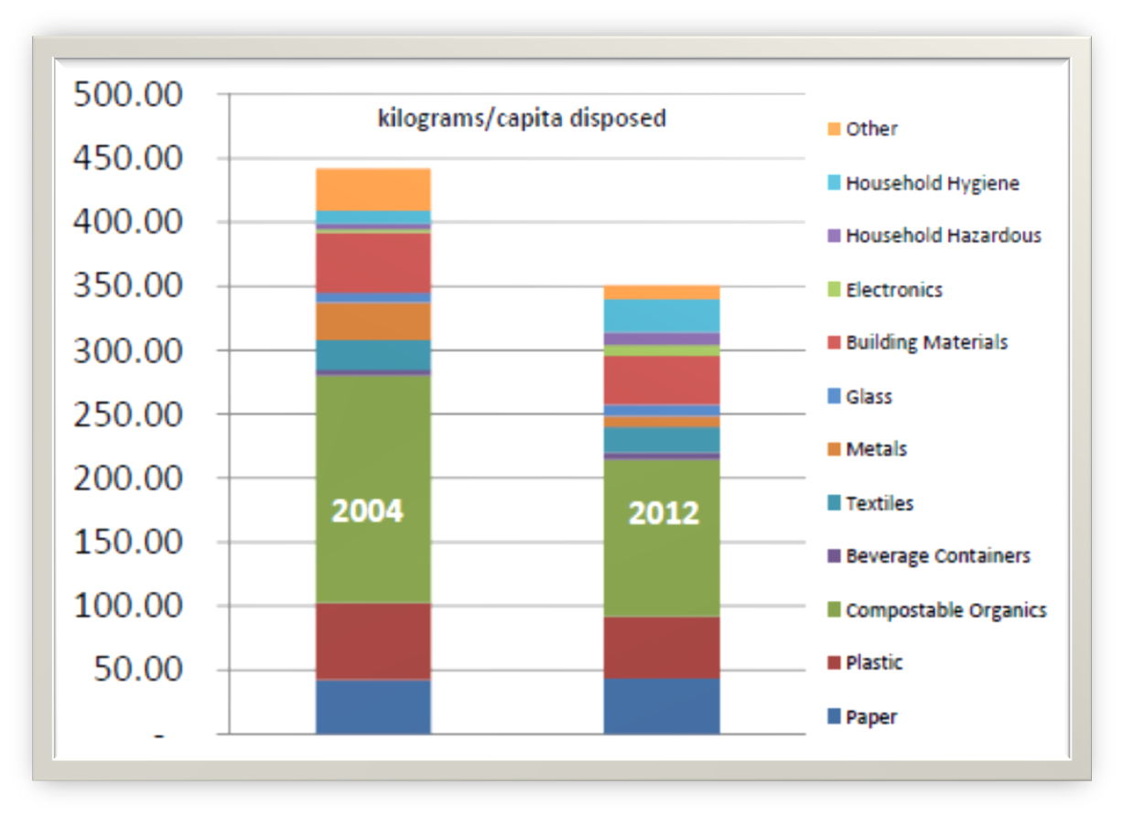

Waste Compostion
CD 11%
Notes:
We don’t expect

Slide 12
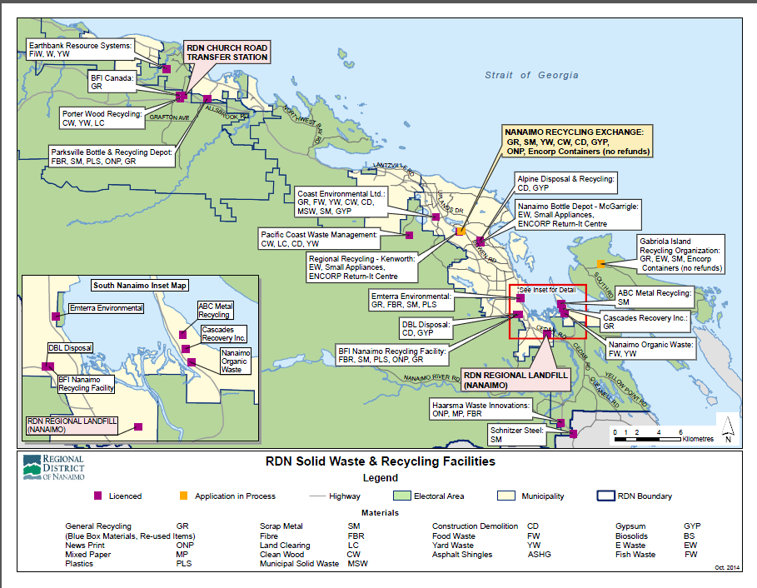
RDN Public & Private Facilities
Notes:
We don’t expect

Slide 13
2012 Overall Waste Diversion
Material | Diverted (tonnes) | Disposed (tonnes) | Generated (tonnes) | Recovery
PPP | 38,807 | 13,866 | 52,676 | 74%
Organics | 21,145 | 18,614 | 39,759 | 53%
EPR | 9,552 | 3,609 | 13,161 | 73%
Other | 39,349 | 17,230 | 56,579 | 70%
Textiles | 1,520 | 3037 | 4,557 | 33%
Building Materials | 19,736 | 5748 | 25,484 | 77%
Scrap Metal | 7,871 | 739 | 8,610 | 91%
Household Hygiene | 0 | 3,932 | 3,932 | 0%
Other | 0 | 3,774 | 3,774 | 0%
Total | 98,631 | 53,319 | 162,172 | 67%

Slide 14
Current Situation
Wood Waste and CD is managed at 8 facilities
- Recycling of asphalt shingles for paving
-Landfill limited use for chips as cover
-W/w is a cost effective fuel source for pulp mills.
Small scale community energy projects:
    Dockside Green.
Notes:
We don’t expect

Slide 15
To 80% and Beyond!
Extended Producer Responsibility (EPR)
BC Recycling Regulation
  Printed Paper & Packaging - MMBC
CCME Action Plan for EPR
  CD materials
  Furniture
  Textiles & carpet

Slide 16
QUESTIONS?
THANK YOU
Notes:
We don’t expect

Slide 17
Clean Wood Waste Ban
4TH Annual Conference / AGM Agenda
Sharon Horsburgh, MA, RPP
Senior Solid Waste Planner
Regional District of Nanaimo
Notes:
We don’t expect

Slide 18
Location
Notes:
We don’t expect

Slide 19
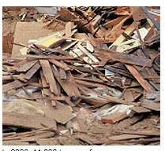
Overview
History
Key Policy Drivers
Impact of landfill bans
Conclusion

Slide 20
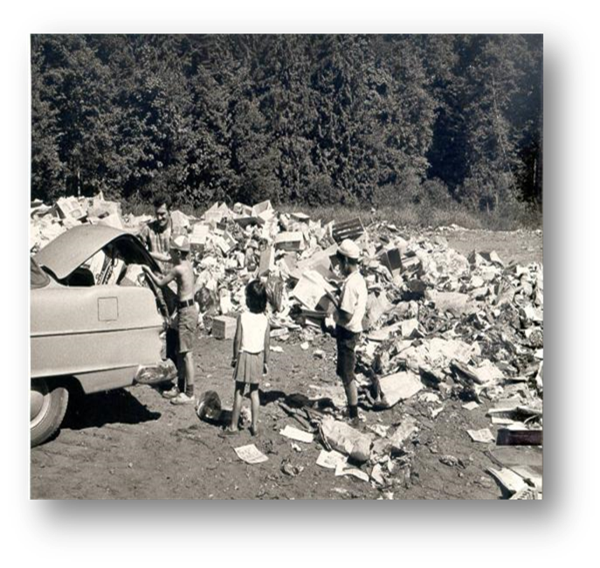
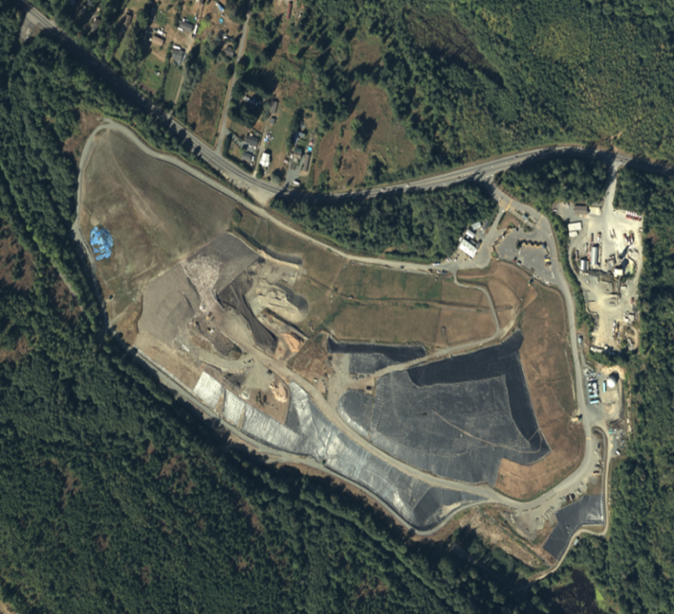
History
“Zero Waste” diversion target
Ensuring that the landfill is designed and operated to maximize environmental protection
Notes:
We don’t expect

Slide 21

Key Policy Drivers
Banning waste materials from disposal in the landfill once an alternative has been established
Organics diversion strategy & CD Waste Diversion Strategy
Waste stream management licensing
User pay (collection, disposal)
Notes:
We don’t expect

Slide 22
What is C&D Waste?

Slide 23
Approach to Policy
Waste Stream Management Licensing
  Private sector infrastructure
  Level playing field
Landfill Disposal Bans
  Regulate
  Collaborate
  Educate
  Enforce
Single Family Food Waste Collection
  User fees
  Can limits
Zero Waste Education & Promotion
Notes:
We don’t expect

Slide 24
Definition of Wood Waste
WOOD WASTE – Wood waste (may be painted but cannot have non-wood materials attached) that has been separated from other construction/demolition waste has been banned from disposal in the landfill.
Non roll-off container loads of wood waste are accepted at the rate of $200/tonne.
Separate wood waste and drywall from other materials to avoid paying the $300/tonne fee for contaminated loads.
Notes:
We don’t expect

Slide 25

Landfill Disposal Bans
Gypsum (1991)
Land clearing waste (1992)
Corrugated cardboard (1993)
Recyclable Paper (1997)
Scrap Metal (1997)
Tires (1997)
Commercial organic waste (2005)
Garden waste (2007)
Wood Waste (2007)
EPR Materials (2007)
Household Plastic Containers (2009)
Metal Food & Beverage Containers (2009)

Slide 26
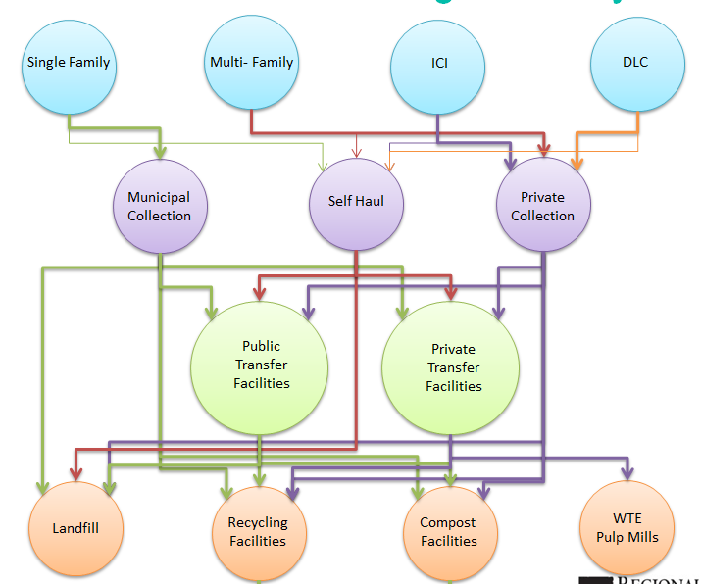
Waste Generation & Flow
Notes:
We don’t expect

Slide 27
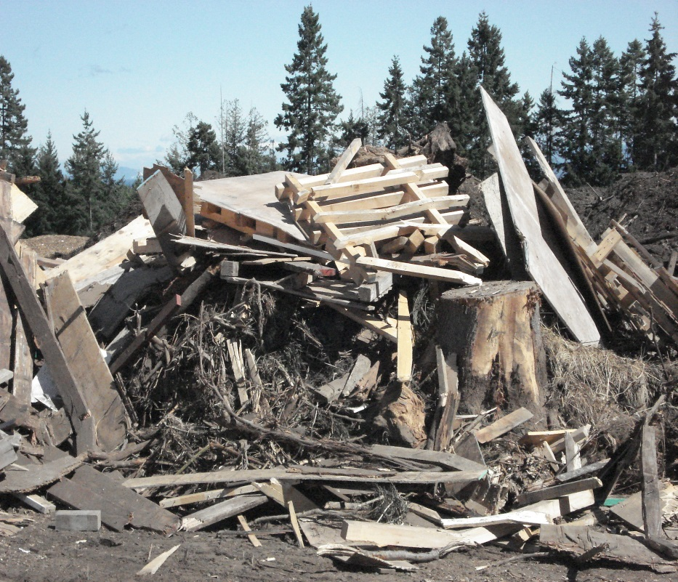
Impact of Clean Wood Ban
Wood waste ban implemented in 2008 diversion rate
Regional facilities saw 38% wood waste diverted
Notes:
We don’t expect

Slide 28
RDN Public & Private Facilities
Notes:
We don’t expect

Slide 29
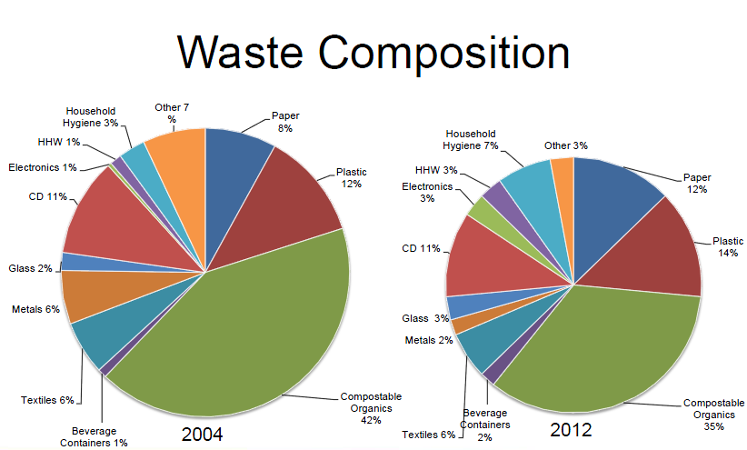
CD 11%
CD 11%
Notes:
We don’t expect

Slide 30
Wood Waste and CD Diversion
2008 | 2009 | 2010 | 2011 | 2012
Notes:
We don’t expect

Slide 31
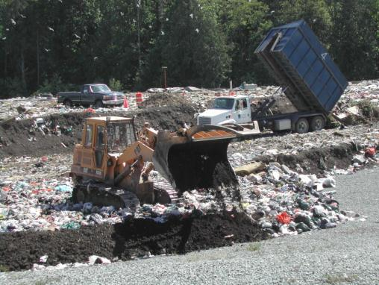
Enforcement
Load inspection
Violation notices
  Issue to Hauler
  3x tipping fee
Zero Waste Compliance Officer
  Collaborate with hauler to educate generator
  Site visits
  Monitor violations

Slide 32

Concluding Comments
Landfill Bans are an effective policy tool to shift behaviours.
Educate generators
Collaborate with Stakeholders
Enforcement protocols to ensure level playing field

Slide 33
QUESTIONS?
THANK YOU
Notes:
We don’t expect

