Slide 1
Environmental Standards Branch Current Initiatives
Environmental Protection Division
Ministry of Environment
Waste Management Association of BC
Mid-Winter Conference and AGM
Surrey BC
January 29, 2015

Slide 2
Overview of Presentation
Who is the Environmental Standards Branch?
Current Initiatives
New Service Plan Targets
Waste Prevention
Clean Communities

Slide 3
Environmental Standards Branch
Environmental Protection
Division
Environmental
Emergencies
& Land Remediation Branch
Environmental Protection
Regional
Operations Branch
David Ranson
Waste Prevention
Clean Air
Glen Okrainetz
Meegan Armstrong Bob McDonald
Clean Technologies
Integrated Pest Management
Clean Communities
Chris Jenkins
Christine
Woodhouse
Kris Ord

Slide 4
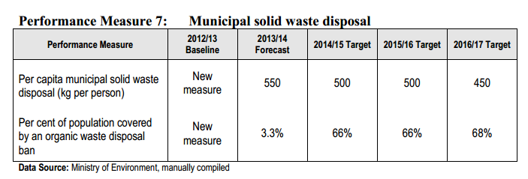
New Service Plan Targets
2019/20 Target
350
75%
Pg. 24:
http://www.bcbudget.gov.bc.ca/2014/sp/pdf/ministry/env.pdf

Slide 5
WASTE PREVENTION SECTION
Areas of work:
Municipal Solid Waste Policy
Industry Product Stewardship (Extended Producer Responsibility Programs)

Slide 6
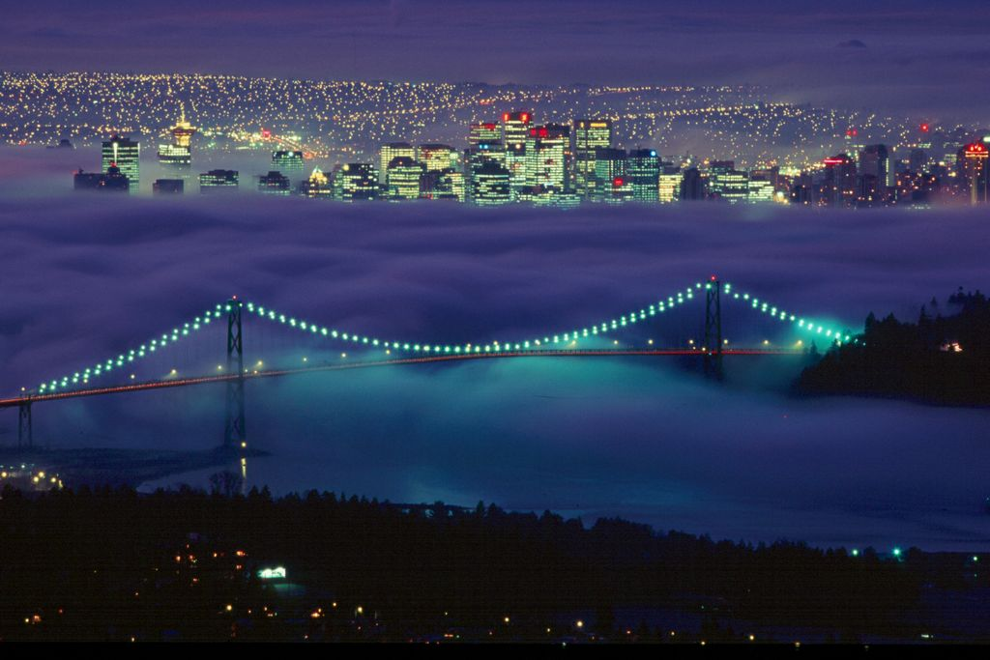
Municipal Solid Waste
New Service Plan targets for MSW
http://bcbudget.gov.bc.ca/2014/sp/pdf/ministry/env.pdf
Zero Waste Business Case
http://www2.gov.bc.ca/gov/topic.page?id=2D645A21C6614A8A8FFBE84389B22884

Slide 7
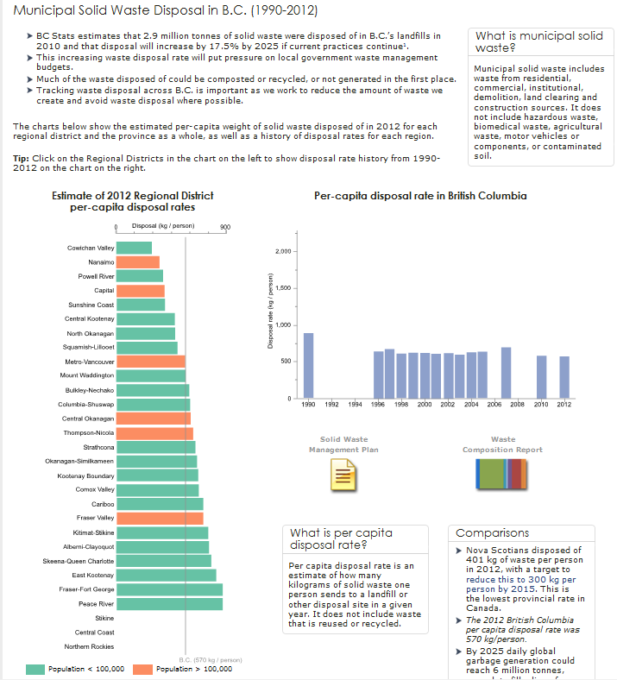
Environmental Reporting BC
http://www.env.gov.bc.ca/soe/indicators/waste/municipal_solid_waste.html

Slide 8
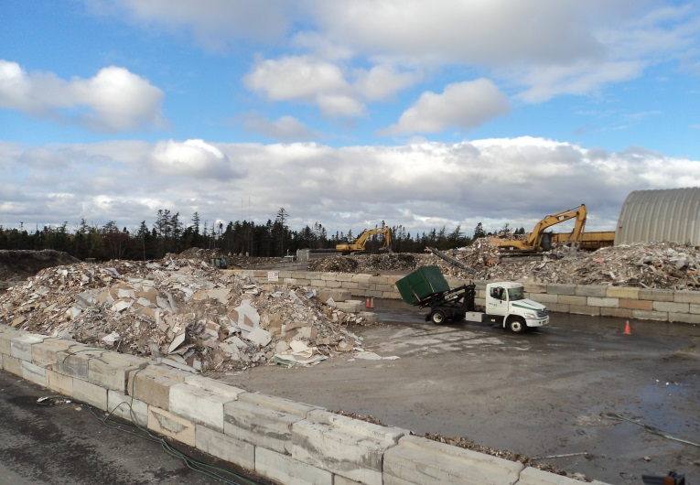
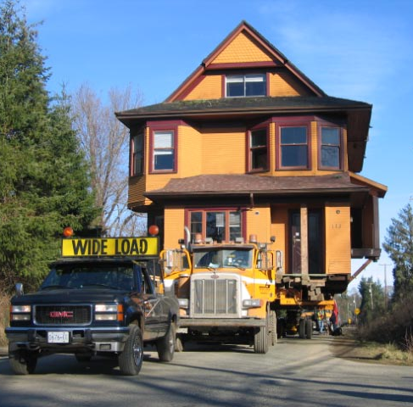
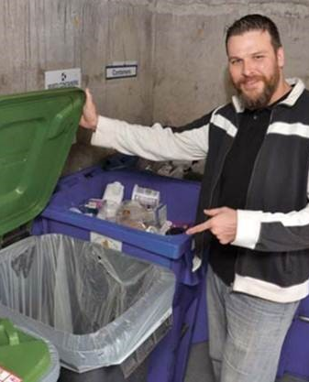
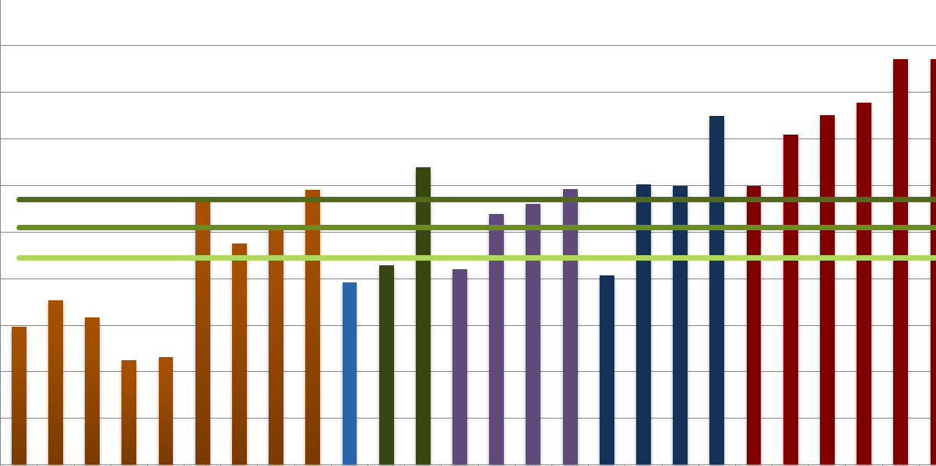
Case studies and potential reduction
http://www2.gov.bc.ca/gov/topic.page?id=CFE8823776E049CFBD8CF5092363DE01

Slide 9
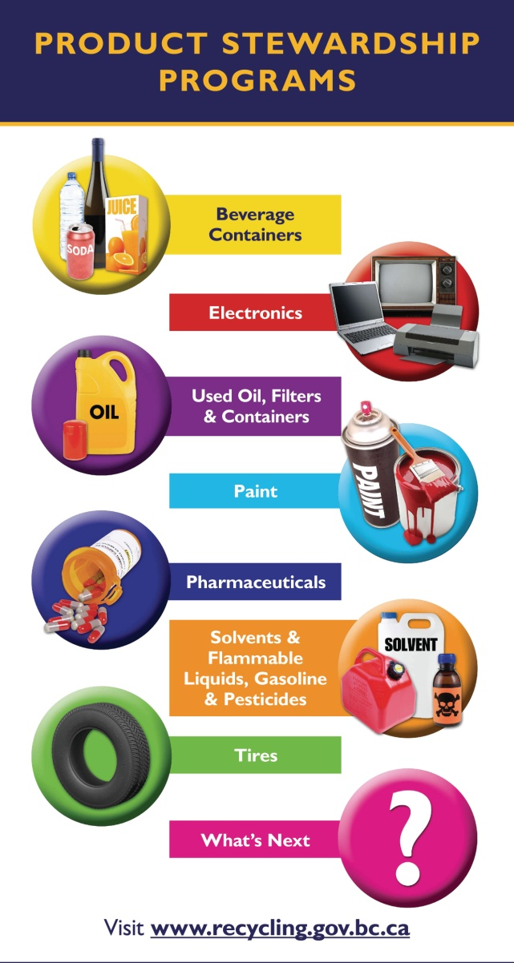
BC’s EPR Programs
24 programs
Flexibility and results
National leader
To date: 150,000 tonnes diverted 2,400 jobs created

Slide 10
National Leader
http://www.eprcanada.ca/

Slide 11
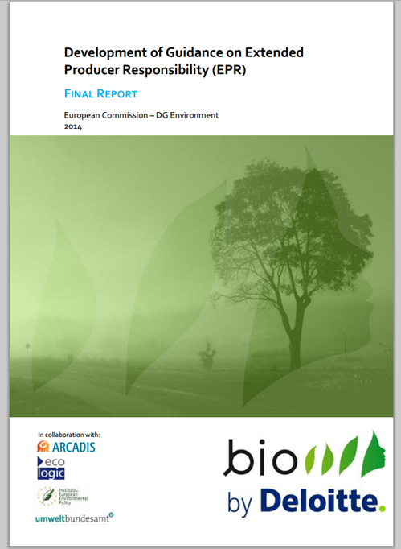
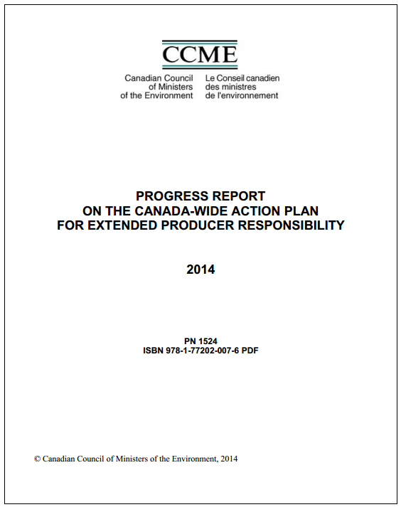
Checking in on EPR
http://epr.eu-smr.eu/
www.ccme.ca

Slide 12
Enhancement & Collaboration
Stewardship plan 5-year renewals
Third party non-financial audits
End-fate reporting
Compliance & enforcement

Slide 13
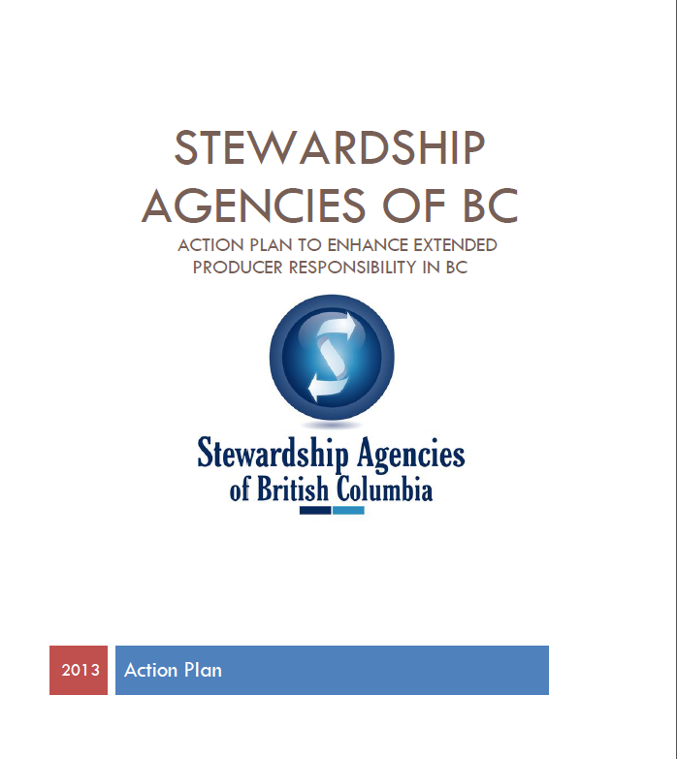
Enhancement & Collaboration

Slide 14
Why EPR?
By 2022, BC’s EPR Programs
Reduced waste costs | $146.8 million
Landfill space saved | 3,322,979 m3
Reduce GHG emissions | 1,107,993 tonnes eCO2
Energy saved | 12,929 GJ

Slide 15
CLEAN COMMUNITIES SECTION
Areas of work:
Leadership in open data
Impact and influence
Built environment
Solid and liquid waste management policy

Slide 16
Built Environment:
Develop With Care 2014
Waste Management
Water Use and Management
Development Near Farmland
Energy and Climate Change
Healthy Built Environment
Air Quality
Farmland
Pesticides
Hazard Management
http://www.env.gov.bc.ca/wld/documents/bmp/devwithcare

Slide 17
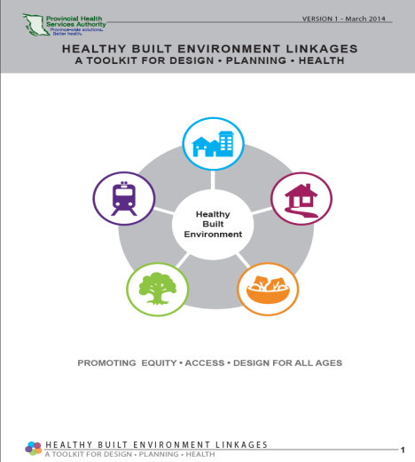
Built Environment:
Healthy Built Environment Linkages Toolkit
Five Planning principles:
Healthy Neighbourhood Design
Healthy Transportation Networks
Healthy Natural Environments
Healthy Food Systems
Healthy Housing
www.phsa.ca/populationhealth
Ministry Contact:
Helene Roberge, Unit Head
Helene.roberge@gov.bc.ca

Slide 18
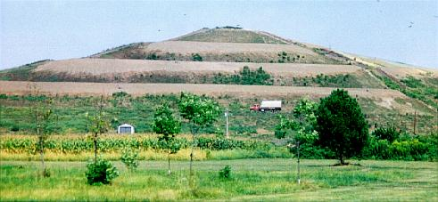
Solid Waste Management Policy:
Residuals Management
Landfill Criteria for Municipal Solid Waste (1993/revised 2014)
Sets standards for landfills and guidance for ministry staff, local government and Q.P’s
Draft second edition completed; comments received June 2014
Feedback under review
Landfill Gas Management Regulation (2008)
Phased implementation and on-going work
Jan. 1, 2016: First due date for installation of landfill
gas collection systems
Ministry Contact:
Natalia Kukleva, Environmental Management Officer
Natalia.Kukleva@gov.bc.ca

Slide 19
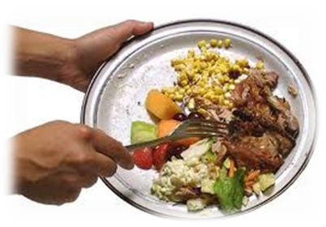
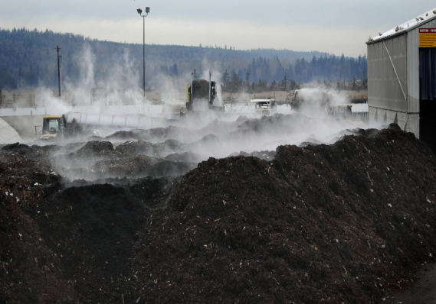
Organic Waste Recycling and Prevention
Ministry Contact:
Maryam Mofidpoor
Environmental Management Officer
Maryam.mofidpoor@gov.bc.ca

Slide 20
New Service Plan Targets
2019/20 Target
350
75%
Pg. 24:
http://www.bcbudget.gov.bc.ca/2014/sp/pdf/ministry/env.pdf

Slide 21
Tools and Resources
Organics Website
Social Media: Twitter
Organic Waste Prevention: Food Waste
Case Studies
Education Opportunities

Slide 22
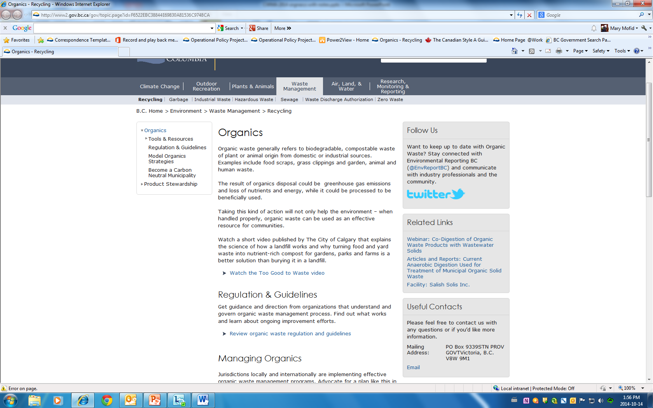

Slide 23
Social Media
@ ENV Report BC #organicwaste
Follow us and re-tweet us!

Slide 24
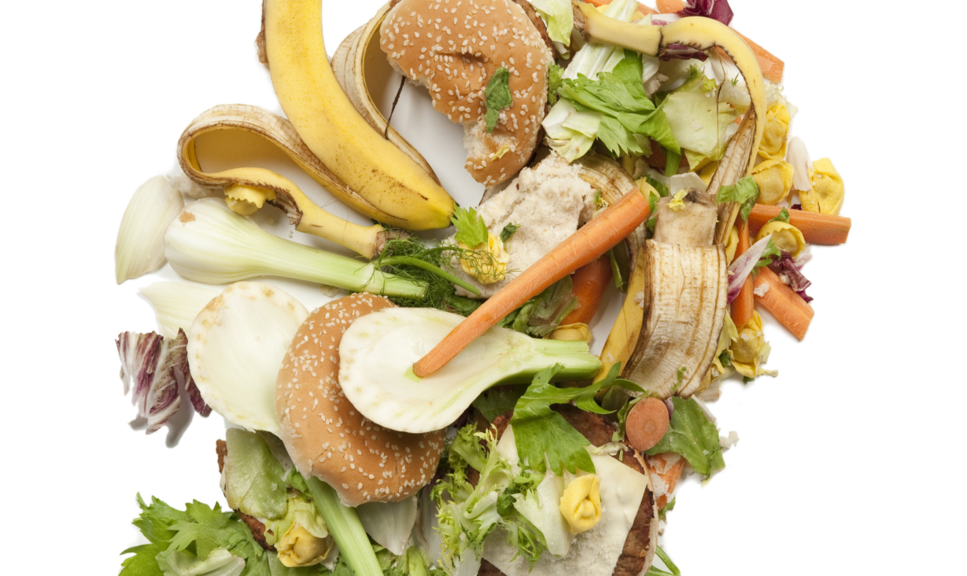
Organic Waste Prevention Food Waste

Slide 25
Food Waste Processing
Not cheap
Not easy (odour, siting, capital cost,…)
Large volumes
Why would we waste food to begin with?

Slide 26
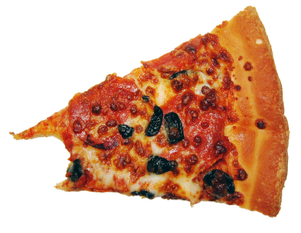
Food Waste Facts - General
~ 200 kg/capita of organic waste was disposed in B.C. in 2012¹
Canadians waste ~ 40% of all food produced, or $27 billion
annually ² more than the GDP of the world’s 32 poorest countries combined ³
British Columbians spend ~ $43.90 weekly on produce and throw away ~ 11% of their purchase (national average =$40.80 &10%) ⁴

Slide 27
Food Waste Facts - Local
Metro Vancouver:
Total avoidable residential food
waste (stale bread, rotten apple,...) is
~ 50,000 tonnes annually
single family dwellings ~ 12%
multi family dwellings ~ 11% ⁵

Slide 28
Food Waste Awareness
Provision of resources to implement food waste reduction pilot projects
Main Tool: USEPA Food Too Good To Waste
Collaborating with Metro Vancouver on food waste reduction initiatives and food waste policy through National Zero Waste Council

Slide 29
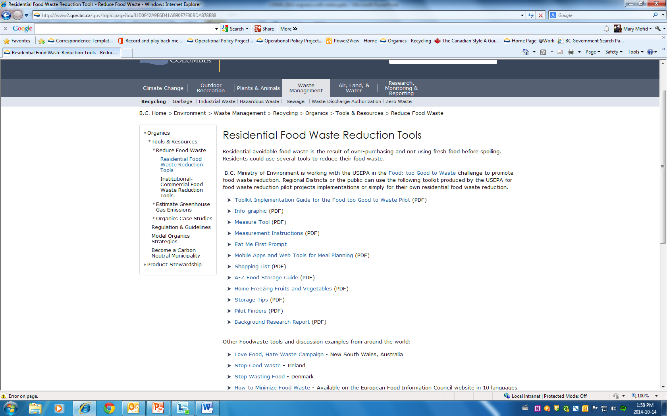

Slide 30
Organics Case Studies
11 studies , B.C. and international
Not just a story – detailed program results
Financial
Environmental
Social
Lessons learned

Slide 31
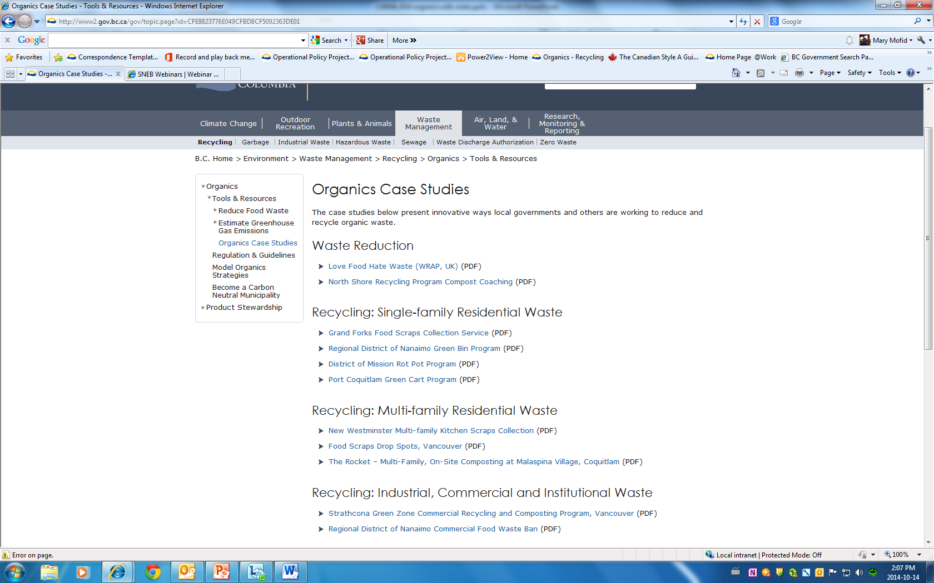

Slide 32
Sources
MoE Environmental Reporting B.C., 2014
Developing an Industry Led Approach to Addressing Food Waste in Canada, Value Chain Management, 2014
Food Waste in Canada, Value Change Management, 2010
Vancouver Sun, 2013
Metro Vancouver Single Family Over–Purchased Food Waste Composition Study, 2011

Slide 33
Questions?
Bob McDonald
Manager, Packaging & Printed Paper Implementation
Waste Prevention Section
250 356-9082
Bob.McDonald@gov.bc.ca
Meegan Armstrong
Unit Head, Industry Product Stewardship
Waste Prevention Section
250 387-9944
Meegan.Armstrong@gov.bc.ca

