Slide 1
WMABC
Annual Meeting
January 29, 2015
James V Repenning
Senior Vice President, Organics

Slide 2
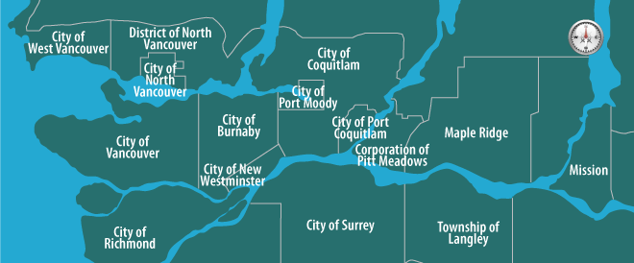
Sites and Services in the Lower Mainland
Food Scraps and Yard Trimmings
Construction and Demolition (C&D) Debris

Slide 3
Material Flow at Harvest – Urban Wood Recycling

Slide 4
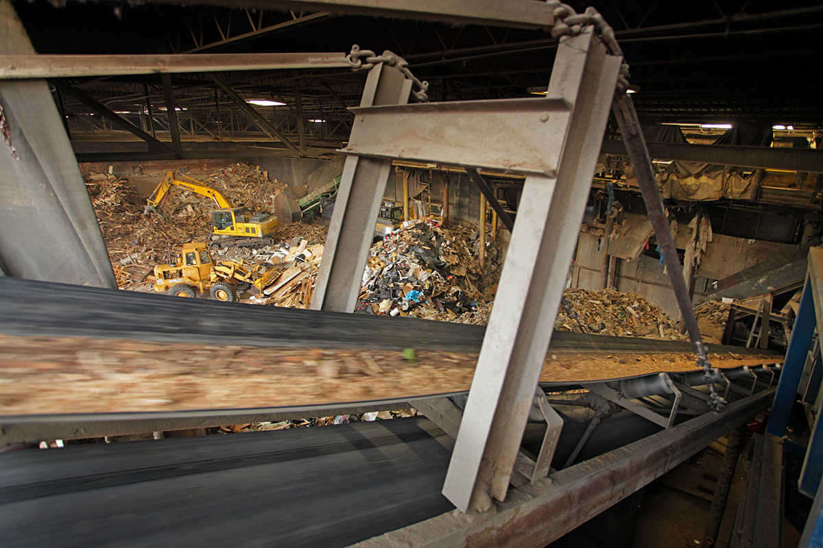
Recycling C&D Materials into Resources

Slide 5
Providing Jobs

Slide 6
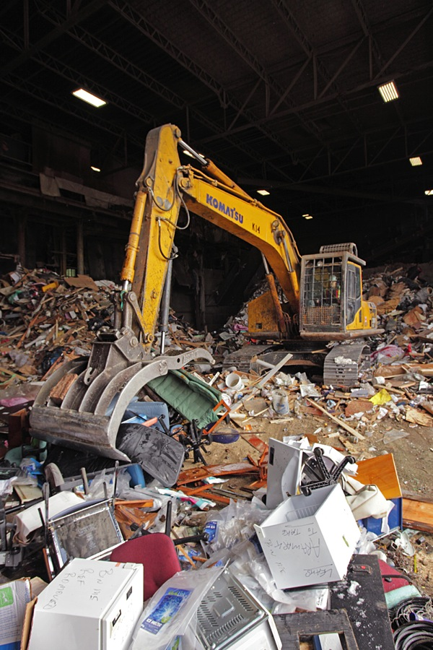
Potential Wood Waste Ban Impacts
Increased Volumes
Increased Questions
Shift in Material Composition; Possible Increased Contamination at all of our sites

Slide 7
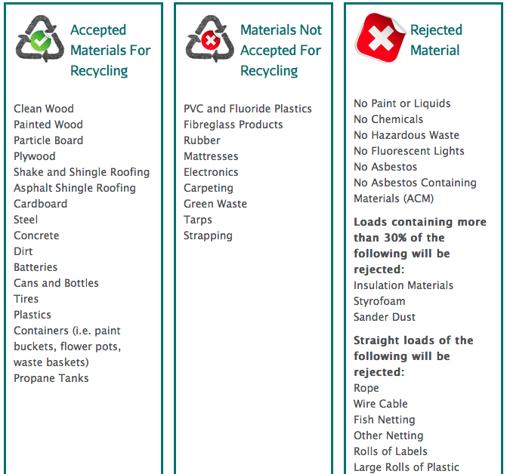
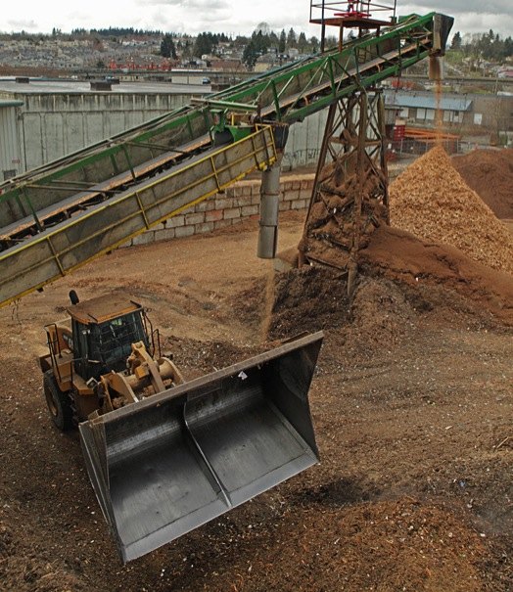
Construction and Demolition

Slide 8
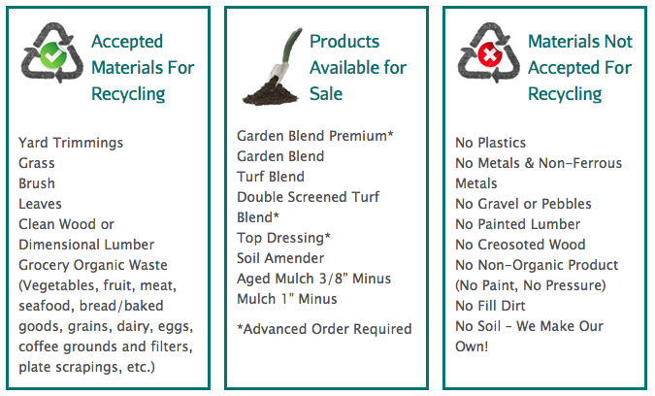
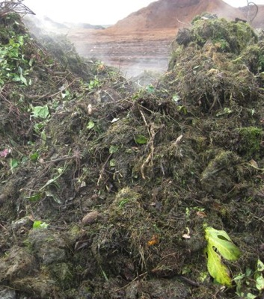
Food Scraps and Yard Trimmings

Slide 9
Contact
Jamie Repenning
jrepenning@harvestpower.com
Louise Roxby
lroxby@harvestpower.com
604 999 3250
Join The Conversation
www.harvestpower.com
Follow us @harvestpower
Like us
Watch our station

