Slide 1
Achieving Zero Waste in Murbs
Daniel Klemky (332848)
Supervisor: Professor Ann Dale
Committee Member: Dr. Richard Kool

Slide 2
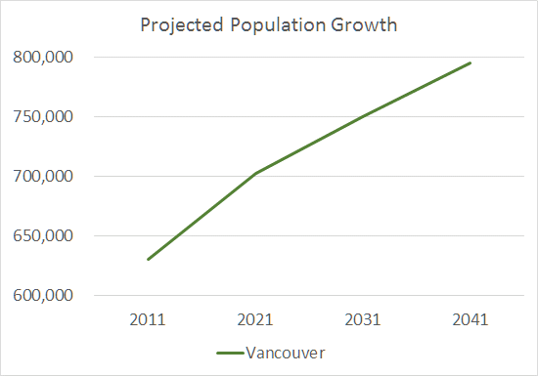
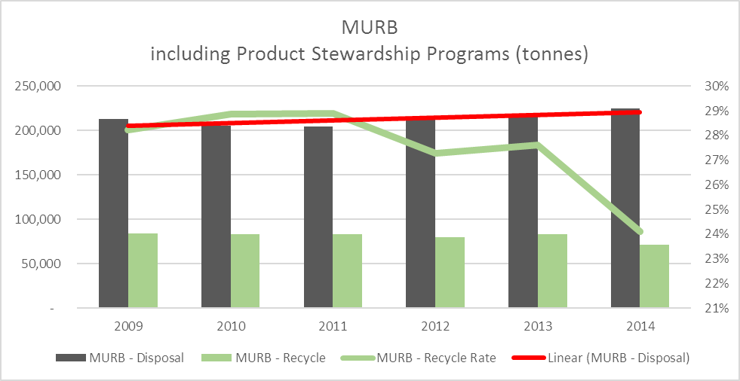
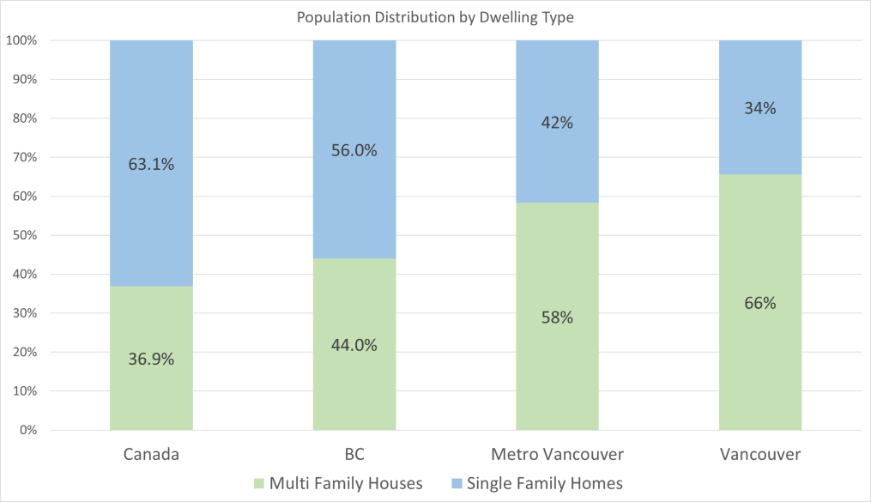
The Problem
Notes:
Multi -unit residential buildings (MURBs) house 60% of Vancouver, BC’s population and, presently, occupants of MURBs in Metro Vancouver only achieve a waste diversion rate of 24%. My research identifies barriers impacting MURB waste diversion rates and attempts to identify solutions to resolve these issues.

Slide 3
My Research
Question
How can zero waste be achieved in an existing MURB in Vancouver, BC?
Methodology
MURB case study on occupants’ waste habits
Purposeful homogeneous sampling
Confidential semi-structured interviews, surveys and literature review
Four step data analysis
Transcribe voice recorded interviews
Develop general themes
Summarize individual responses & begin coding
Summarize coded information and further refine themes
Notes:
I used a mixed methods case study with a grounded theory approach to identify how zero waste could be optimized in MURBs. I used purposeful sampling to recruit research participants and I conducted audio-recorded, semi-structured interviews until data saturation was reached. Information was also collected from survey participants and a literature review.

Slide 4
My Research
13 Research Participants
6 interview and survey participants
6 interview only participants
1 survey only participant
Limitations
Small sample size
MURB may not represent a broader range of MURBs (e.g., high-rise, social housing)
Potential distortion of information (i.e., reactivity)
Researcher and respondent bias (i.e., participants are not completely truthful)
Notes:
I used a mixed methods case study with a grounded theory approach to identify how zero waste could be optimized in MURBs. I used purposeful sampling to recruit research participants and I conducted audio-recorded, semi-structured interviews until data saturation was reached. Information was also collected from survey participants and a literature review.

Slide 5
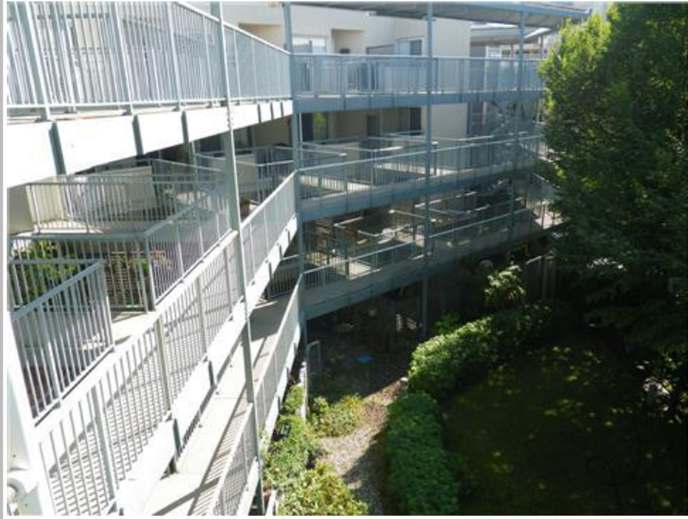
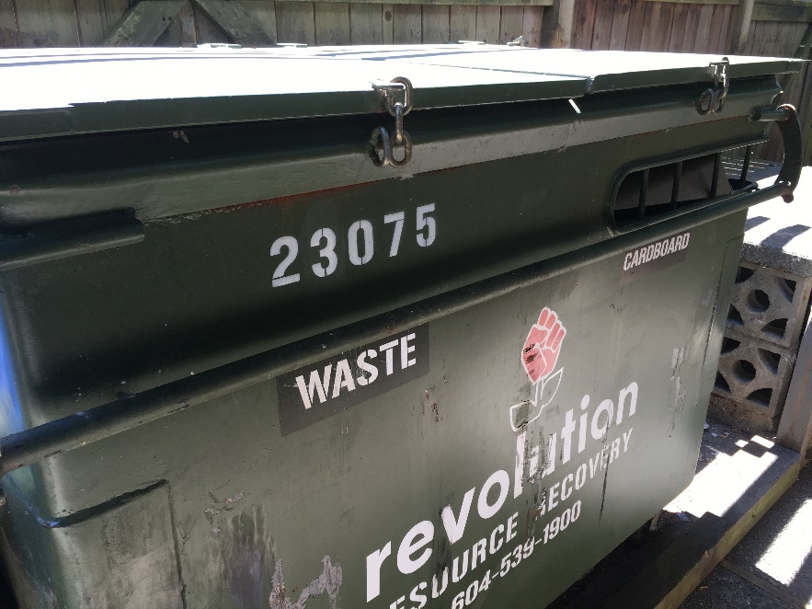
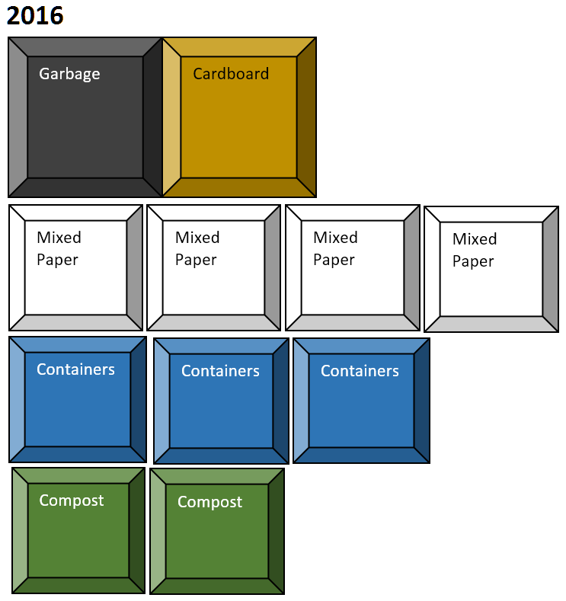
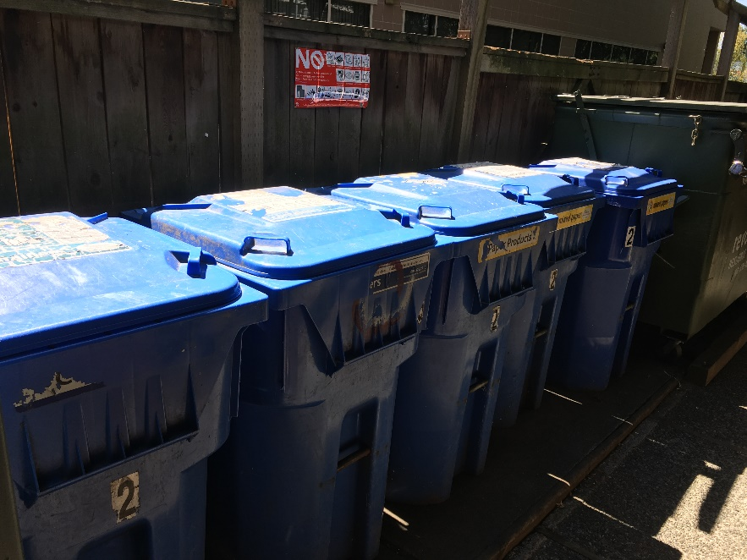
The Case Study MURB

Slide 6
The Results & Discussion
Benefits of waste diversion (social, environmental and economic)
Purchasing power
Stress, frustration and the unknown
Shifting the responsibility
Obeying the law
Conflicting beliefs and behaviours
Norms and influences on waste diversion
Proud waste diverters
There is still hope
Sources of waste
Reduce & reuse
Yuck factor
Going the extra mile or not
Mind the Gaps

Slide 7
My Conclusion
Waste diversion is not always possible or a top priority for people
Educated, motivated and able bodied…hopeless
Honesty about the effectiveness of our current program structure (reliance on the individual)
People want divertible material removed from the waste stream and put back to good use by whatever means is most efficient and cost effective
The bigger issue
Consumer culture
Single-use products and packaging
Poorly made products
The collective lack of accountability for our waste
Notes:
Three major waste diversion themes emerged from my research: the need for additional services, a required shift in the delivery of education, and the need to embrace technology and innovation. By addressing these main themes, it would be possible to improve waste diversion rates and even achieve zero waste in the case study MURB.

Slide 8
My Recommendations
Macro-level (e.g., national, global)
Stronger standards on product and packaging material to reduce waste at the source
Meso-level (e.g., city, region)
Standardized approach to waste diversion across regions and building types
Integrated use of MRFs
Micro-level (e.g., building)
Centralized programs (e.g., services, technology) that targeted the more “difficult” material (e.g., batteries, paint)
Better education and awareness on existing and future programs
Embrace technology

Slide 9
Thank you!

