Slide 1
Driver Safety
Is it just safe driving?
WMABC AGM January 29, 2015

Slide 2
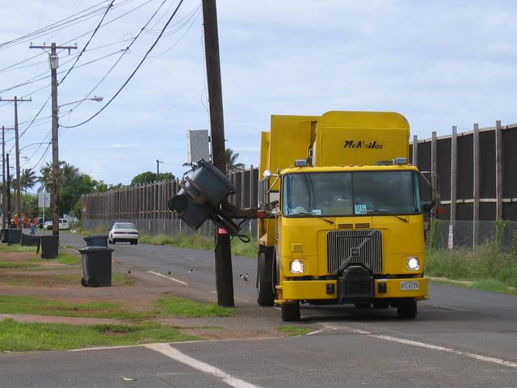
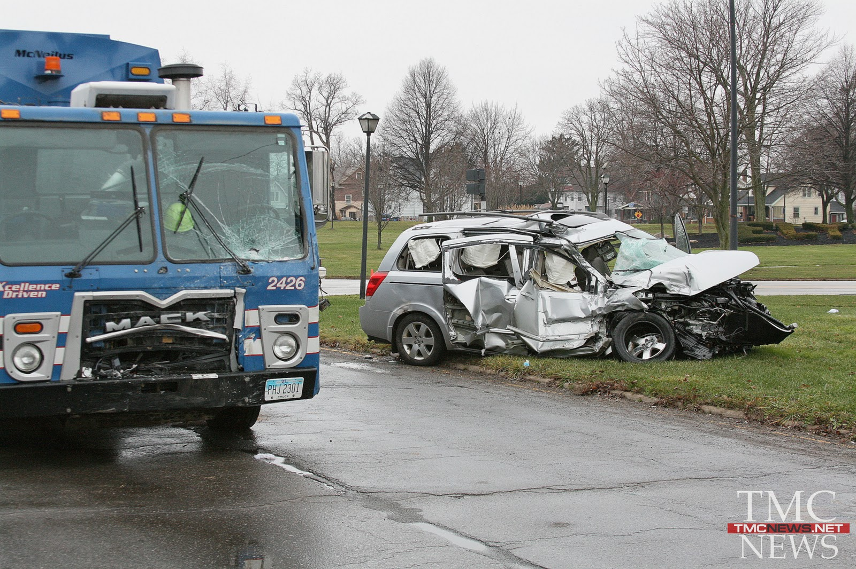
What defines “Driver Safety”
Safe, Courteous Driving?
No Traffic Accidents or Incidents?

Slide 3
Crash Factors
Factor | Commercial Driver | Public
Distracted Driving | 20.01% | 18.33%
ICBC Business Insights – Road Safety Report - 2015CMN0122-0

Slide 4
Crash Factors
Factor | Commercial Driver | Public
Distracted Driving | 20.01% | 18.33%
Road Conditions | 13.00% | 9.82%
Speed | 11.50% | 8.12%
ICBC Business Insights – Road Safety Report - 2015CMN0122-0

Slide 5
Crash Factors
Factor | Commercial Driver | Public
Distracted Driving | 20.01% | 18.33%
Road Conditions | 13.00% | 9.82%
Speed | 11.50% | 8.12%
Fail to Yield | 6.07 | 6.27
ICBC Business Insights – Road Safety Report - 2015CMN0122-0

Slide 6
Crash Factors
Factor | Commercial Driver | Public
Distracted Driving | 20.01% | 18.33%
Road Conditions | 13.00% | 9.82%
Speed | 11.50% | 8.12%
Fail to Yield | 6.07 | 6.27
Driver Error/Confusion | 6.54 | 6.24%
Following Too Close | 6.49 | 4.27%
ICBC Business Insights – Road Safety Report - 2015CMN0122-0

Slide 7
Crash Factors
Factor | Commercial Driver | Public
Distracted Driving | 20.01% | 18.33%
Road Conditions | 13.00% | 9.82%
Speed | 11.50% | 8.12%
Fail to Yield | 6.07 | 6.27
Driver Error/Confusion | 6.54 | 6.24%
Following Too Close | 6.49 | 4.27%
ICBC Business Insights – Road Safety Report - 2015CMN0122-0

Slide 8
Mechanical Factors
Vehicle Factor | Percentage of Collisions
Tires Inadequate/Failure | 1.2%
Insecure Load | 1.0%
Defective Brakes | 0.9%
ICBC Business Insights – Road Safety Report - 2015CMN0122-0

Slide 9
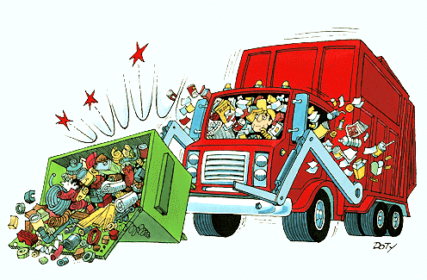
Cost of Un-Safety
28.96% of your fleet will be involved in a crash
3% will involve casualties
ICBC Road Safety Report 2015CMN0115 – Commercial Vehicle Stats

Slide 10
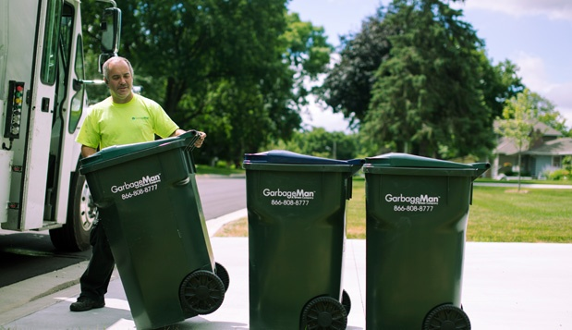
What defines “Driver Safety”
General Workplace Safety?

Slide 11
Driver Safety
Is Both
Road Safety
and
Workplace Safety

Slide 12
Workplace Safety
Accident Type | Count | Percent
Overexertion | 28 | 29.5%
Fall From Elevation | 15 | 15.8%
Fall on Same Level | 12 | 12.6%
Struck By | 12 | 12.6%
MVI’s | 11 | 11.6%
Accident Type | Costs | Percent
Struck By | $849,000 | 32.0%
MVI’s | $628,000 | 23.6%
Fall From Elevation | $420,000 | 15.8%
Overexertion | $386,000 | 14.5%
Other Bodily Motion | $205,000 | 7.7%
WorkSafeBC 2010 – 2014 – 732018 Transport Drivers only

Slide 13
Cost of Un-Safety
www.worksafebc.com January 2015

Slide 14
Human Factors
Scheduling
Is it practical
Does it encourage “Modification for Personal Profit”
Monitoring
Are you detecting substandard scheduling or performance?
Discipline
Are you making fair and just corrections?

Slide 15
Human Factors
Training
Is it all it should be?
Is it completed on time?
Is there provision for cross training
What would you offer if the budget really was unlimited?

Slide 16
Human Factors
85% of what an employee deals with is not under their control
Are we guaranteeing failure?
Attitudes
Are you demonstrating what you want to see?

Slide 17
Attitudes are Catching!
Is Yours Worth It?

