Slide 1
City of Vancouver
Compostable Organics Waste Ban
WMABC – Jan 29, 2015

Slide 2
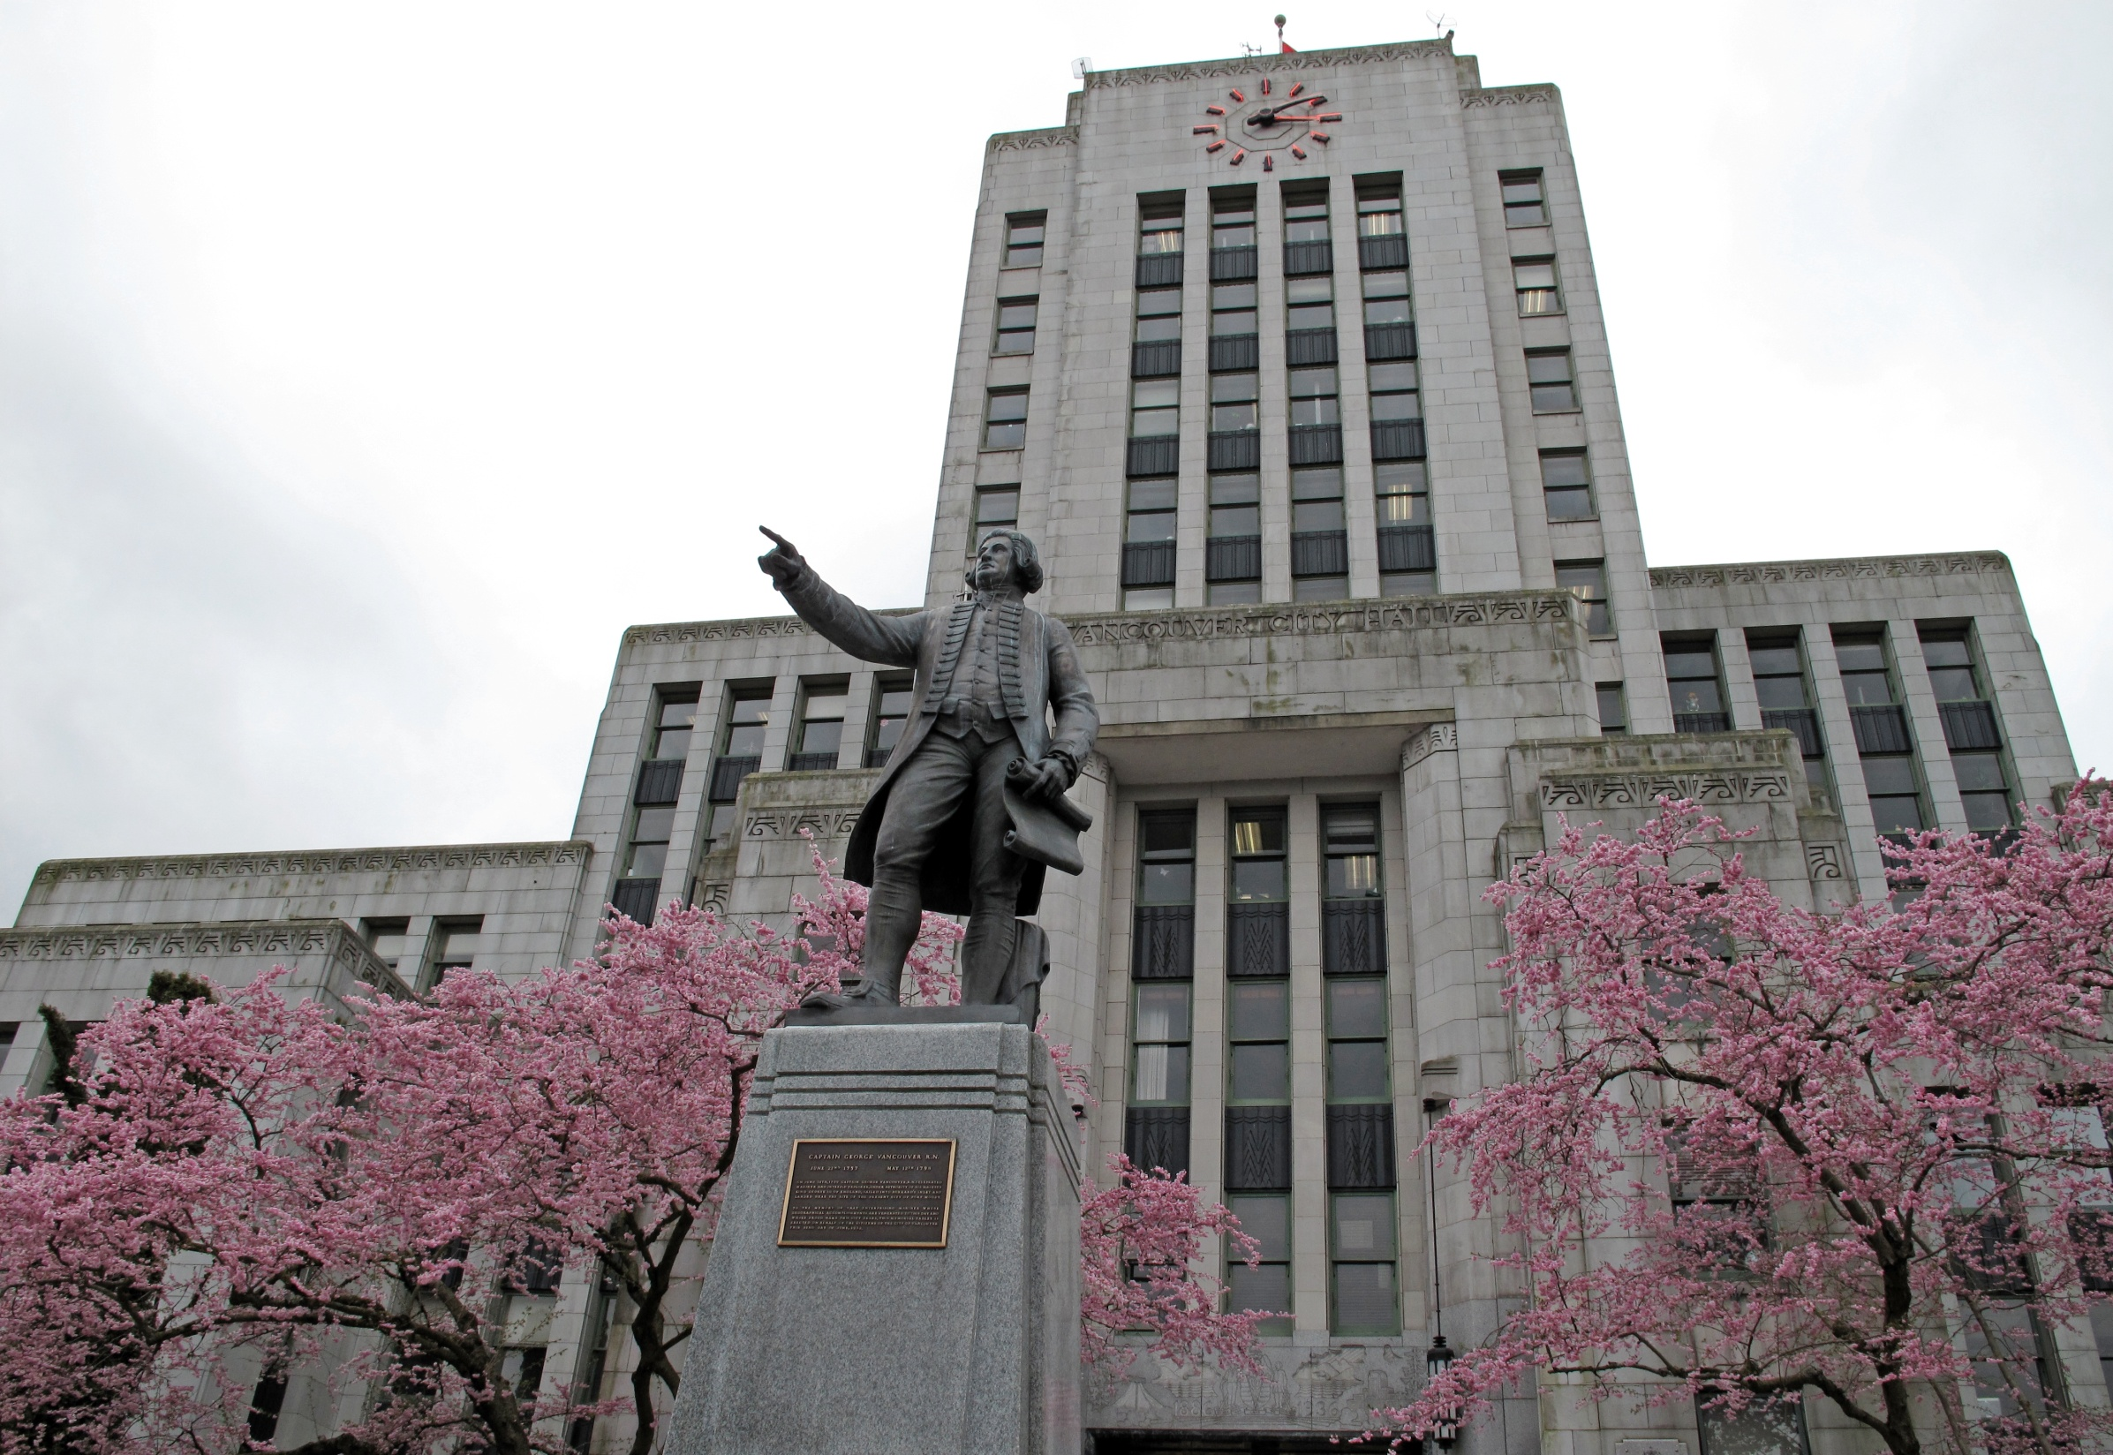
City Role and Bylaw Regulations

Slide 3
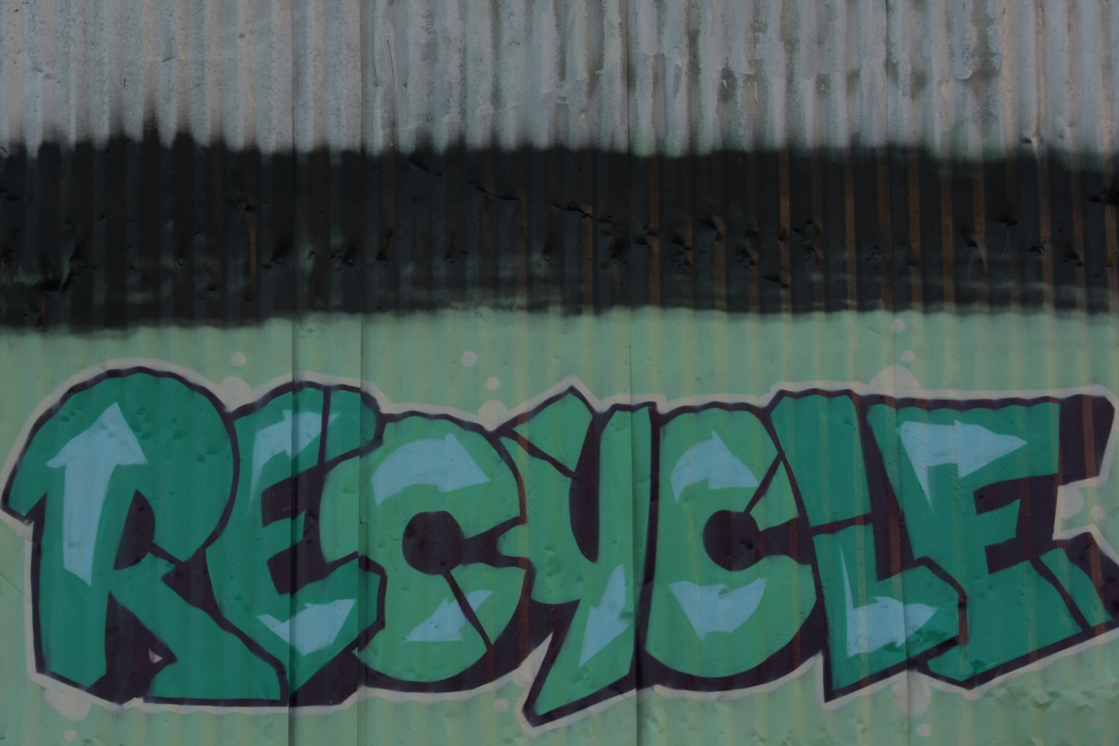
Two Levels of Organics Disposal Regulations
Metro Vancouver
Compostable organics disposal ban, enforced at point of disposal at regional facilities
City of Vancouver
Reflect Metro Vancouver’s organics ban in the City’s by-law
Require recovery programs at the building level to foster participation
Allow for different forms of recovery
Notes:
Notes: (adjust depending on what Paul says about Bylaw 280 in his presentation)
Describe two levels of bylaws – regional and City
Bylaw 280
Recently, Metro Vancouver’s By-law 280 was rejected by the provincial government. The By-law was a regulatory framework that would have required waste haulers to deliver residential and commercial waste to facilities approved by Metro Vancouver. With the Province’s rejection of By-law 280, private haulers may potentially take waste out of the region for disposal to a facility that may not have a food scraps disposal ban.
Nonetheless, City of Vancouver by-laws require food scraps recycling plans to be in place for every building, irrespective of By-law 280 or where waste is taken.

Slide 4
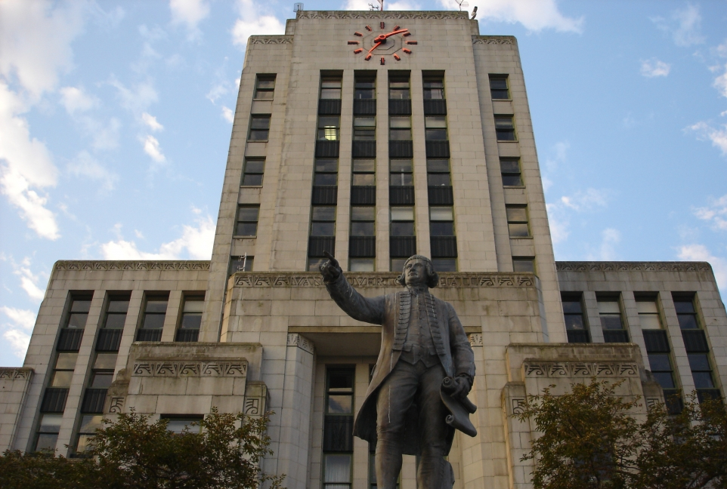
City of Vancouver By-Law Amendments
City by-laws amended, requiring:
All business license holders, and owners or occupiers of either residential or non-residential properties in Vancouver:
Must have a food waste diversion plan
And ensure food waste is disposed of according to that plan
Actual by-law amendments available at Vancouver.ca

Slide 5
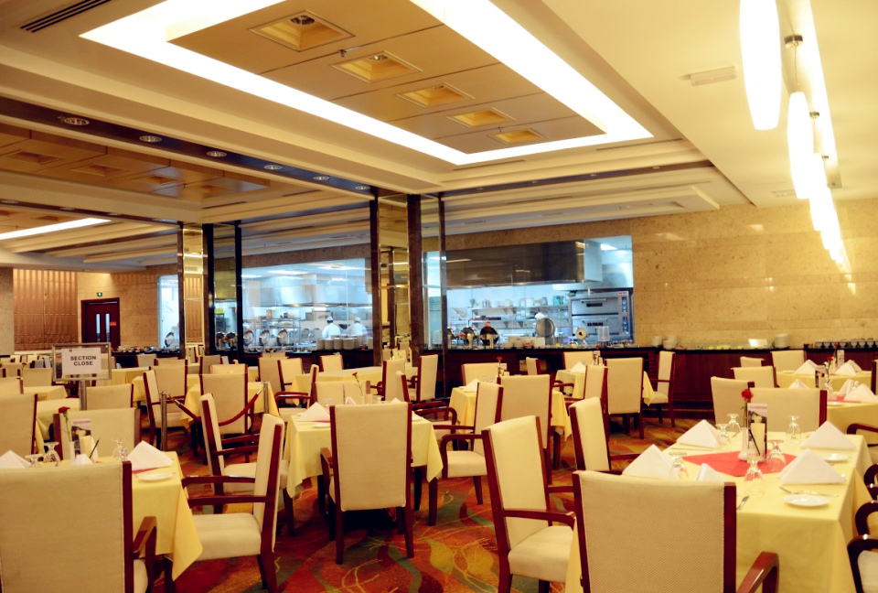
City of Vancouver Bylaw Timeline
Jan 2015
By-law amendments come into effect January 1, 2015
1st Year
City’s focus for the first year will be support and education, starting with highest generators

Slide 6
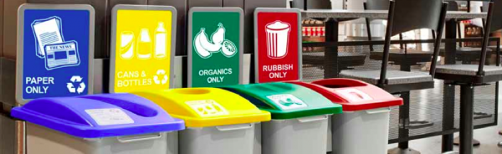
City of Vancouver Bylaw Amendments Con’t
Food waste diversion plan could include:
No food waste generated in the business
Collection of food waste separate from garbage for composting
Delivery of mixed waste to a processing facility (MRF)
On site Composting options
Notes:
Bylaw was designed to be flexible to allow innovation and options, while still achieving food scraps diversion objective

Slide 7
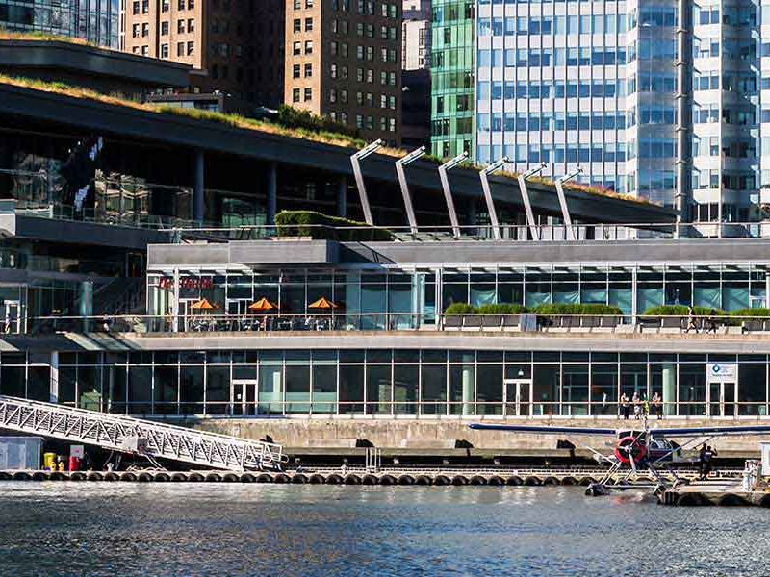
Outreach & Resources for Multi-Unit Residential Building and Business Managers/Owners

Slide 8
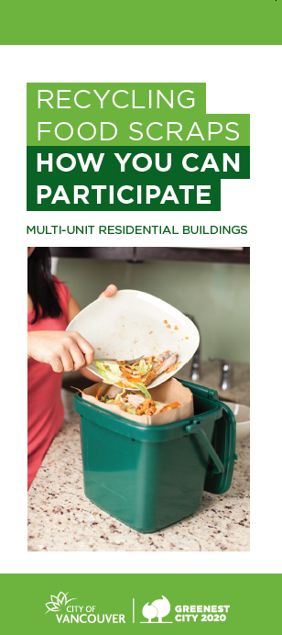
Increasing Awareness of Ban
Business licence renewal insert
Working with stakeholder organizations (such as BIAs, Tourism Vancouver, Hotel Association, CHOA, etc)
Multi-lingual brochures
Collection calendars
On-going liaison with Metro Van to best address stakeholder needs
Notes:
We have been working over the last year to increase awareness about the organics ban and of the need to get a program in place
Business licence renewal organics ban insert (Fall 2014)
Working with stakeholder organizations (such as BIAs, BOMA, Tourism Vancouver, Hotel Association of Vancouver, BC Restaurant and Foodservices Association, Condo Homeowners Association, Landlord BC, etc) to send out information on the ban to their members and speak to stakeholder organizations
Developed multi-lingual brochures and working to distribute them through BIAs, City sites, special events, associations. Also available to haulers
Information on ban in this year’s City collection calendars
Also worked with Metro Van on fall food scraps recycling campaign, to help shift social norms around disposing of food scraps
Continuing to work with MV to coordinate efforts to best address needs of stakeholders

Slide 9
Develop a plan
Look at how much food waste is generated (how will the ban affect me?)
Where does it come from?
Can it be separated easily & how can it best be separated?
Do I have space for more containers?
Who can pick it up for me and what is the cost?
Could or should I consider on site composting?
What sort of information/communications do I need to provide to my staff/residents?
Notes:
Business need to develop food scraps collection plan which works for them, and will need to consider their unique circumstances

Slide 10
Considerations when developing a plan
On-site storage space (pick-up frequency, container size)
Collection access
Food scraps generation rates
Existing contracts
Notes:
Some of things to consider include:
On-site storage space:
Containers on City property (laneways etc) require permits
City’s strong preference is containers stored on private property. Only consider off-site storage when no on-site options.
Can manage storage requirements via pick-up frequency, changing container sizes/split containers
Collection access
Rate of food scraps generation – seasonal fluctuations
Existing contracts – flexibility, higher organics generators may be able to reduce garbage collection container sizes and/or frequency

Slide 11
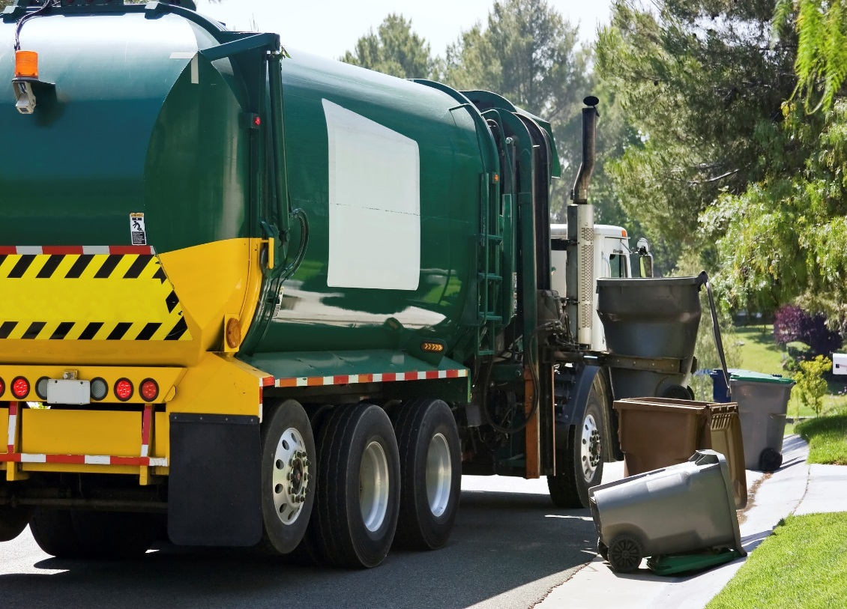
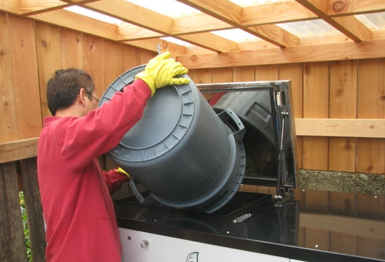
Web-based Information on Options
Collection contractor
On-site Systems
Notes:
Buildings need to develop food scraps collection plan which works for them. We have web-based information on options, including:
Hire a hauler
Considerations when hiring a hauler for food scraps collection (contract, containers, collection frequency, bin cleaning, lining, education available etc)
Developed in consultation with WMABC and food scraps haulers operating in Vancouver
Listing of all Vancouver food scraps haulers with information about their services
On-site organics management
Some buildings may also want to consider on-site organics management options.
We list some cursory considerations on our website, and link to two MV reports for evaluation of technologies

Slide 12
Hauler Listing
vancouver.ca/organicsban
metrovancouver.org
Sample – full list available on vancouver.ca/organicsban
Notes:
This is a sample page from our hauler listings, which has been a useful resource for building or business owners/managers. There are more 20 private waste collectors offering organics collections services of various kinds. Table has haulers, contact information, container type, size, whether bins are lockable, if cleaning or bin liners included, what type of education they can provide, etc.
Helps buildings find a contractor that provides service that addresses their needs.

Slide 13
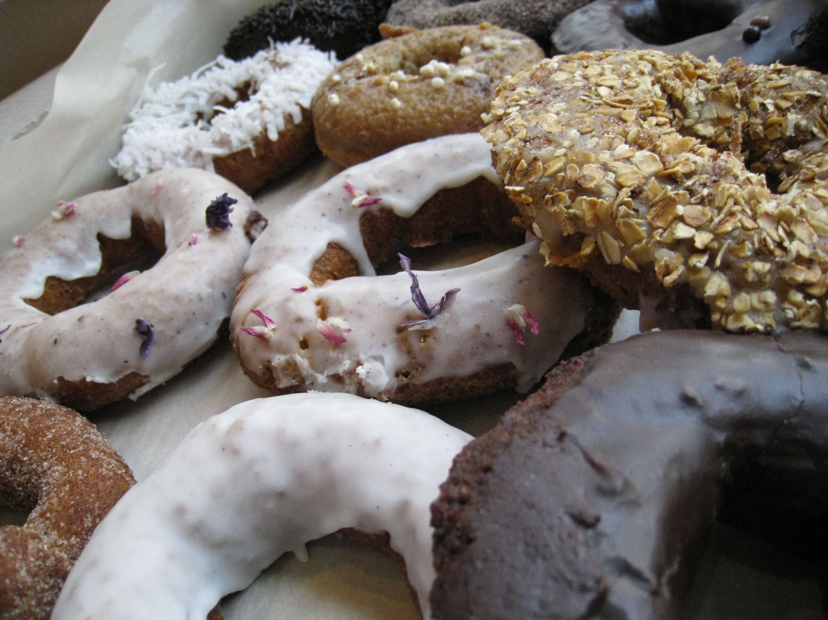
How City is Supporting Haulers
Increasing awareness of ban and need for program
Multi-lingual outreach materials
Continued partnership and on-going dialogue/consultation
CoV kitchen container contract pricing
Providing customizable resources to haulers for their customers (CoV unbranded materials)
Notes:
Working to increase awareness of ban and need for a program:
Provided CoV letter advising of the ban and that action is needed to haulers for distribution to their customers (May 2014)
Business licence renewal organics ban insert (Fall 2014)
Working with stakeholder organizations (such as BIAs, BOMA, Tourism Vancouver, Hotel Association of Vancouver, BC Restaurant and Foodservices Association, Condo Homeowners Association, Landlord BC, etc) to send out information on the ban and speak to stakeholder organizations
Also worked with Metro Van on fall food scraps recycling campaign
Multi-lingual outreach materials:
Developed a multi-lingual information card with options (hauler, on-site management, etc) and weblinks for more info
Working with stakeholder organizations and haulers to distribute.
Providing customizable resources to haulers for their customers
Providing access to the City’s unbranded, editable educational and outreach materials (pproperty manager toolkit, resident brochures, stickers, letters etc)
Providing our lobby talk/strata presentation staff training manual to haulers
CoV’s contract pricing for kitchen containers
For Vancouver food scraps haulers
Continued partnership and on-going dialogue/consultation
Consulted with haulers on resource materials (hauler listings, considerations)
Will consult with haulers on draft container storage guidelines when they are ready
Will continue dialogue, currently having meetings with all of the food scraps haulers in Vancouver, welcome feedback and collaboration

Slide 14
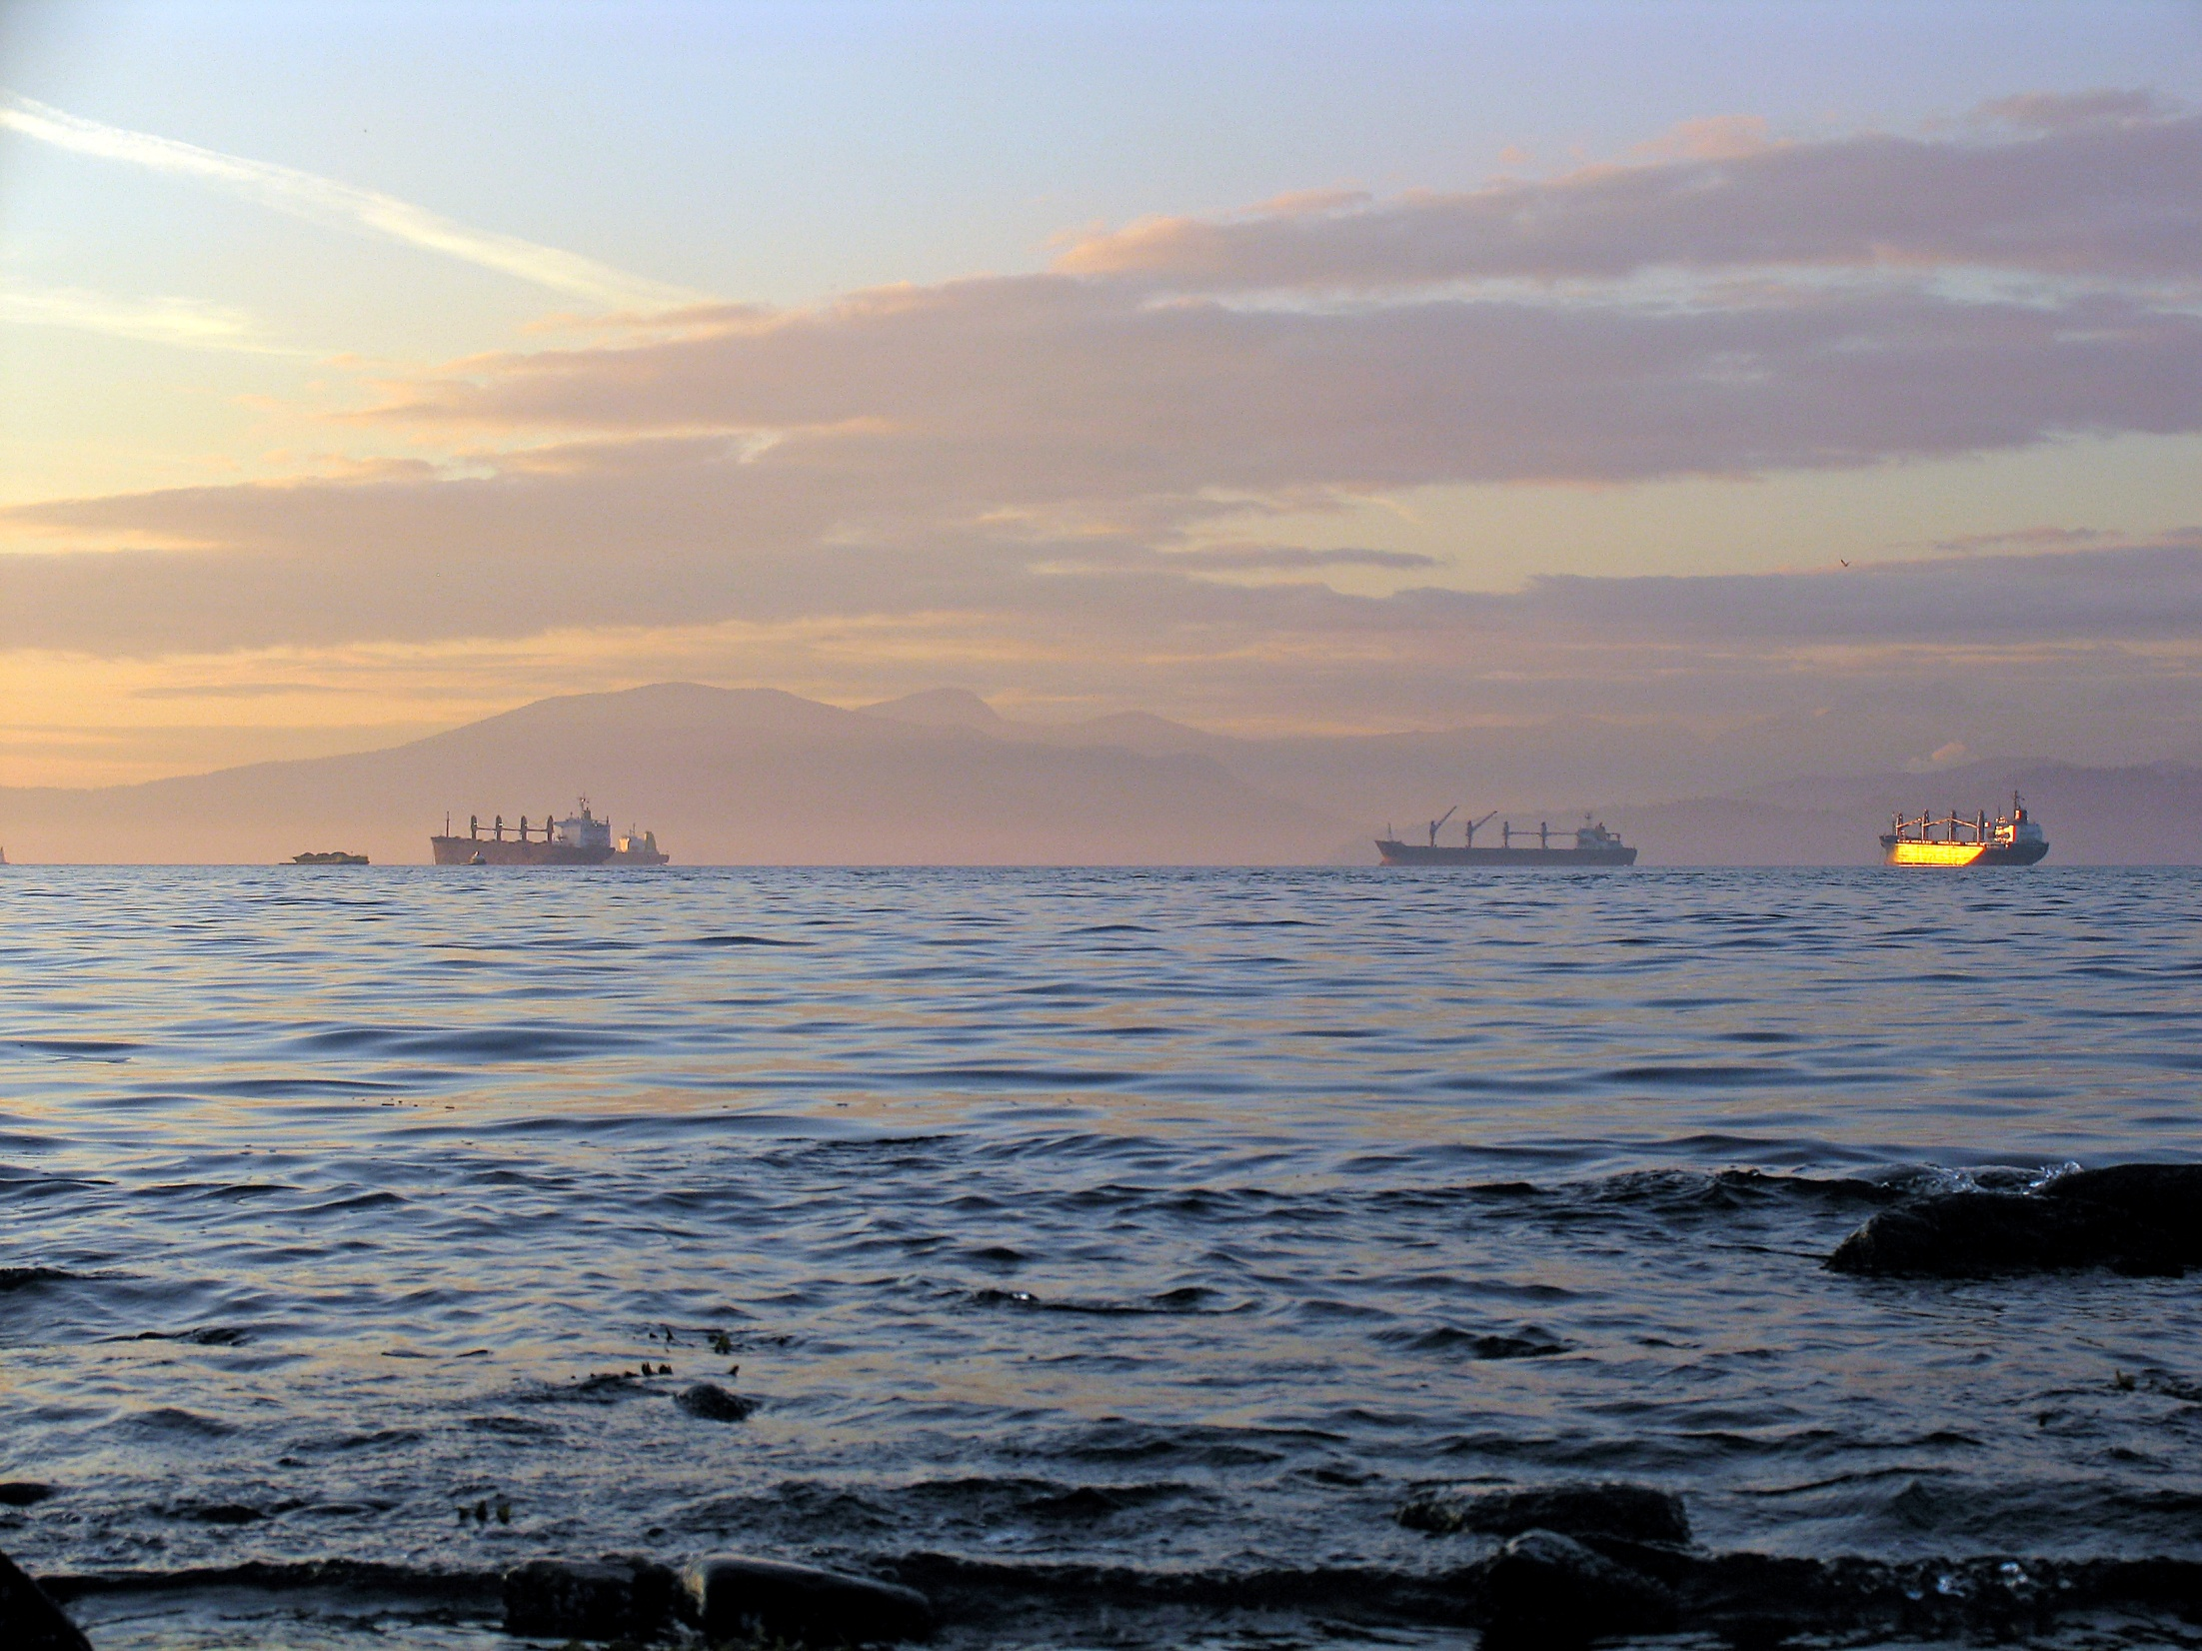
Thank You!
Questions
Albert Shamess
Director of Waste Management & Resource Recovery
City of Vancouver

