Slide 1
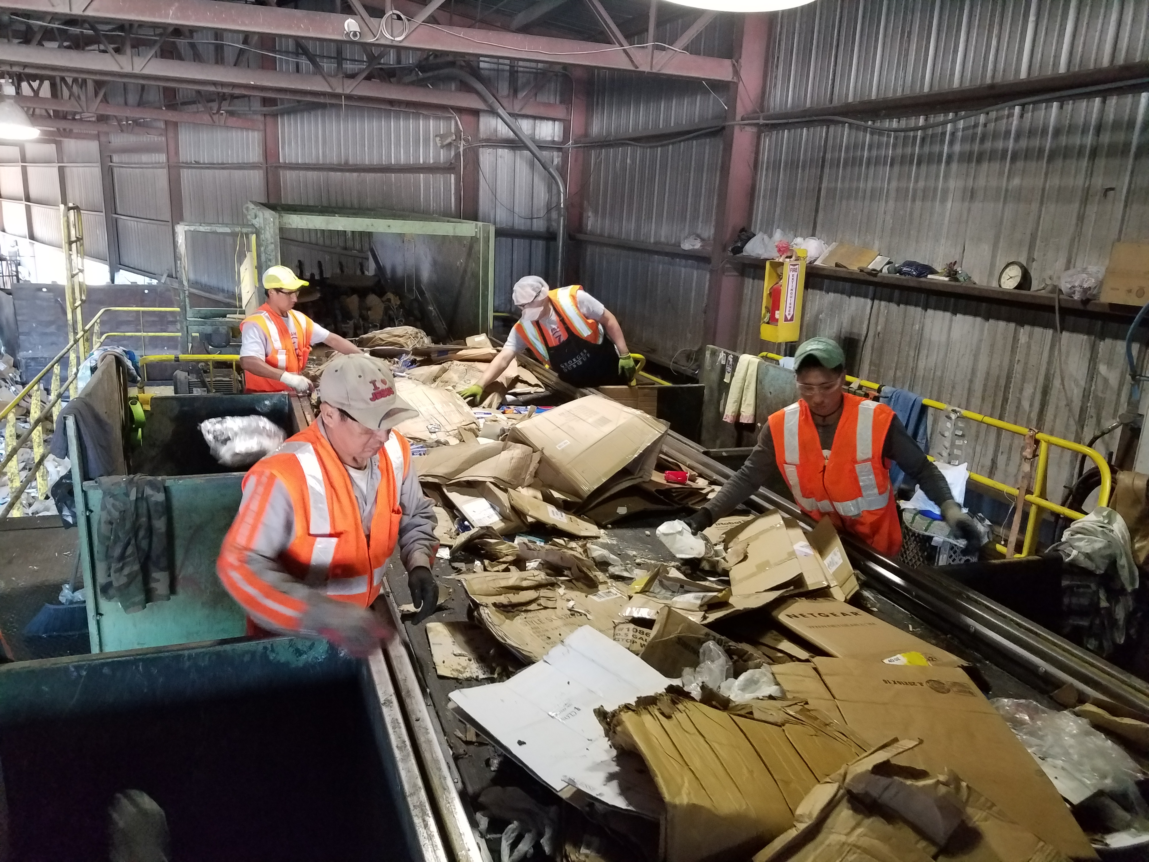
  Serving our city, protecting our environment, creating safe jobs,
  producing career paths to the middle class
Understanding Industry Economics – Perspectives

Slide 2

New Yorkers for Responsible waste management
Kendall Christiansen, Executive Director
Former Manager, NYC Chapter – National Waste and Recycling Association
Principal, Gaia Strategies – senior consultant to InSinkErator (NYC, US, Canada)
Founding Asst. Director, NYC’s recycling system
Former Chair, NYC Citywide Recycling Advisory Board

Slide 3
Four Anecdotes
About Economic Disruption/Chaos
NYC’s Commercial Waste Regulatory Scheme – and Proposals
LA’s new Districting/Franchising System
What Gets Measured…Changing Metrics
Food Fights A’Coming

Slide 4
National Perspective
Waste is local – historical; specialized knowledge; adaptation
Open market remains dominant system
Franchising Options –
  Exclusive, non-exclusive, “utility”
  Limited comparative analyses
Regional differences
  West Coast models
  Cost of disposal, access to markets, etc.

Slide 5
Commercial Waste in NYC
Key Metrics
4 million tons annually – 50% of MSW(not C&D)
80 active companies - 20 largest collect from 81% of businesses; locally-owned; multi-generational)
Employment: direct – 4,000+; diverse; unionized; well-paid
Collection cost: $133/ton (DSNY: $307)
Disposal cost – 30% to 50% less

Slide 6

NYC Commercial System
ICI minus multi-residential
Still “carters”; some still “ashes”
Well-regulated – reformed 1996
Competitive, efficient, economical
Two-year contracts
Rate caps – dry/wet
  $18.87 per CY loose (volume)
  $12.38 per 100 lbs. (weight)
Not vertical – no disposal capacity
Expanded recycling + targeted organics = capacity

Slide 7
Franchising Impacts
Frozen industry for six+ years
Cost/rate increases – including “franchise fees”
Loss of choice, customization/leverage
Loss of companies (40-50) + direct/indirect jobs
Shift from B-to-B to Business-to-City
Franchise fees?

Slide 8
LA’s Districting Initiative
Six-year process (five-year notice)
Exclusive vs. Non-exclusive
144 companies (15 = 99%) reduced to 7
11 districts (3-4 small)
Contract term: 10 yrs + 5+5
Franchise fee – 15%; < 100 staff
Trigger $200M investment in plant, equipment, CNG trucks
90% diversion goal
Price increases pending

Slide 9
DISrupter I:
What gets measured…
Recycling vs. Diversion Rates
  Volatile Markets
GHG Emission reductions
  WM’s “Spectrum” - cost per ton of GHG emissions
Agency vs. Utility vs. Authority
ICI vs. Residential Split
PAYT/SAYT (Pay/Save As You Throw)
On-Demand Sensors

Slide 10
Disrupter 1i:
FOOD FIGHTS
Intense Interest – NRDC, ReFED, National Zero Waste Commission, US EPA
Hierarchy more compelling – LoveFood/HateWaste
Food waste reduction/recovery
Composting vs. animal feed vs. AD
Entry of WRRFs/utilities
  new business relationships
  Comparative cost – liquid vs. solid
Bans with Plans – MassDEP economic analysis

Slide 11
Emerging Concepts
Evolving Tonne
Zero Waste
Sustainable Materials Management
Circular Economy
Extended Producer Responsibility

Slide 12
