Slide 1
Circular Economy
WMABC Conference
January 29, 2015
Jocelyn Doucette
Regional Business Manager – Organics West
jdoucette@harvestpower.com
604-220-7734

Slide 2
About Harvest
Biogas & Energy
Organics Processing
Soils, Mulches and Natural Fertilizers
Zero Waste

Slide 3
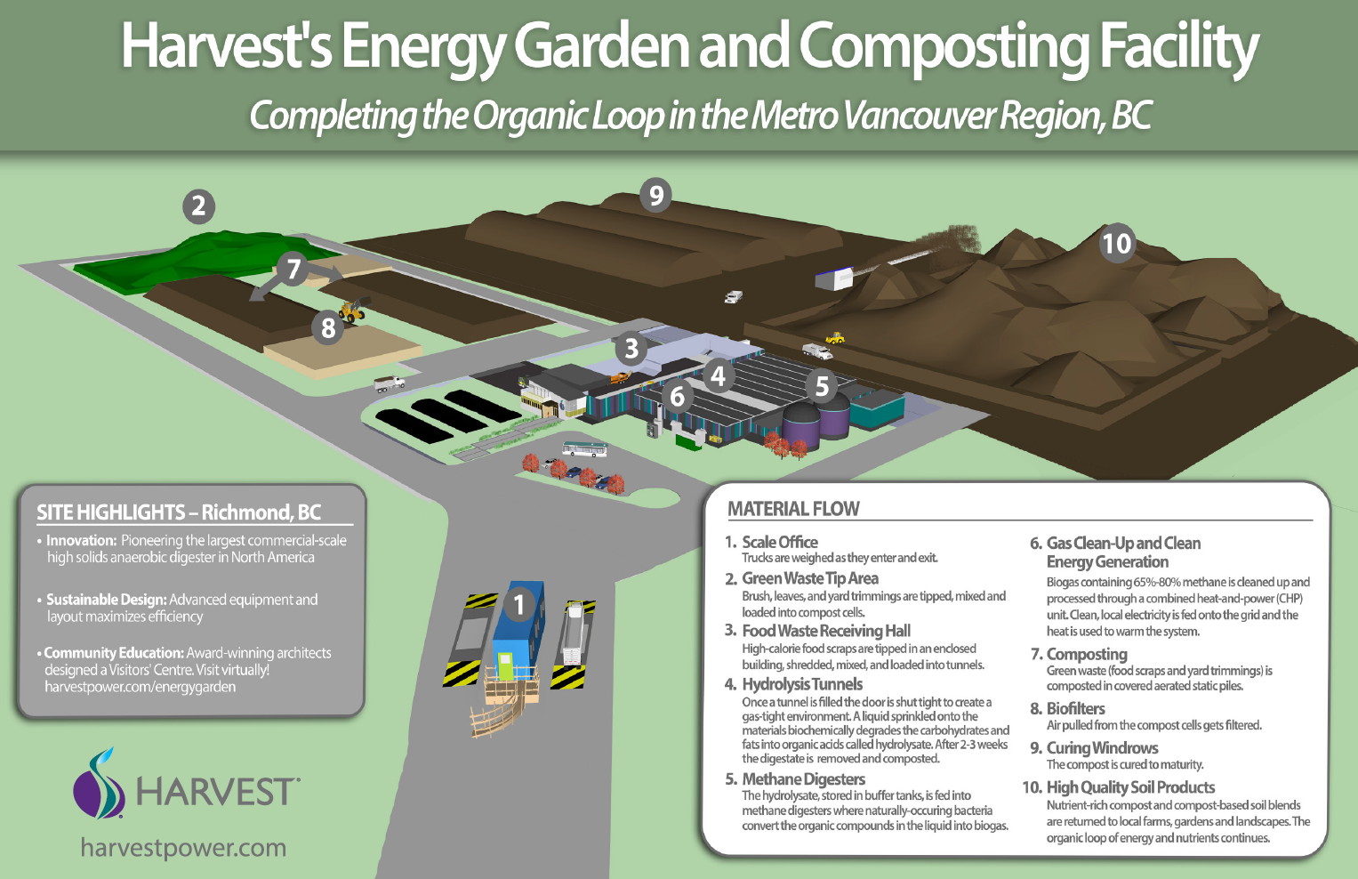

Slide 4
Harvest Urban Wood Recyclers

Slide 5
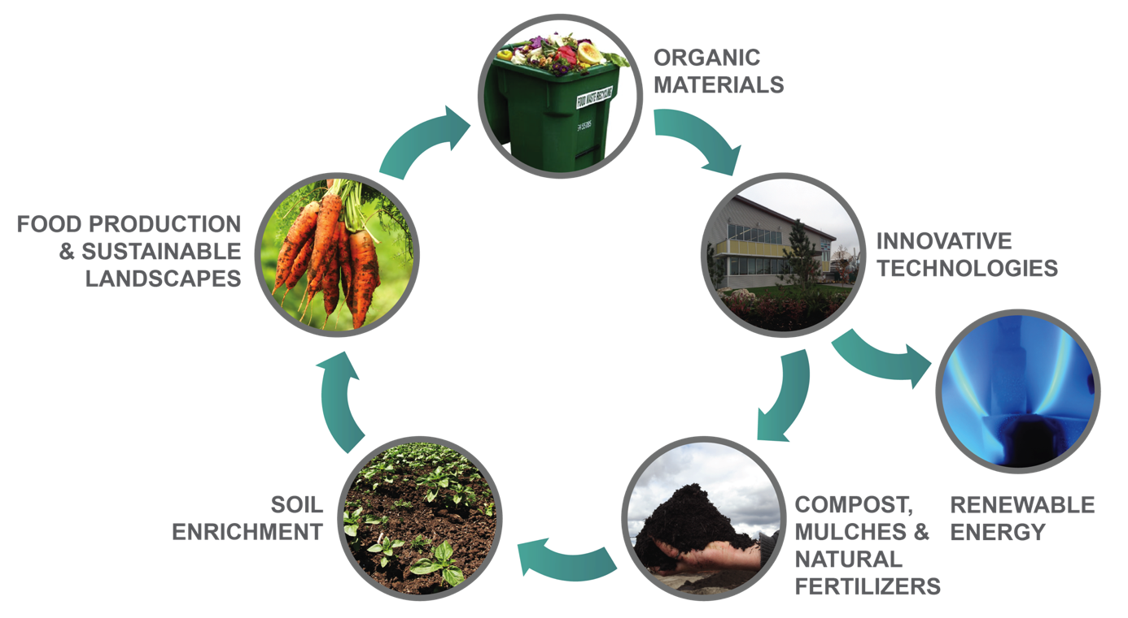
Organics Operating System™

Slide 6
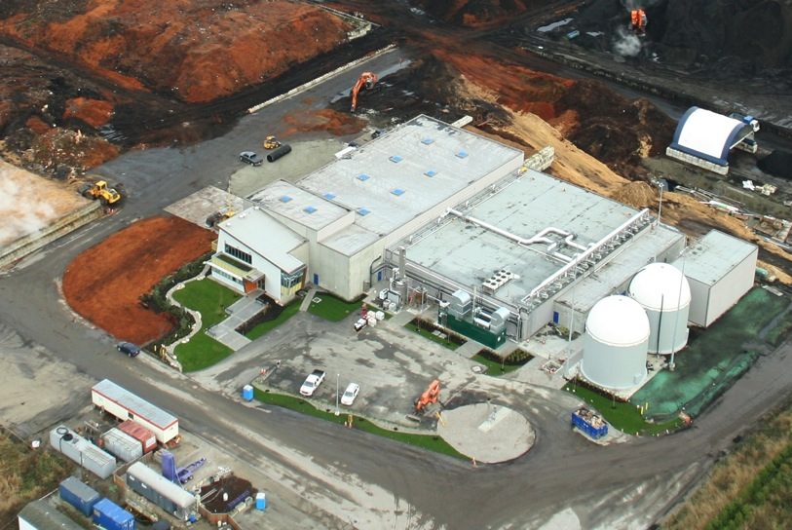
Anaerobic Digester: Harvest Energy Garden - Richmond, BC
Key Statistics
Start-Up: Spring 2013
Capacity: 40,000 MT /yr. organics (mixed food & yard waste)
Energy Output: 2.2 MW combined heat-and-power
Product Output: 21,000 MT /yr. high quality compost
Public Outreach: Visitor Center to host educational tours and promote Zero Waste

Slide 7
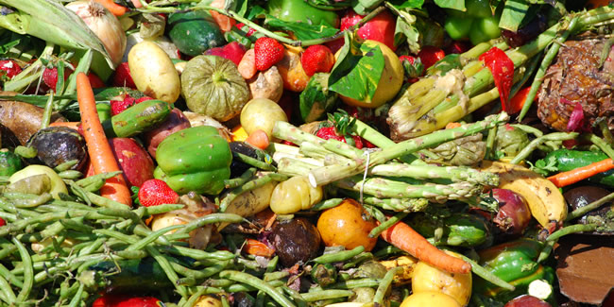
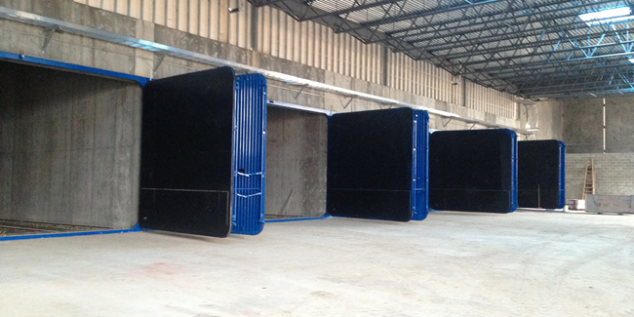
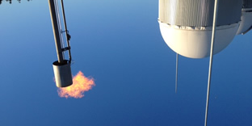
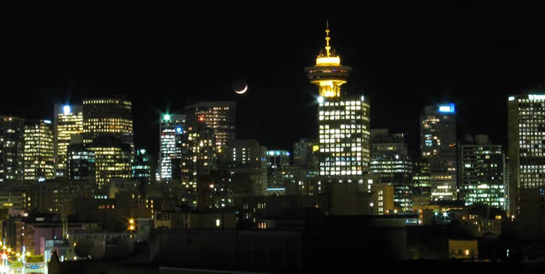
Our Anaerobic Digestion Process
Commercial food scraps are delivered.
We load the food waste into the sealed digester tunnels.
After two weeks of processing, gases are trapped.
Electricity is manufactured and put back onto the grid.

Slide 8
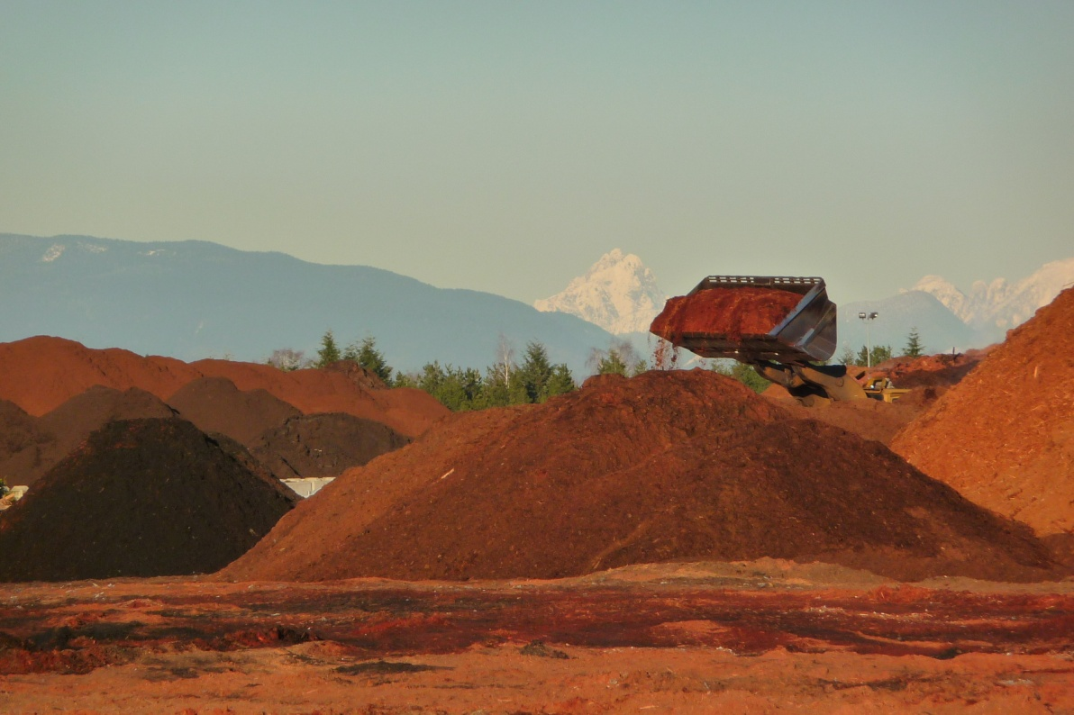
Composting System: Harvest Power - Richmond, BC
Key Statistics
Start-Up: Spring 1994
Capacity: 300,000 tonnes /yr. organics (mixed food & yard waste)
Product Output: 200,000 cy /yr. class A compost
Public Outreach: Site tours and soil education programmes in place. Over 500 cy per year donated to local community gardens.

Slide 9
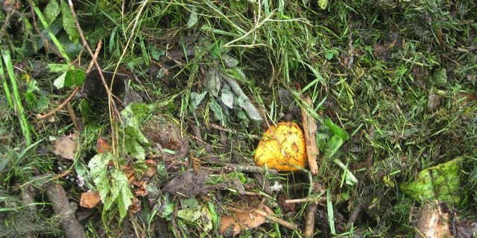
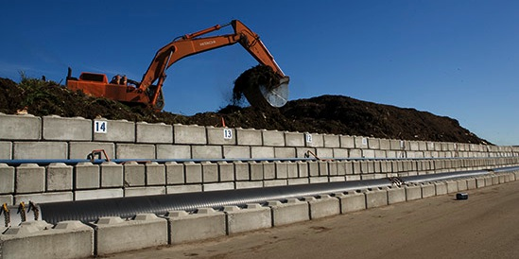
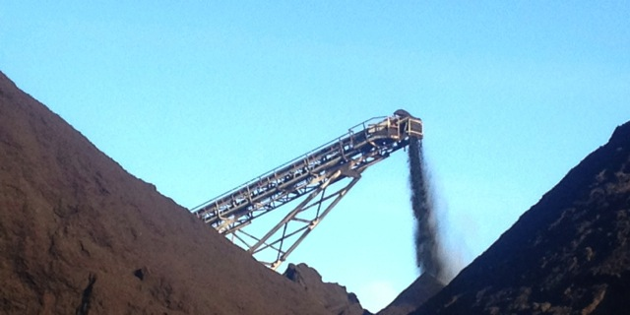
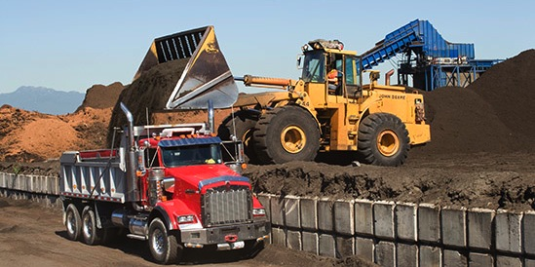
Our Composting Process
Yard trimmings and food scraps are delivered.
We mix and layer the materials into compost cells.
After 8-9 weeks, plus curing, we screen the compost.
Compost and soil blends are delivered to local gardens.

Slide 10
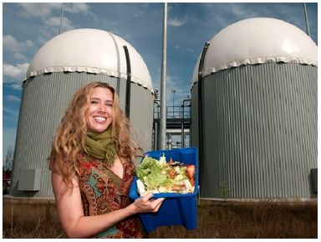
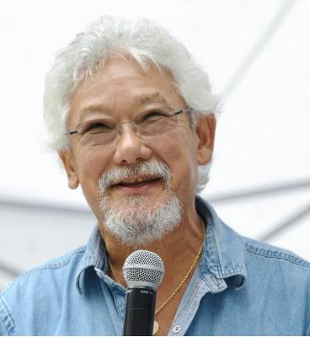
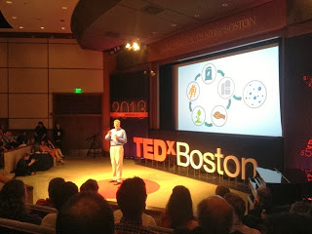
Jocelyn Doucette
604-220-7734
jdoucette@harvestpower.com
Join The Conversation
www.harvestpower.com
Follow us @harvestpower
Like us
Watch our station

