Slide 1

FOOD ISN’T GARBAGE
Metro Vancouver’s Organics Disposal Ban
WMABC 4th Annual Conference / AGM
January 29, 2015
Notes:
1

Slide 2
OUTLINE
Background
Organics Ban Details
Business Resources

Slide 3

METRO VANCOUVER
21 municipalities, one Treaty First Nation, one Electoral Area
Notes:
Metro Vancouver Overview
Federation of 23 local governments, including 1 Treaty FN, 1 Electoral Area
40 Directors appointed by municipal councils
Roles overview – regional utilities function, other non-mandated responsibilities (housing, air quality, parks, EComm, etc.)
Governance overview – consensus based decision making, unique role whereby Directors are expected to adopt a regional perspective when considering Metro Vancouver issues
Political leadership – “convener” role

Slide 4
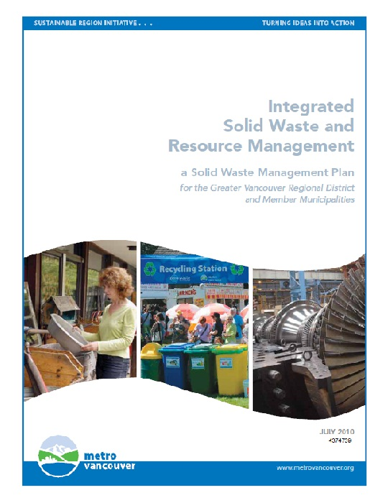
INTEGRATED SOLID WASTE & RESOURCE MANAGEMENT PLAN
70% diversion by 2015
80% diversion by 2020
10 % per capita waste reduction
2013: 60% diversion

Slide 5
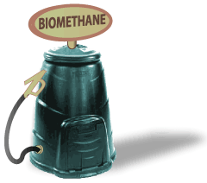
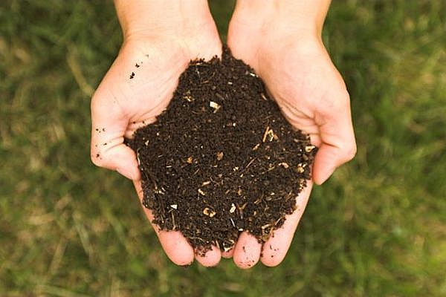
KEEPING FOOD OUT OF OUR GARBAGE
36% of regional garbage in 2013 was compostable organics
Recycling organics takes us closer to 80% and:
  Creates compost
  Can create biogas
  Prevents landfill methane
Notes:
2 components:
1. Ban organics from garbage going to regional disposal facilities
Bans are a key regulatory tool we have to promote recycling. Without waste coming to regional facilities for disposal, Metro Vancouver cannot enforce these bans
It’s an important signal to the region to raise awareness and enable others to push for a change to organics recycling
2. Focused communications and engagement initiatives
Metro Vancouver has been asked by municipalities, business and community organizations to take a leadership role in communicating consistent messages across the region and providing standard toolkits and resources that other can implement in their own organizations
To avoid duplication of resources and to increase consistency in messaging

Slide 6
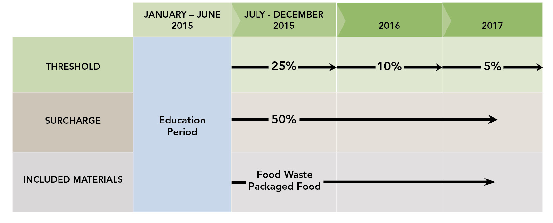
IMPLEMENTATION DETAILS
Notes:
Looked at 4 options, considered feedback from consultation
Researched best practices in other jurisdictions
Reflected on our own successes and challenges implementing past bans
Phased implementation – details in Tipping Fee Bylaw
3 ban elements - Kept 2/3 elements of the ban consistent throughout the implementation to simplify transition
Education periods for the first 6 months of 2015, 16 then 17
Declining threshold over the period - Start with highest generators first
Only those without a recycling system in place would be affected by the surcharge
Surcharge 50% - same as other bans today
Included materials – does not include food soiled paper – consultation input told us to wait until processors could accept all papers

Slide 7
EDUCATION
Email updates to member municipalities and stakeholder databases – December 2014
Media Release – December 15, 2014
Average 20-25 calls/emails per day
  Residential Property Managers (majority)
  Residents
  Businesses
  Media
Notes:
*Average calls/day include the MV Info Centre AND RCBC Hotline. (majority of calls go to RCBC)
Calls from:
Residential property managers – looking for resources to get started on a program
Residents – often residents from Maple Ridge who do not have curbside collection, wondering where to take their organics. Also residents in MF buildings that do not have foodscraps programs
Businesses: Inquiries about cost, and ban phasing. Wondering if the ban applies to their business. Questions about haulers.
Media – interview requests

Slide 8
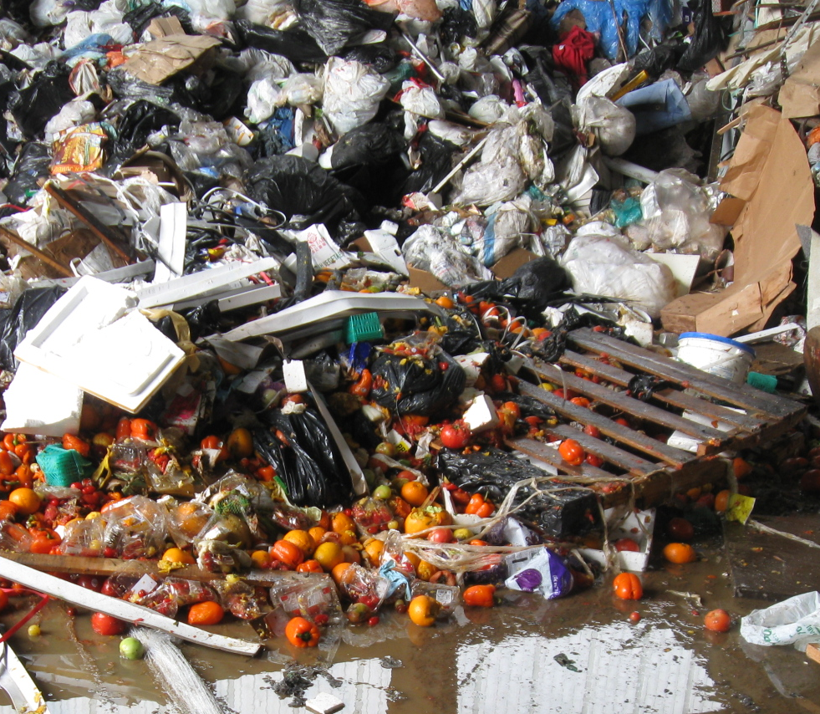
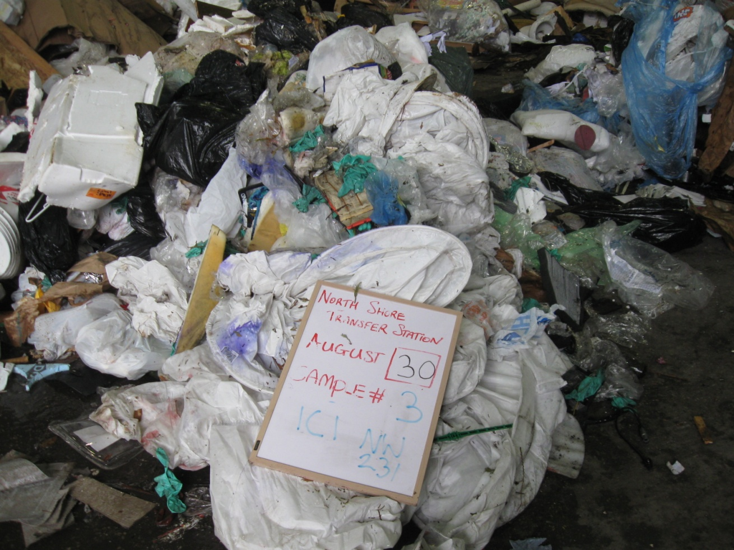
ENFORCEMENT
Bans enforced at disposal facilities
Inspection for visible organics by volume
Surcharge added to tipping fee paid by haulers
>25%
<5%
Notes:
Upper photo: 25% visible organics – 50% organics by weight. Less than 5% of all loads fall in this category.
Lower photo: 5% visible organics – 30% organics by weight.

Slide 9
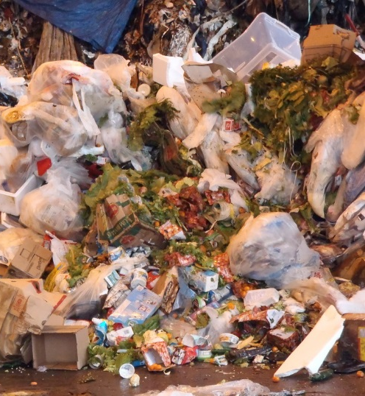
ENFORCEMENT
First week of January 2015:
3 educational notices issued for loads exceeding 25% food waste
Jan 17-23, 2015
6 educational notices issued
Notes:
3 warnings for food were ALL commercial customers
Photo of load full of food scraps - taken January 12th at Coquitlam Transfer Station

Slide 10
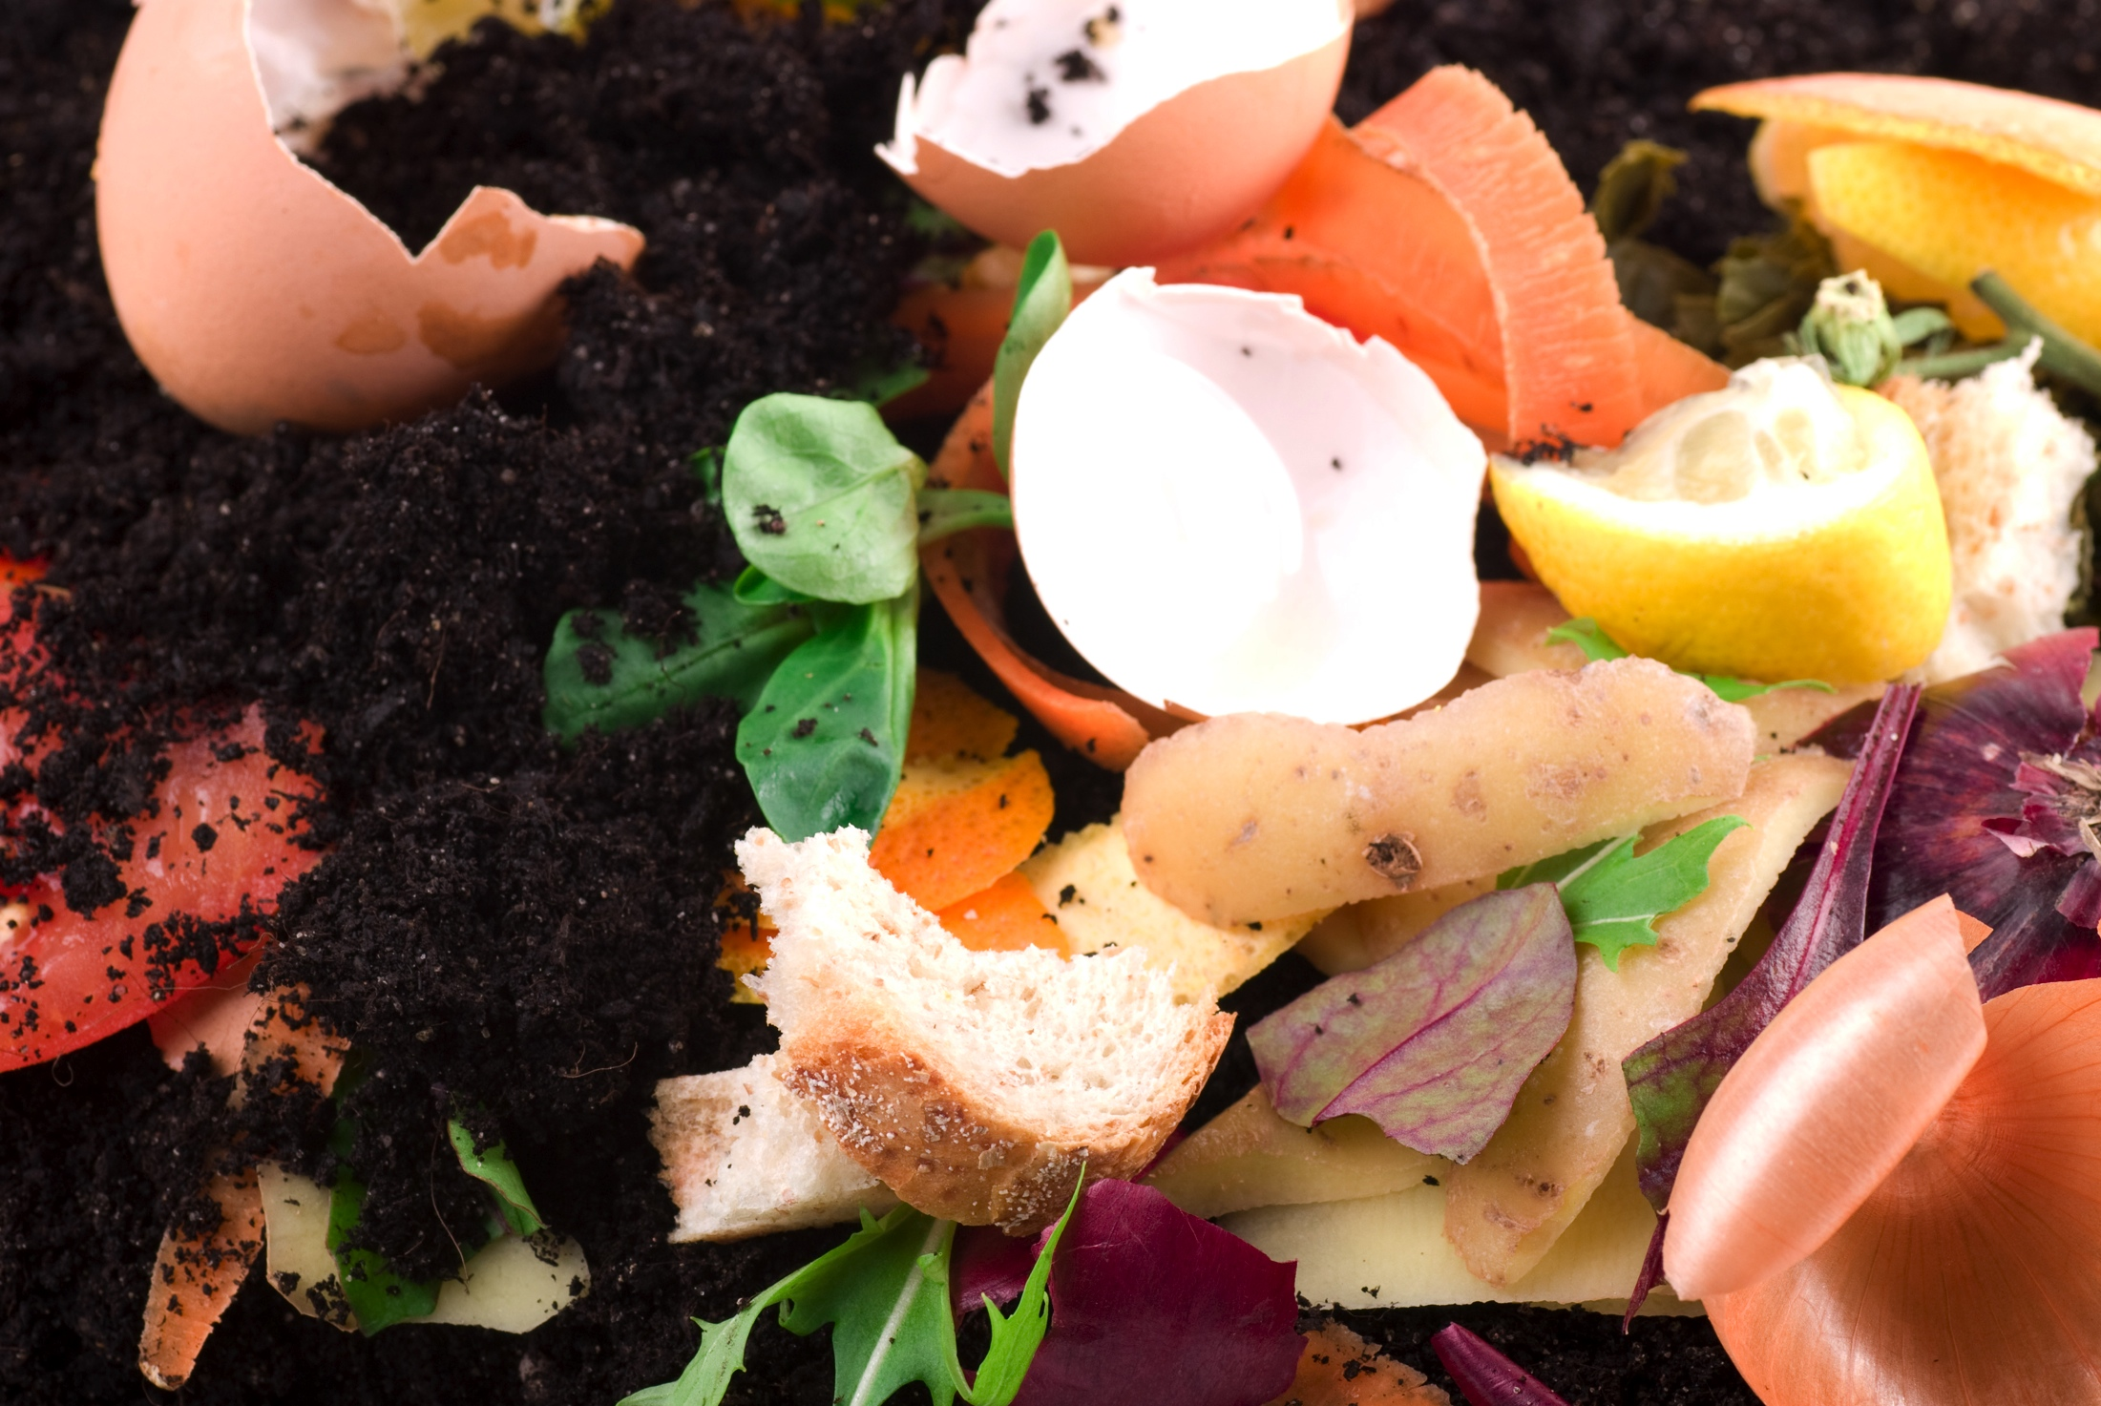
BUSINESS RESOURCES
Notes:
Ban Implementation and Transition – Options

Slide 11

ORGANICS RECYCLING OUTREACH
Regional ad campaign in partnership with member municipalities
ICI ad campaign
Standardize communications
Toolkits and guides
Convene stakeholders
FOOD ISN’T GARBAGE

Slide 12

Notes:
You can all use and rebrand this ad campaign – files are all available on our website
Our campaign consists of funny, personified food items, because they’re cute and fun, it works that they’re directing us to recycle them.
Direct URL to the overall page on organics recycling & our logo.
In all the executions you’re going to see, the text is identical.
Food isn’t garbage. Food scraps belong in your green bin.

Slide 13
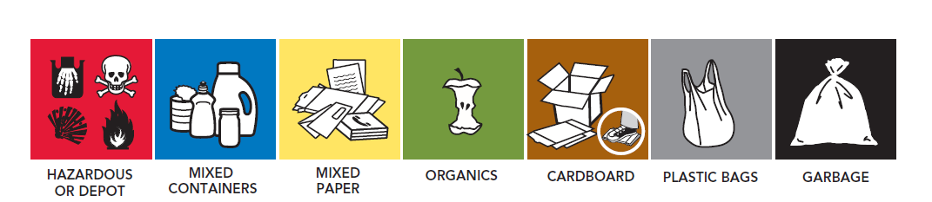
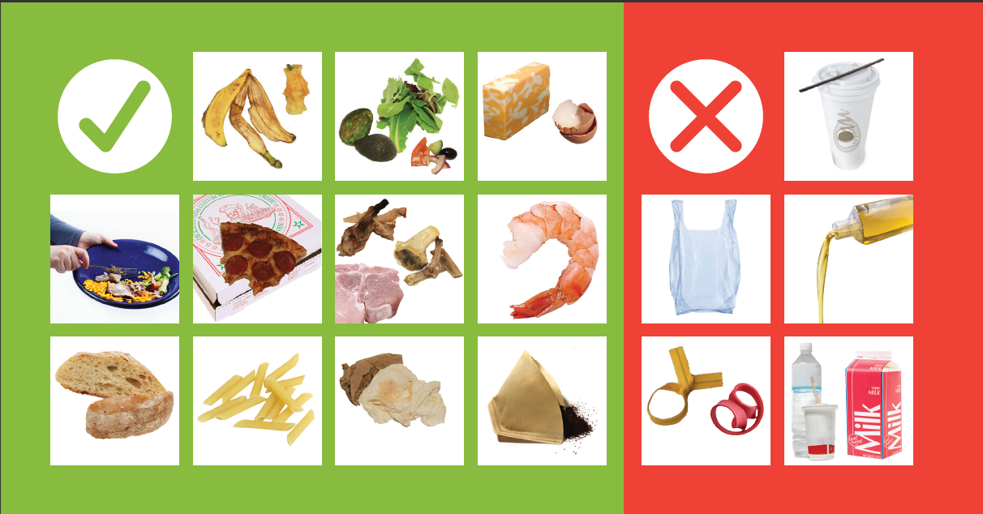

STANDARDIZED SIGNAGE
Notes:
You can all use and rebrand all MV signage – files are all available on our website
Engagement process identified a demand for more consistent recycling images and colour schemes across the region.
Businesses, school districts, institutions operate across municipal boundaries, and asked what can be done to encourage consistency.
We wouldn’t regulate this, but when we set up focus groups to get feedback and a sense of what direction the colours and imagery were taking from the cities, and myriad people and zero waste offices we created a set of tools:
colours, icons, stickers for kitchen catchers, banned material stickers for commercial bins that were refined from the input, and are now used.
When people see consistent directions, they follow them better.

Slide 14
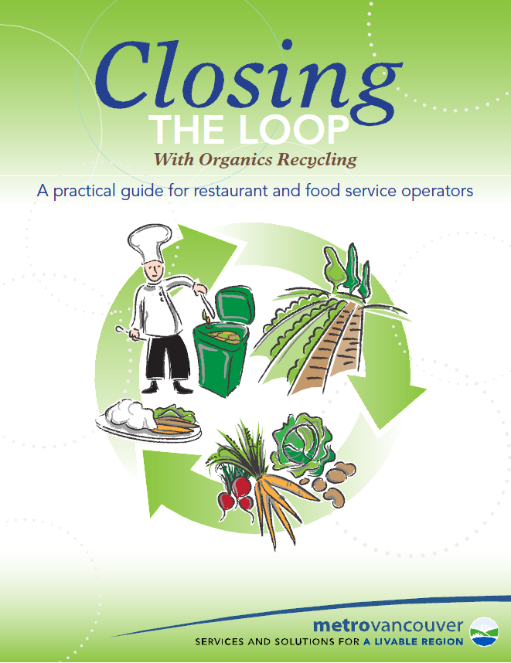
TOOLKITS AND RESOURCES
Organics Recycling Guides (restaurants, multi-family, property managers)
On-site Organics Management Options
Food Donation Guidelines
Business Case Studies
Videos
RCBC Hotline
Notes:
Along with consistent colours and icons we are also developing or have developed a series of
Toolkits, best practice guides and case studies.
Two Examples:
Food donation guidelines – we estimate about 13000 tonnes of healthy edible food is thrown out annually. Working with the BC CDC and CFIA to develop new guidelines for donors and recipients that make donating healthy food easier.
BIAs met with us regularly, many small businesses are members, and they have a role to provide information and support to their members in meeting regulations. Capturing experiences, making presentations, providing information for newsletters
For many of these resources, both municipal staff and the audience for the guides have provided content, contacts, reviews, top tips. The idea being Metro produces them and many others will use on their audiences, so that information and messages are consistent no matter the source.
Businesses asked about onsite technologies to either avoid hauling off site or benefit from producing compost material on site, and Metro reviewed the technologies available.
Small business questions are different from larger businesses. We’re putting in place case studies of regular restaurants, grocers and bakeries across the region.
Engagement identified a need for videos from a 90second clip that can be shown in a business doorway between customer, to capturing the basics on how to set up a kitchen. Metro is producing the videos once to that waste service providers, BIAs, managers of institutions and more can shoe them to their staff over and over.
Recycling Council of BC has stepped in to include Organics Recycling in the Hotline Services. This gives cities a resource when businesses call into their information centres asking what they need to do when or why.
From these we can demonstrate as examples :
How are other small businesses like mine doing this?
How are schools making change, and what tips do schools that are already recycling organics have to share with others getting started?
How are Business Improvement Areas supporting their members in preparing? What are the common challenges and how are the leaders meeting them?
14

Slide 15
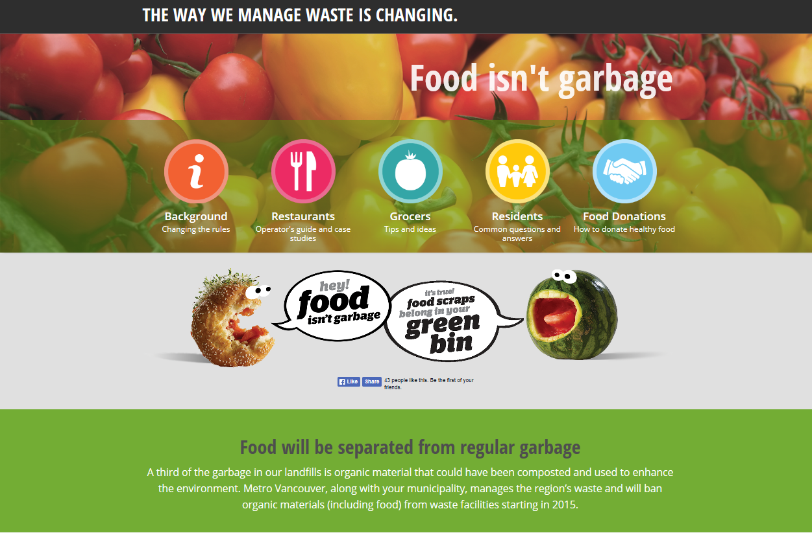
Social media
ONLINE
Notes:
Metrovancouver.org/foodscraps landing page.
Sector specific resources and this (restaurants & grocers) can be found when clicking the relevant button.
Under the residents button, tools, resources, artwork and links to each municipalities’ green bin program.
Facebook Like & share buttons directly in the middle of the page.

Slide 16

Next Steps
NEED MORE INFORMATION?
E-mail icentre@metrovancouver.org
Visit www.metrovancouver.org/foodscraps
Call 604 RECYCLE
Notes:
16

Slide 17
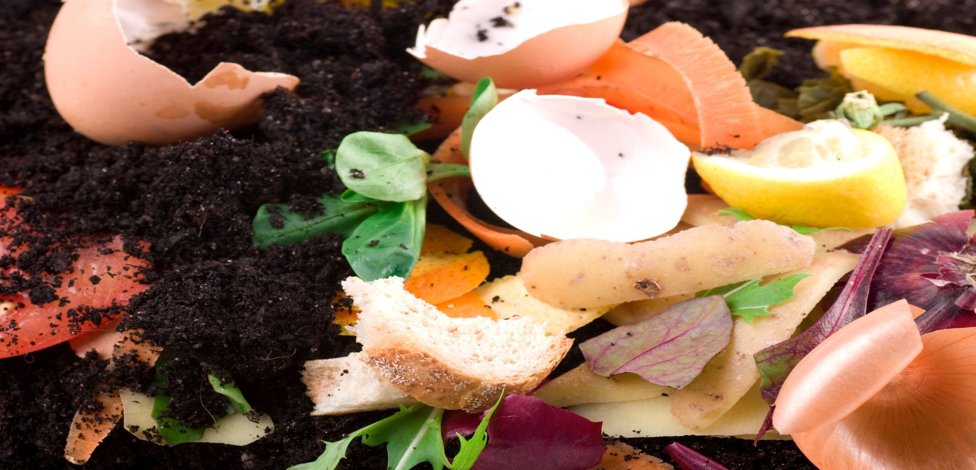

QUESTIONS?

