Slide 1
WMABC AGM
Charlie Ker
Cummins Westport
January 2015

Slide 2
Agenda
Cummins Westport Overview
Company Profile and Technology
ISL G
ISX12 G
OEM Availability
Fuel Systems, Fuel Economy and Gearing
Natural Gas Playbook and Training

Slide 3
Cummins Westport Inc. (CWI)
A Joint Venture of Westport & Cummins
Cummins Inc.
Westport Innovations Inc.
Cummins Inc.
50%
50%
“CWI”
Cummins Westport Inc.
Established in 2001
6-12 litre on highway natural gas engines
Over 50,000 engines delivered.
New 10 year Agreement 2012

Slide 4
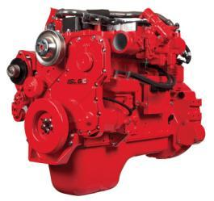
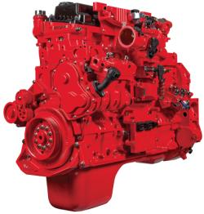




2014/16 Cummins Westport Products.
2016
6.7 Litre
Spark Ignited SEGR Three Way Catalyst
8.9 Litre
Spark Ignited SEGR Three Way Catalyst Up to 60,000 miles/year 66,000 lb. GVW
11.9 Litre
Spark Ignited SEGR Three Way Catalyst Up to 80,000 lb. GVW
All engines
Notes:
The ISB6.7 G began field tests in 2014 with production scheduled to begin in 2016.

Slide 5
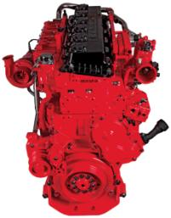
CWI – Technology Strategy
Cooled Exhaust Gas Recirculation (CEGR)
Stoichiometric Combustion
Spark Ignition
Three Way Catalyst (TWC)
Cummins
Cummins Westport
Cummins Westport
Cummins
Emission Solutions
Notes:
Cummins mid range recipe for 2007 is Cooled EGR, Variable Geometry Turbo, and a Diesel Particulate Filter.

Slide 6
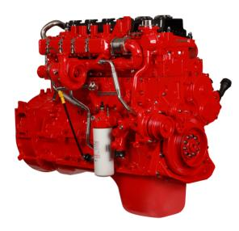
What is Stoichiometric Combustion?
Ideal combustion process where fuel is burned completely
  Ideal air/fuel ratio - chemically correct mixing of fuel and air
  Consumes all fuel & air without excess of either in exhaust
  No Oxygen in exhaust stream allows Three Way Catalyst to handle NOx control
Benefits:
  Increased power density
  Increased thermal efficiency
  Decreased emissions
Notes:
Stoichiometric combustion is also known as complete combustion because fuel and air are combined in a ration that ensures that the fuel is burned completely and there is nothing left over after the combustion process.
Benefits
Increased power density
Torque curves are virtually the same as diesel
Diesel-like transient response/performance
More torque at idle (over 30%)
Increased thermal efficiency
5% fuel economy improvement vs. lean-burn natural gas engines
Lower methane emissions (GHG benefit)
Decreased emissions
Achieved EPA 2010 emissions requirements in 2007
Simple, passive, maintenance-free aftertreatment

Slide 7
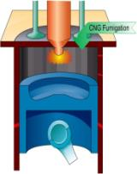
CWI Combustion Technology
Spark Ignited Stoichiometric with Cooled EGR
Stoichiometric EGR
Three Way Catalyst
Architecture
Spark Plug
Three Way
Catalyst
Spark Ignited
EGR Cooler
Fuel, EGR and air are premixed outside the cylinder
Spark plug ignites the mixture
Air flow controls fuel flow
Air/Fuel ratio controls emissions
Charge Air Cooler
Fuel
Throttle

Slide 8
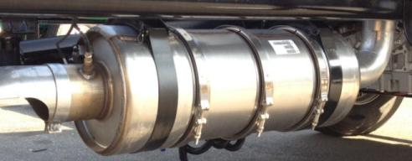
Three Way Catalyst Aftertreatment
Similar to catalyst on gasoline passenger cars.
Packaged as a muffler. Vertical or horizontal mount.
Easy to install
Weighs ~100 pounds
Passive device
  No Regeneration
  No SCR
  No Maintenance
O₂ Sensor

Slide 9
What is Different Between Natural Gas and Diesel Engines?
 | Natural Gas Engine | Diesel Engine
Base Engine is the Same | 4 cycle, in line 6 cylinder, turbocharged, CAC | 4 cycle, in line 6 cylinder, turbocharged, CAC
Turbo Charger | Wastegate | Variable Geometry
Cylinder Head | 2 Valve – ISL G 4 Valve – ISX12 G | 4 Valve
Ignition | Spark Ignition (spark plugs) | Compression Ignition
Fuel System | Intake Manifold | Common Rail
Aftertreatment | Three way catalyst | Particulate Filter + SCR
Compression Ratio | 12:1 | 16.6:1
Maintenance Cost | Cost of maintenance related to ignition and overhead valve adjustments adds incremental maintenance costs.
Lubricating Oil | Natural gas engines require a specific oil that meets Cummins specification CES 20074
Noise | Natural gas engines are up to 10db quieter at idle
Notes:
This slide highlights the differences between diesel and
natural gas engines.
There are components on the ISL G (spark ignition, 2 valve head etc) that add some incremental maintenance costs to natural gas operations, however these costs are typically offset by the overall savings in fuel costs with natural gas.
It is important to note that a specific natural gas oil that meets Cummins Spec CES20074 be used in the ISL G.
The ISL G is very quiet, 10db at idle is significant, For example one diesel at idle is the same as 10 ISL G’s at idle!

Slide 10
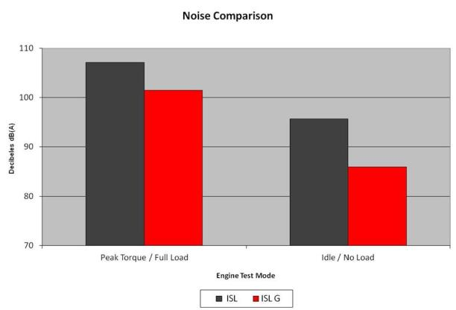
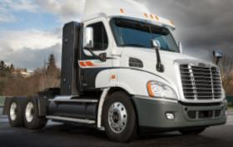
Reduced Noise
*
Spark ignition provides quiet operation
Communities notice the natural gas noise advantage.
ONE Diesel engine idling is louder than TEN natural gas engines idling together
ISL G is 5.5 decibels quieter at peak torque and load
ISL G is 9.9 decibels quieter at Idle/no load
* ISX12 G Noise Data TBA

Slide 11
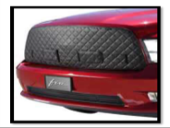
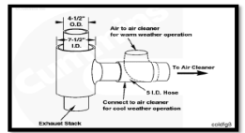
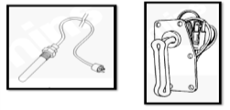
Cold Weather Operation
Guidelines are published in ISL G/ISX12 G CM2180 owners manual and operation and maintenance manuals
Refer to Customer Service Bulletin 4332709 – Operation of Natural Gas Engines in Cold Climates.
AEB 174.04 Provides further guidelines for Cold Weather Engine operation for All Automotive and Industrial Engines.
Cummins Technical Service Bulletin TSB140013
  ISL G and ISX12 G: Fault Codes While Operating in Temperatures Below Freezing 0°C [32°F]
Winter Fronts
Warm Underhood Intake Air
Oil & Coolant Heaters

Slide 12

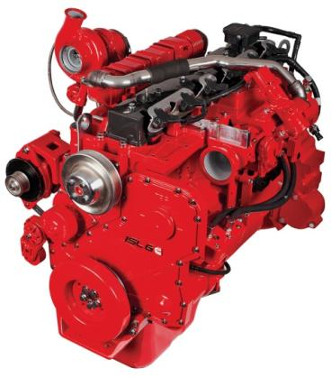

Slide 13
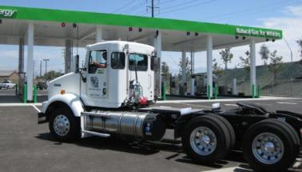


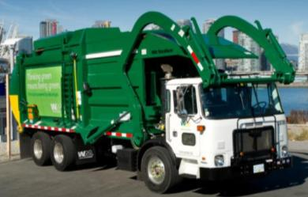
Cummins Westport Historical Success:
Urban Return-to-Base Fleets

Slide 14
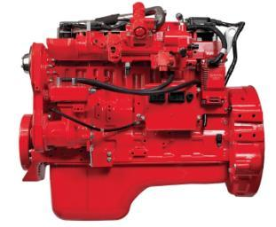

ISL G Product Timeline
2007
2008
2009
2010
2011
2012
2014
  First Heavy Duty Engine Certified 2010 EPA and CARB
# 1 natural gas engine in transit
#1 natural gas engine in Refuse
#1 natural gas engine
in Conventional Truck
10,000th ISL G produced at RMEP
Over 28,000 engines in service
Notes:
28,000 engines produced as of Aug 2014

Slide 15
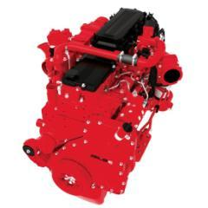
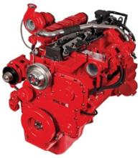
What is the Same Between ISL9 & ISL G?
Major Engine Components & Technology
  Block, crankshaft, main bearing, connecting rods etc.
  Over 80% parts commonality
Parts, Service, Training, Warranty
  Cummins Distributor Network
320, 300, 280, 260 and 250 HP rating
Compatible w/ Cummins Diagnostic Tools
  Insite
  QuickServe Online
Notes:
This slide highlights what is shared as common between the ISL9 diesel and ISL G natural gas engines

Slide 16
ISL G Technical Specifications
Advertised Horsepower | 250 - 320 hp
Peak Torque | 660 - 1000 lb-ft
Governed Speed | 2200 rpm
Clutch Engagement Torque | 550 lb-ft
Number of Cylinders | 6
Oil System Capacity | 7.3 U.S. gallons
Engine Weight (Dry) | 1,625 lb
Aftertreatment | Three way catalyst
Fuel Type | CNG / LNG / Biomethane (methane number 75 or greater)

Slide 17
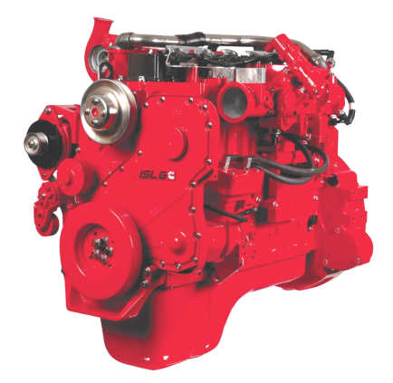
2013 Production Improvements
Low Pressure Regulator
- New Diaphragm
- New Spring
Turbocharger
- New Wastegate bushing
Exhaust System
- New 3 Piece Manifold
- New 2 Piece Manifold
Coil
- Manufacturing change to coil bracket
Thermostat
- New Thermostat
Ignition Control Module
- New ICD 4 module
Water Pump
- New Impellor
Calibration
- O2 sensor startup delay
- FCV max current increase
- EMD+ Requirements

Slide 18
2014 Production Improvements
Exhaust System
- 6 Ply Inconel Gasket
Humidity Sensor
EGR Cooler
Turbine Inlet Temp Sensor
Calibration
- O2 Sensor Improvements
- FCV Idle Improvements
- Exhaust Temp Control
Knock Detection (3 Tier)
Combustion Stability
Oil Pressure Sensor

Slide 19
ISL G: Performance Similar to diesel
 | ISL9 |  | ISL G
Engine Displacement | 540 CU. IN. | 8.9 LITRES | 540 CU. IN. | 8.9 LITRES
Horsepower | 260-380 HP | 194-283 kW | 250-320 HP | 186-239 kW
Peak Torque | 720-1250 lb-ft | 976-1695 N-m | 660-1000 lb-ft | 895-1356 N-m
Torque at Idle | 550 lb-ft | 949 N-m | 550 lb-ft | 949 N-m
Aftertreatment | DPF + SCR |  | Three Way Catalyst
Engine Brake Performance | Optional 270 HP @ 2100 RPM |  | NA

Slide 20
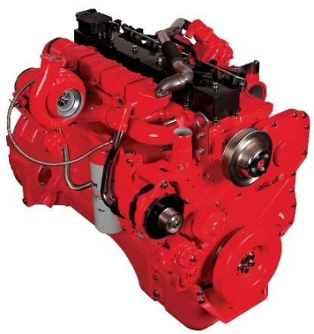
The Right Applications
ISL G
  MidRange Engine
  Pickup and Delivery Truck
  Vocational
  Transit Bus
  Up to *66,000 lbs GVW
  Less than 60,000 miles
  per year
  *Refuse Packer ,Crane / Cherry Pickers, Concrete Ready Mixer allow up to 80,000 GVW
Notes:
The ISL G is designed as a MidRange Engine. The main applications that make sense for the ISL G are Pickup and Delivery Truck, and Vocational applications. The ISL G is limited to 66,000 lbs GVW with the only exceptions being for Refuse Packers, Crane and Cherry Pickers, or a Concrete Ready Mixer. Refuse Packers, Crane and Cherry Pickers, and Concrete Ready Mixers allow up to 80,000 lbs GVW.
Applications that use an ISL G are limited to 60,000 miles per year. For all applications that would exceed 60,000 miles / year, an ISX12 G is recommended.

Slide 21
ISL G Warranty & Extended Coverage
2 Year / 250,000 Mile Base Warranty
Extended Coverage options are available
  3 to 7 yr, 100,000 to 300,000 mile – Protection Plan 2 - Truck
  3 to 5 yr, 100,000 to 300,000 mile – Protection Plan 1 – Truck
  5 yr, 200,000 to 300,000 mile - Transit
All extended coverage programs are available from Cummins Distributors

Slide 22

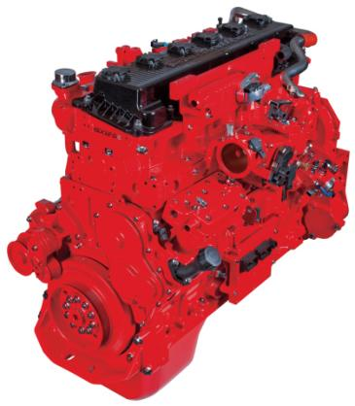

Slide 23

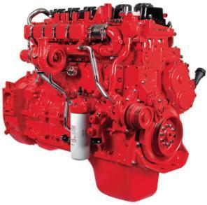


Natural Gas Engine
Key Product Attributes
  4 cycle, spark ignited, in-line 6 cylinder, turbocharged, CAC
  11.9 litres (726.2 cu in)
  Peak rating: 400 hp, 1450 lb-ft
  2013 EPA/CARB certified
  Meets 2014 EPA GHG requirements
  Dedicated 100% natural gas engine
  Three Way Catalyst after-treatment
  Engine braking
  Manual/Automatic Transmission capable
    AMT 2014

Slide 24




The Right Applications
ISX12 G
  Heavy Duty Engine
  400 hp / 1,450 lb ft
  Tractor Configurations
    Line Haul, Regional P&D, Local Delivery
  Vocational
  Refuse (cab over and roll off)
  Up to 80,000 lb GVW
  Any application over 60,000 miles per year

Slide 25
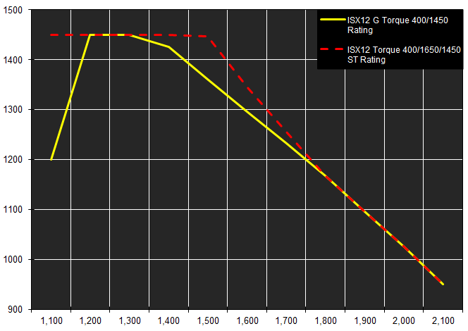
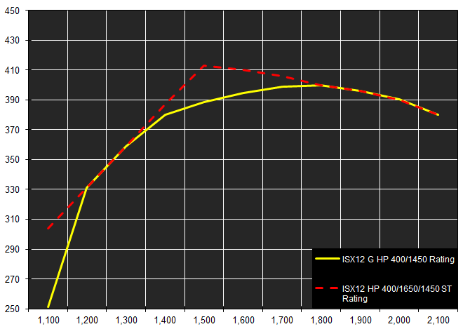
ISX12 G: Performance Similar to diesel
 | ISX12 |  | ISX12 G
Engine Displacement | 726.2 CU IN | 11.9 LITRES | 726.2 CU IN | 11.9 LITRES
Horsepower | 310-425 HP | 231-317 kW | 320-400 HP | 239-298 kW
Peak Torque | 1150-1650 lb-ft | 1559-2237 N-m | 1150-1450 lb-ft | 1559-1966 N-m
Torque at Idle | 800 lb-ft | 1085 N-m | 700 lb-ft | 949 N-m
Aftertreatment | DPF + SCR |  | Three Way Catalyst
Engine Brake Performance | Optional 380 HP @ 2100 RPM |  | Optional 240 HP @ 2100 RPM
Lb-ft
Horsepower
RPM
Diesel ISX12 400 ST curve is the low curve for this rating

Slide 26
ISX12 G Warranty
Automotive Base warranty for Cummins Westport natural gas engines is same as Cummins diesel base platform
2 Year / 250,000 Mile Warranty
  100% parts and labor on warrantable failures*
  Travel or towing when an engine is disabled by a warrantable failure
  Consumables not reusable due to covered failure
  Limited progressive damage, including aftertreatment
Protection Plan 1 and 2 Extended Coverage options available.
  Up to 5 years, 500,000 miles
Notes:
Extended Coverage are published and available on CIRCUIT.
*Warrantable failures are those due to defects in Cummins material or factory workmanship.

Slide 27
OEM Availability

Slide 28





ISL G Refuse Availability
LOW CAB FORWARD / REFUSE
OEM | AutoCar | Mack | Peterbilt | ALF | Crane Carrier
Model | Xpeditor | TerraPro LE Terra Pro CO | 320 | Condor | LET
Engine | ISLG 300/320 | ISLG 320 | ISL G 320 | ISL G 320 | ISLG 320

Slide 29



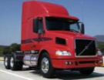

ISL G Availability – Conventional Trucks
OEM | Freightliner | Peterbilt | Kenworth | Volvo | Navistar
Model | M2 – 112 SD - 114 | 320 384 365 | T800SH W900S T440 T470 | VNM | TranStar 2012
Engine | ISLG 320 ISL G 300 | ISL G 320 | ISLG 320 | ISL G 320 | ISL G 320
Application | 6x4 Tractor 4x2 Tractor 4x2 Truck 6x2 Truck Vocational | Tractor Vocational Mixer | Tractor Vocational Mixer | Tractor | Tractor

Slide 30
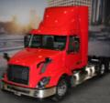
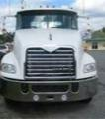




ISX12 G Availability
OEM | Freightliner | Peterbilt | Kenworth | Volvo | Mack | Autocar
Model | Cascadia Day Cab, Sleeper * 114SD** | 320 384 365 579 * 567* | W900S T660 T800 SH T680 * | VNL | Pinnacle | Xpeditor
Engine | ISX12 G | ISX12 G | ISX12 G | ISX12 G | ISX12 G | ISX12 G
Application | Tractor | Refuse Tractor Vocational | Tractor Vocational | Tractor | Tractor Vocational | Refuse
*New chassis for 2014
** New chassis for 2015

Slide 31
Fuel Systems, Fuel Economy and Gearing

Slide 32
Fuel and Fuel Systems
Cummins Westport natural gas engines fuel requirements enable the use of both CNG or LNG.
Customers may choose CNG or LNG depending on duty cycle, application, and/or fuel availability.
Natural gas fuel (CNG or LNG) must meet fuel quality requirements per AEB 79.05 (CES14624)
Regardless of how the fuel is stored on the vehicle, the at engine fuel inlet pressure at rated conditions requirement is the same
  ISL G - minimum 70 psi, maximum 150 psi
  ISX12 G – minimum 60 psi, maximum 150 psi

Slide 33

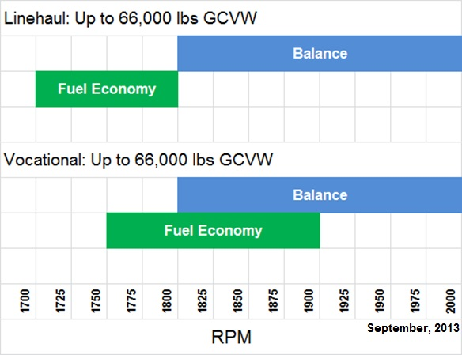
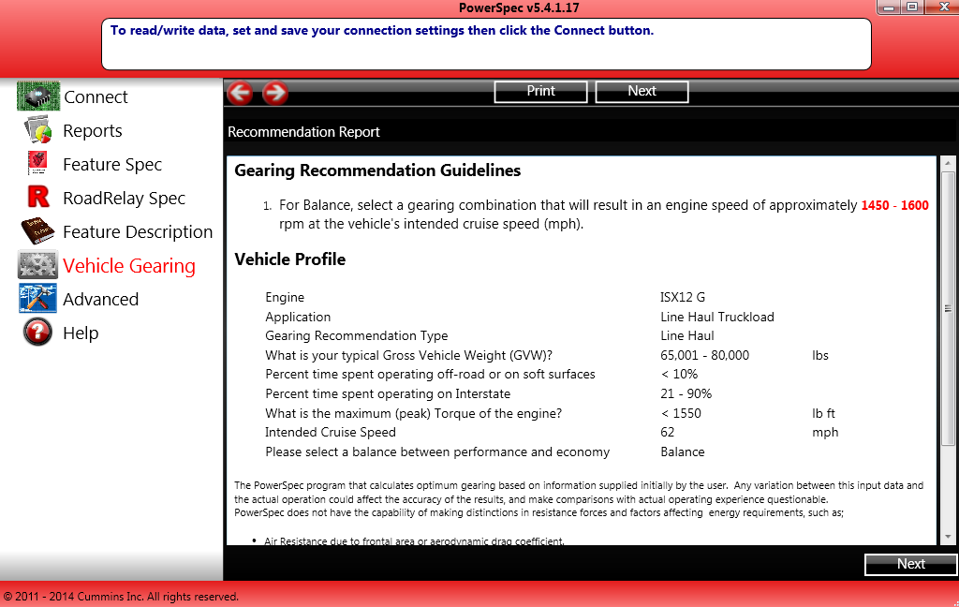
2014 Gearing Recommendations
250-320 HP
RPM at desired cruise speed
1800-2000 rpm
1700-1800 rpm
For gearing recommendations use Free Cummins PowerSpec tool with ISL G and ISX12 G (version 5.4.1) available at Powerspec.cummins.com
1800-2000 rpm
1750-1900 rpm
Notes:
Natural Gas engines are designed to deliver a balance of Fuel Economy and Performance. For those looking for fuel economy, the cruise RPM range can be dialed down to the lower ends of the fuel economy range, bearing in mind that performance trade-offs exist.
The ISL G has gearing recommendations from 1700-1800 RPM for linehaul applications or 1750-1900 for vocational applications with a fuel economy goal. For a balance of fuel economy and performance choose a gearing combination that results in 1800-2000 rpm at desired cruising speed.
The ISL G can be selected for trucks that will be operating up to 66,000 lbs GCVW. Anything operating above 66,000 lbs GCVW should spec an ISX12 G.

Slide 34
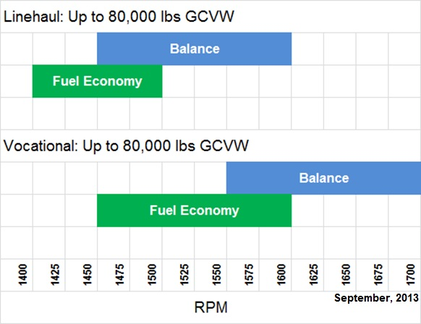
2014 Gearing Recommendations
RPM at desired cruise speed
1450-1600 rpm
1400-1500 rpm
For gearing recommendations use Free Cummins PowerSpec tool with ISL G and ISX12 G (version 5.4.1) available at Powerspec.cummins.com
1550-1700 rpm
1450-1600 rpm
Notes:
The ISX12 G performs like a heavy-duty engine. The ISX12 G allows for customers to haul a gross combined vehicle weight of up to 80,000 lbs.
Linehaul gearing recommendations are for 1400-1500 rpm for fuel economy and 1450-1600 rpm for balance and performance. A 1450 rpm target rpm at cruise is recommended for specification purposes.
Like the majority of the engines, vocational gearing requires more power to meet the customers expectations. The ISX12 G’s gearing recommendations for vocational applications are 1450-1600 RPMs for fuel economy and 1550-1700 rpms for balance.

Slide 35
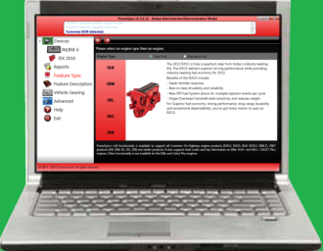
Powerspec 5.4
Software Application
  Gearing calculator
  Electronic features- settings and descriptions
  Customized engine ‘specs’
  “Easy Spec” available for fleets
  Collects valuable trip information
  Reporting feature
For more information or to download PowerSpec, visit:
Download PowerSpec 5.4:
http://www.powerspec.cummins.com
Notes:
Powerspec version 5.4 is available online at www.powerspec.cummins.com

Slide 36
Maintenance Keys to Success
Follow Cummins maintenance intervals and procedures outlined in QuickServe On Line or in Operation and Maintenance manuals
Use Cummins Authorized parts
Set oil drain / service intervals based on average fleet speed
Use only natural gas engine oil per Cummins Specification (CES 200074)
Check air intake every 250 hours, and use only OEM approved air filters
Check/drain natural gas fuel filter daily
Visually check coolant recovery tank level daily.

Slide 37
Maintenance Intervals
ISX12 G Truck | Hours | Miles | Kilometers | Months
Spin-on Fuel Filter | Daily Check
Oil & Filter* | 500 | 25,000 | 40,000 | 6
Coolant Filter* | 1,500 | 75,000 | 120,000 | 12
Spin-on Fuel Filter* | 1,000 | 50,000 | 80,000 | 9
Spark Plugs* | 1,500 | 75,000 | 120,000 | 12
Overhead Adjustment* | 1,500 | 75,000 | 120,000 | 12
Engine Brake (Adjust) | 6,000 | 300,000 | 480,000 | 24
Standard Coolant | 6,000 | 300,000 | 480,000 | 24
Air Cleaner/Element | Follow vehicle manufacturers published recommendations
500 hour Service Intervals are similar to Diesel
ISL G Truck | Hours | Miles | Kilometers | Months
Check CAC cooler, piping and Air Cleaner | 250 | 7500 | 12,000 | 3
Oil & Filter* | 500 | 15,000 | 24,000 | 6
Coolant Filter** | None¹ | None¹ | None¹ | None¹
Spin-on Fuel Filter | 1,000 | 30,000 | 48,000 | 12
Spark Plugs | 1,500 | 45,000 | 72,000 | 18
Standard Coolant | 2,000 | 60,000 | 96,000 | 24
Overhead Adjustment*** | 2,000 | 60,000 | 96,000 | 24
Air Cleaner/Element | Follow vehicle manufacturers published recommendations
Distance reduced with lower average speed
Default interval is the hours stated. Interval is whichever comes first – hours, miles or time.
Use CES20074 engine oil
Refer to Owners Manual or QSOL for complete details on Maintenance Intervals.

Slide 38
Natural Gas Playbook and Training

Slide 39
The Cummins Westport Natural Gas Playbook
Resource toolkit available from Cummins / Cummins Westport to help customers through the natural gas adoption process
Address questions and concerns about purchasing and operating natural gas engines/vehicles
Prepare for successful operation of CWI powered vehicles
Step 1 – Assess
Step 2 - Specify
Step 4 - Implement
Step 5 - Operate
Step 3 - Prepare
CWI Natural Gas Playbook

Slide 40
Cummins Westport Natural Gas Playbook
Available only from Cummins, the 5 step Playbook provides information and resources for the key steps involved when implementing natural gas into a fleet.
Contact your Cummins or Cummins Westport representative for details.
1
2
3
4
5
Assess
Specify
Prepare
Implement
Operate &
Maintain
Fleet profile
OEM
Confirm fuel availability
Conduct fuel quality test
Conduct daily maintenance & inspections
Routes & loads
Chassis
Environment & terrain
Confirm service & parts availability
Conduct pilot truck test
Current fuel profile
Engine
Complete facility modifications
Confirm fuel economy & range
Monitor fuelling procedures
NG fuel availability
Transmission & gearing
Fuel price expectations
Obtain permits, licenses & approvals
Develop rollout plan
Monitor fuel consumption
Fuel type & quality
Truck delivery & PDI
Service capability
Fuelling procedure
Operations & maintenance training
Conduct driver training
Conduct scheduled maintenance & inspections
Incentives
Safety training
Regulations & codes
NG fuel system type, capacity & configuration
Conduct fuelling training
Facility requirements
Fire & emergency response plan
Conduct scheduled fuel quality inspections
Previous experience
Safety equipment
Test problem resolution processes
Define driver training process
Business case
Warranty package
Infant care support
Manage & resolve problems
Risks & mitigation
Delivery dates
Define problem resolution processes
Kick off event

Slide 41
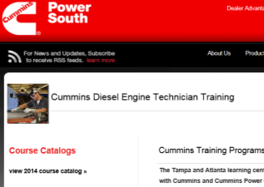

Natural Gas Service Training
Classroom service technician training is
offered by Cummins Western Canada and Cummins Eastern Canada - contact your local
Cummins Representative for schedules and locations.
Technicians already trained on the ISL G & ISX12 diesel engines, can get trained on the ISX12 G via the Cummins Virtual College online course, available via QSOL
CWI engines are compatible with Cummins Diagnostic Tools: INSITE / QSOL / PowerSpec

Slide 42
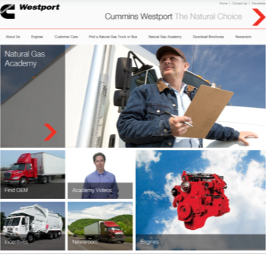
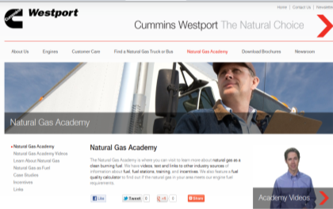
www.cumminswestport.com
Great source of information about natural gas engines and vehicles.
Features the Natural Gas Academy, a series of instructional videos
  Designed to provide a general overview of natural gas as a fuel whether it is compressed (CNG) or liquefied (LNG), and how it is used with vehicles.
  ISX12 G and ISL G engine walk around videos

Slide 43
Thank You!
Charlie Ker
Office 604.718.1902
charles.ker@cummins.com

