Slide 1
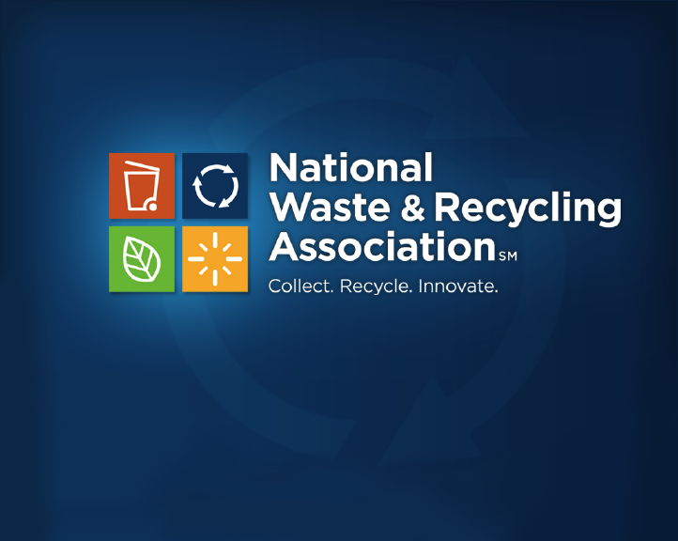
WASTE MANAGEMENT ASSOCIATION OF BRITISH COLUMBIA CH-CH-CH-CHANGES!
January 19, 2017
Notes:
TED TALK CHAZ CHAT

Slide 2
IT’S ALL ABOUT CHANGE
Politics of waste
Our raw material & How we manage it
What is on the horizon?
Notes:
I WAS ASKED TO TALK ABOUT THE OUTLOOK FOR OUR INDUSTRY IN 2017 (AND BEYOND)
THE FUTURE OF WASTE MANAGEMENT & RECYCLING UNDER THE NEW ADMINISTRATION IN THE STATES
WHAT’S HAPPENING TO OUR RAW MATERIAL
& HOW WE MANAGE IT
LOOK AT TRENDS IN OUR INDUSTRY
THE POLITICAL COMMENTS ARE US-CENTRIC
BUT THE OTHER TRENDS I BELIEVE APPLY, FOR THE MOST PART, ON BOTH SIDES OF THE BORDER
BUT FIRST A CAVEAT ABOUT MY PREDICTIVE ABILITIES

Slide 3
MR. WIZARD
Notes:
ABOUT A YEAR AGO, I SAID THAT MR. TRUMP HAD AS MUCH CHANCE OF BEING ELECTED PRESIDENT AS THE CUBS HAD OF WINNING THE WORLD SERIES
SO I OFFER UP THESE PREDICTIONS W/A DOSE OF HUMILITY
BUT A BELIEF THAT WHEN IT COMES TO THE NEXT FEW YEARS OF GARBAGE & RECYCLING MY PREDICTIONS ARE ON A BETTER FOOTING

Slide 4
POLITICS OF WASTE
Federal/EPA
States
Notes:
WHAT DO I EXPECT POLITICALLY IN THE WORLD OF WASTE & RECYCLING IN THE U.S.?
LET’S START NATIONALLY

Slide 5
WASTE & RECYCLING LAWS: NATIONAL
Resource Conservation and Recovery Act (RCRA)
Barely mentions recycling
State not federal responsibility
Notes:
AT THE NATIONAL LEVEL, THE RESOURCE CONSERVATION & RECOVERY ACT IS AMERICA’S SOLID WASTE & RECYCLING LAW.
PASSED BY CONGRESS IN 1976.
SUBTITLE C HAZARDOUS WASTE REGULATORY PROGRAM
SUBTITLE D SOLID WASTE PROGRAM INCLUDING LANDFILL GUIDELINES
BARELY MENTIONS RECYCLING.
RCRA IS CLEAR THAT STATES & LOCAL GOVERNMENTS ARE RESPONSIBLE FOR SOLID WASTE & RECYCLING – NOT THE FEDERAL GOVERNMENT.
SINCE 1976 CONGRESS HAS SHOWN LITTLE INTEREST IN RECYCLING.
BUT EPA HAS SOLID WASTE RESPONSIBILITIES SO LET’S FIRST LOOK AT EPA

Slide 6
EPA
Notes:
THIS IS SCOTT PRUITT – MR. TRUMP’S NOMINEE FOR EPA ADMINISTRATOR
MR. PRUITT – WHO IS THE ATTORNEY GENERAL OF MY HOME STATE OF OKLAHOMA – IS ON RECORD AS A CLIMATE CHANGE SCEPTIC
HE SETS THE TONE & IS THE PUBLIC FACE OF THE AGENCY
BUT THE DEPUTY ADMINISTRATOR, THE ASSISTANT ADMINISTRATORS & THE REGIONAL ADMINISTRATORS REALLY RUN EPA.
REMEMBER THAT ONE BIG DIFFERENCE B/W THE U.S. & CANADA IS THAT MOST TOP-LEVEL POSITIONS IN FEDERAL AGENCIES ARE POLITICAL APPOINTMENTS
4000 PLUS
12 EPA POSITIONS REQUIRE SENATE HEARINGS & CONFIRMATION
THIS INCLUDES THE ADMINISTRATOR, THE DEPUTY ADMINISTRATOR, THE ASSISTANT ADMINISTRATORS FOR EACH “OFFICE” SUCH AS AIR. LAND MANAGEMENT & A FEW OTHERS
24 ADDITIONAL EPA APPOINTMENTS ARE “SCHEDULE C” POLITICAL APPOINTMENTS
ANOTHER 150 ARE “NON CAREER” POLITICAL APPOINTMENTS (REGIONAL ADMINISTRATORS +) OR CAREER APPOINTMENTS
TOTALS 1.2% OF 15000+ EMPLOYEES
OLEM = 1 SENATE CONFIRMATION, 1 NON-CAREER & 9 CAREER APPOINTMENTS
ONLY PRUITT ANNOUNCED – SENATE HEARING NOT SCHEDULED
This publication contains data (as of June 30, 2016) on over 9,000 Federal civil service leadership and support positions in the legislative and executive branches of the Federal Government that may be subject to noncompetitive appointment (e.g., positions such as agency heads and their immediate subordinates, policy executives and advisors, and aides who report to these officials). The duties of many such positions may involve advocacy of Administration policies and programs and the incumbents usually have a close and confidential working relationship with the agency head or other key officials. Following are the major categories of positions listed: • Executive Schedule and salary-equivalent positions paid at the rates established for levels I through V of the Executive Schedule; • Senior Executive Service (SES) ‘‘General’’ positions; • Senior Foreign Service positions; • Schedule C positions excepted from the competitive service by the President, or by the Director, Office of Personnel Management, because of the confidential or policy-determining nature of the position duties; and • Other positions at the GS–14 and above level excepted from the competitive civil service by law because of the confidential or policy-determining nature of the position duties.

Slide 7
EPA
Transition timing
McCarthy “Exit Memo”
Notes:
MOST OF THE POLITICAL APPOINTEES WILL NOT BE IN PLACE UNTIL THE SUMMER
TRANSITIONS ALWAYS SLOW
MCCARTHY EXIT MEMO BARELY MENTIONED WASTE (LANDFILL METHANE – TRASH-FREE WATERS – SUPERFUND – G7 & MATERIALS MANAGEMENT & 42% EMISSIONS)
FOCUSSED ON EPA AS PUBLIC HEALTH AGENCY &
JOB CREATION THROUGH ENVIRONMENTAL INVESTMENTS
(ACCOUNTING FOR UPS & DOWNS DUING BUSH, OBAMA, ETC) EPA BUDGET ESSENTIALLY FLAT SINCE 1981)
WHAT EPA ISSUES DOES ARE INDUSTRY CARE ABOUT?

Slide 8
EPA
Enforcement policy
Deregulation?
Climate change
Notes:
ENFORCEMENT POLICY WILL BE CRUCIAL
INDUSTRY BUILT ON REGULATION & FAIR & EQUAL ENFORCEMENT OF THE LAW
STB
DEREGULATION?
SUBTITLE D REGS NOT CONTROVERSIAL EXCEPT ENFORCEMENT OF LANDFILL METHANE
SUBTITLE C REGS NOT HIGH PRIORITY
MIGHT ATTEMPT CHANGES IN AIR & WATER REGS (CLEAN POWER, WOTUS, ETC)
WILL BE POLITICALLY CONTENTIOUS
EXPECT LAWSUITS IN PARTICULAR OVER THE FINDINGS OF FACT IN THE NEW REGULATION AS OPPOSED TO THE OLD ONE
CLIMATE CHANGE:
ANYTHING CLIMATE CHANGE RELATED WILL BE SUBJECT TO REVIEW
WILL THE WARM MODEL (WASTE REDUCTION MODEL) – WHICH CALCULATES THE GREENHOUSE GAS EMISSION IMPACT OF VARIOUS MANAGEMENT TECHNIQUES ON A VARIETY OF MATERIALS & PRODUCTS – BE KEPT?
BOTTOM LINE: SOLID WASTE & RECYCLING NOT LIKELY TO BE HIGH EPA PRIORITY
WHAT ABOUT THE HILL?

Slide 9
FEDERAL/HILL ISSUES
Infrastructure
Better roads & bridges
More C&D to manage
Free Trade
Recycling dependent on exports
Trade war?
Food waste
Uniform “best used by” labelling
Notes:
MORE IMPORTANT ACTUALLY FOR THE INDUSTRY:
INFRASTRUCTURE SPENDING COULD LEAD TO BETTER ROADS & BRIDGES: ALWAYS GOOD
MORE C&D TO MANAGE
FREE TRADE IS THE LINCHPIN OF RECYCLING
RECYCLING DEPENDENT ON EXPORTS
WILL TRUMP LAUNCH A TRADE WAR W/CHINA?
FOOD WASTE LEGISLATION TO REQUIRE UNIFORM “BEST USED BY” DATE LABELLING COULD PASS
BI-PARTISAN
WIDELY SUPPORTED
NON-CONTROVERSIAL
HOW DO STATES FIT INTO THIS?

Slide 10
WASTE & RECYCLING LAWS: STATE
50 states + 5 territories & DC
56 different recycling laws
Set guidelines for local programs
Mostly cover homes, not businesses
Landfill regs follow EPA Subtitle D
Notes:
REMEMBER MY COMMENT THAT RCA SAID STATES & LOCAL GOVERNMENTS HAVE AUTHORITY OVER SOLID WASTE & RECYCLING
ALL 50 STATES ADOPTED THE SUBTITLE D LANDFILL REGULATIONS & ENFORCE THEM
STATES CAN ADOPT STRICTER REGS THAN EPA’S BUT NOT A GREAT DEAL OF VARIATION
HOWEVER THE 50 STATES, DCOLUMBIA & THE 5 TERRITORIES HAVE GONE THEIR OWN WAYS ON RECYCLING
THEIR LAWS VARY WIDELY.
DIFFERENT GOALS
DIFFERENT REQUIREMENTS FOR LOCAL GOVERNMENTS .
THE LAWS GENERALLY SET THE GUIDELINES FOR LOCAL (COUNTY & CITY) RECYCLING PROGRAMS.
ALL OF THESE LAWS APPLY TO RESIDENTIAL (HOME) RECYCLING.
ONLY A FEW APPLY TO BUSINESSES.
PROBABLY SAFE TO SAY THAT THE NUMBER OF EMPLOYEES ASSIGNED TO SOLID WASTE/RECYCLING AT THE STATE ENVIRONMENTAL AGENCIES HAS DECLINED OVER THE LAST TWENTY YEARS
RECYCLING LAWS IMPLEMENTED
LANDFILL REGS PROMULGATED & ENFORCED
STATE RESOURCES NEEDED ELSEWHERE
HOW WILL WASTE & RECYCLING FARE IN STATE LEGISLATURES IN 2017?

Slide 11
2017 STATE LEGISLATIVE PRIORITIES
Obamacare
Financial stress
Immigration
Zika
Infrastructure spending
Policing
Marijuana
Opiods
Clean energy
Social issues
School choice
Foster care
Higher education
Notes:
THESE ARE THE BIGGEST POLICIES & PROBLEMS FACING STATE LEGISLATURES IN 2017 ACCORDING TO GOVERNING MAGAZINE
ARGUABLY 3 OF THESE (ZIKA, INFRASTRUCTURE SPENDING & CLEAN ENERGY) HAVE ENVIRONMENTAL IMPLICATIONS
NO MENTION OF SOLID WASTE OR RECYCLING
NUMBER OF WASTE/RECYCLING-RELATED BILLS AT THE STATE LEVEL HAS BEEN STATIC FROM 2006 TO 2016. WHY?
NO HORROR STORIES
LITTLE PRESS INTEREST
FEELING THAT PROBLEMS EITHER RESOLVED OR UNDER CONTROL OR STATES SIMPLY HAVE BIGGER PRIORITIES
ONLY EXCEPTIONS

Slide 12
STATE PRIORITIES & RECYCLING
Food waste legislation
Fix deposit law (California)
Notes:
FOOD WASTE LEGISLATION IS LIKELY TO BE A PRIORITY FOR SOME STATE LEGISLATORS
PARTICULARLY IN STATES W/HIGH TIPPING FEES OR LIMITED DISPOSAL CAPACITY
CALIFORNIA, OUR LARGEST STATE, HAS TO FIX ITS DEPOSIT LAW
THE STATE’S UNIQUE CONTAINER REDEMPTION VALUE PROGRAM IS FINANCIALLY STRAINED
& ITS INTERNAL PROCESSES CAUSED MANY REDEMPTION CENTERS TO GO OUT OF BUSINESS IN 2016
FIXING THIS IS A HIGH PRIORITY FOR CALIFORNIA LEGISLATORS
SO IF I SEE LITTLE LEGISLATIVELY AT THE NATIONAL OR STATE LEVEL FOR SOLID WASTE OR RECYCLING WHAT TRENDS DO I SEE AFFECTING OUR INDUSTRY?
FOR THE MOST PART, THESE ARE TRANSBORDER NOT LIMITED TO MY COUNTRY OR CANADA
LET’S START W/SOME QUICK DATA

Slide 13
IT’S ALL ABOUT CHANGE
Politics of waste
Our raw material & How we manage it
What is on the horizon?
Notes:
I WAS ASKED TO TALK ABOUT THE OUTLOOK FOR OUR INDUSTRY IN 2017 (AND BEYOND)
THE FUTURE OF WASTE MANAGEMENT & RECYCLING UNDER THE NEW ADMINISTRATION IN THE STATES
WHAT’S HAPPENING TO OUR RAW MATERIAL
& HOW WE MANAGE IT
LOOK AT TRENDS IN OUR INDUSTRY
THE POLITICAL COMMENTS ARE US-CENTRIC
BUT THE OTHER TRENDS I BELIEVE APPLY, FOR THE MOST PART, ON BOTH SIDES OF THE BORDER
BUT FIRST A CAVEAT ABOUT MY PREDICTIVE ABILITIES

Slide 14
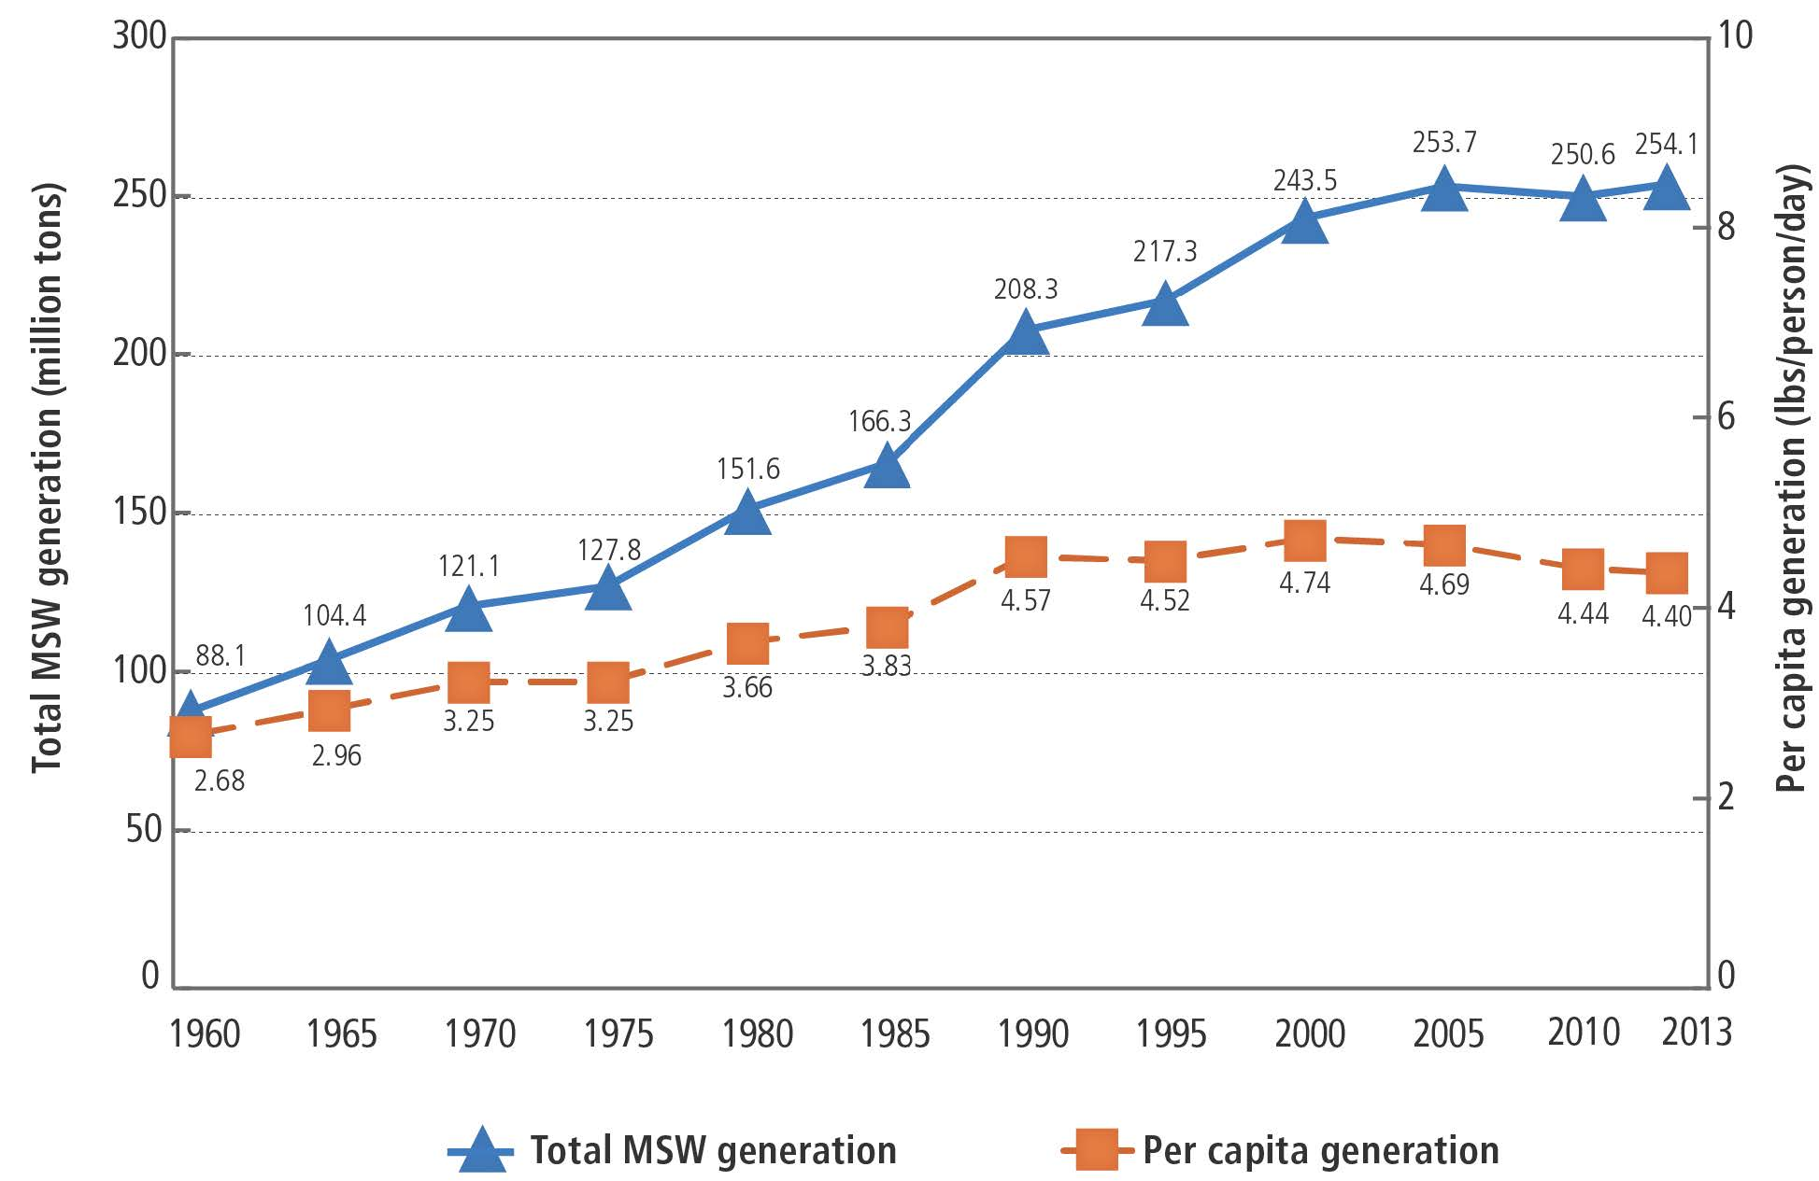
MSW GENERATION RATES
Notes:
GROWTH IN SOLID WASTE GENERATION FLAT SINCE 2000
POPULATION GREW AT TWICE THE RATE OF GARBAGE 2000 – 2014
PER PERSON DOWN BY .3 POUNDS PER DAY OR 6.4%
WHY ISN’T ANYONE COMPLAINING THAT GARBAGE GENERATION IS STAGNANT?

Slide 15
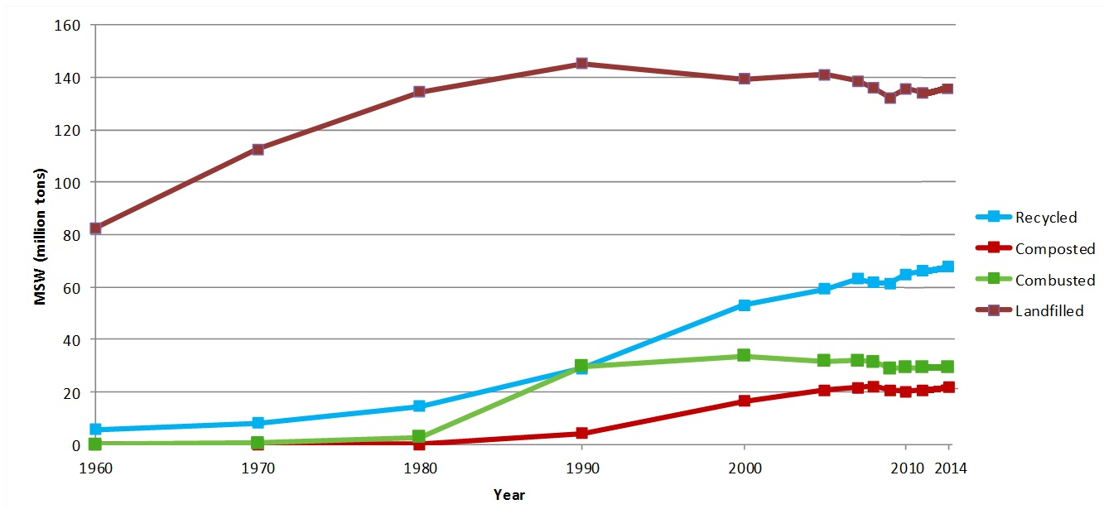
MANAGEMENT TRENDS
Notes:
THIS IS HOW WE MANAGE IT
THIS IS EPA DATA: 1960 – 2013 TOTAL AMOUNT OF MSW WE GENERATED BEFORE RECYCLING & COMPOSTING
(NOTE ALL DATA EPA)
DISPOSAL WHETHER LANDFILLING OR ENERGY FROM WASTE PEAKED IN 1990
SLOW DECLINE SINCE
RECYCLING & COMPOSTING BOTH ROSE DRAMATICALLY
RECOVERY TONNAGE INCREASED BY 161%
RECOVERY RATE INCREASED BY 107%
SEGUE: LET’S LOOK AT THE RECOVERY RATES MORE CLOSELY

Slide 16
RAW MATERIAL TRENDS
Less garbage
Different garbage
Notes:
THIS HAS BEEN THE BIGGEST STORY OF WASTE & RECYCLING SINCE 2000 (OR EARLIER)
CAUSING SERIOUS OPERATIONAL & REVENUE ISSUES AT MRFS & IMPACT ON LANDFILLS

Slide 17
LESS WASTE/DIFFERENT WASTE TRENDS
Less printed paper
Lighter weight packages
Zero waste by industry
Source reduction
Have we hit the wall?
Notes:
PRINTED PAPER DOWN 20 MILLION TONS IN GENERATION
NEWSPAPER PEAKED 2002
OFFICE PAPER 2007 (SO DID CATALOGS & DIRECT MAIL)
PLASTIC LIGHTWEIGHTING INTENSE
WATER BOTTLE 37% REDUCTION IN A DECADE
INDUSTRY INTENSE ADOPTION OF ZERO WASTE STRATEGIES THAT EMPHASIZE USING LESS MATERIALS TO MAKE MORE PRODUCTS & DIVERTING “WASTE” TO RECYCLING OR ORGANICS RECOVERY
EXAMPLE OF HORMEL - 4.7 MILLION POUND PACKAGING WEIGHT REDUCTION PROJECTS IN 2013 THE GIFT THAT KEEPS ON GIVING
BUT HAVE WE HIT THE WALL?
LIMITS TO LIGHTWEIGHTING: PACKAGE MUST STILL CONTAIN THE PRODUCT
NOTE NEW WALMART SUSTAINABLE PACKAGING PRIORITIES:
DESIGN FOR RECYCLING
SOURCE SUSTAINABILITY INCLUDING RECYCLED CONTENT BUT
PROTECT THE PRODUCT WHILE REDUCING PACKAGING
FAR FEWER INDUSTRY ZERO WASTE EXAMPLES IN 2015 & 2016
HAS IT RUN ITS COURSE?
SUSTAINABILITY EFFORTS IN CORPORATIONS APPEAR TO BE SLOWING DOWN
HAVE THE ACHIEVABLE, VALUE-ADDED TARGETS BEEN HIT?

Slide 18
WHAT IS ON THE HORIZON
Flexible packaging
E-commerce
Drones
Organics
Notes:
WORTH NOTING THAT AS I WAS DRIVING TO WORK TO WRITE THIS PRESENTATION, BBC NEWS HAD A SEGMENT ON THE TENTH ANNIVERSARY OF THE INTRODUCTION OF THE SMART PHONE
CELL PHONES ON STEROIDS?
WASTE & RECYCLING ARE NOT IMMUNE FROM DISRUPTIVE TECHNOLOGIES & PRODUCTS

Slide 19
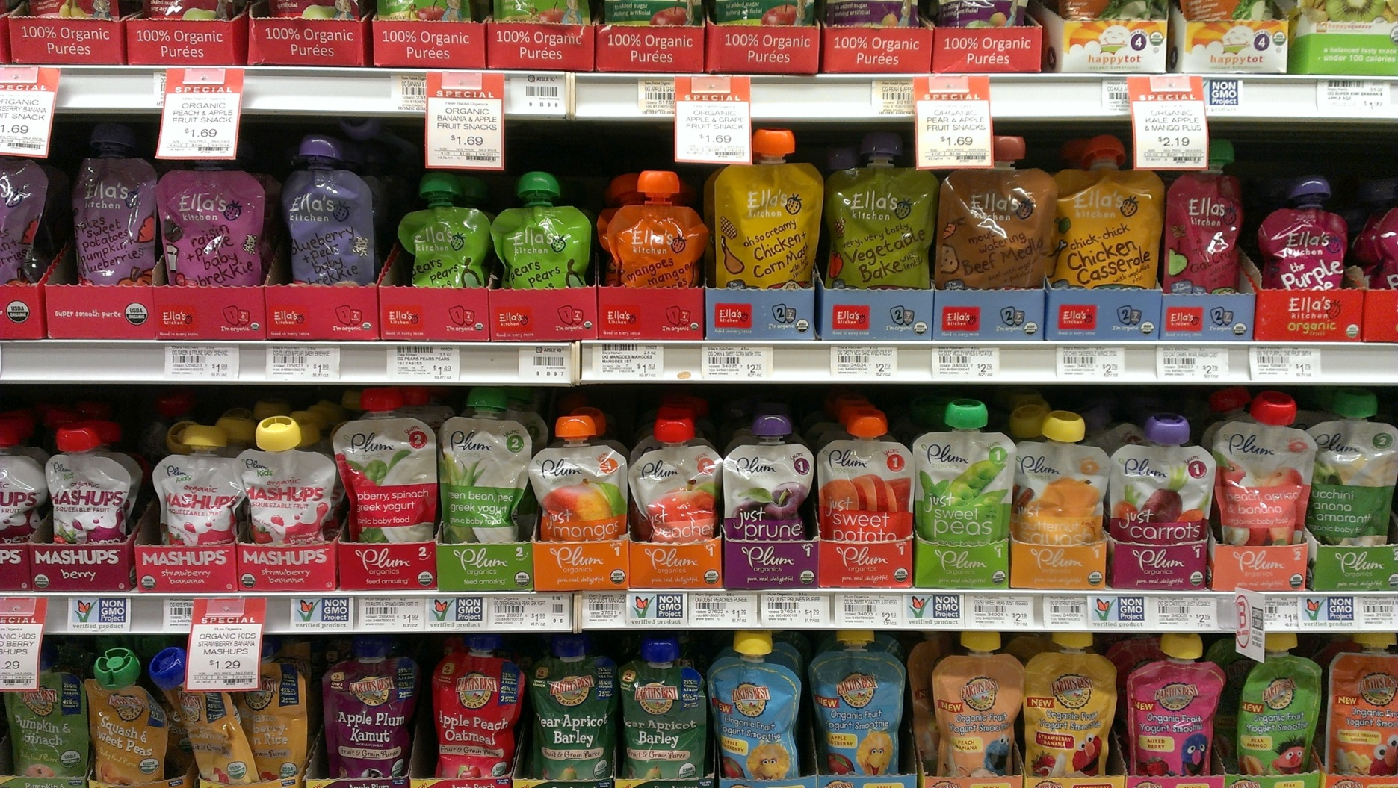
FLEXIBLE PACKAGING
Notes:
FLEXIBLE PACKAGING: THE FASTEST GROWING PACKAGE
18% OF THE PACKAGING MARKET (CORR 23%, RIGID PLASTICS 16%, METAL CANS 13%, PAPERBOARD 12%, GLASS 4%, OTHER 14%)
FLEXIBLE PACKAGING HAS NO SHAPE OF ITS OWN
MOSTLY PLASTIC (69%) BUT CAN INCLUDE PAPER (15%) FOIL (4%) & ADHESIVES, COATINGS & INKS (12%)
TECHNOLOGICALLY ADVANCED
MULTI-LAYER & MULTI-RESIN
BARRIER LAYERS & TIE LAYERS
CAN’T BE RECYCLED BUT BUSINESSES LOVE B/C OF ENVIRONMENTAL & ECONOMIC SAVINGS
CONSIDERING HOW MUCH WASTE THEY HAVE ELIMINATED WHY DO THEY ALSO HAVE TO BE RECYCLED?
SALES ARE PROJECTED TO KEEP GROWING & GROWING

Slide 20
E-COMMERCE
26% retail sales in 2015
50% in ?
Corrugated boxes
Catalogs?
Flexible/film wrap
Notes:
E-COMMERCE HAS BEEN THE SAVIOR OF THE PAPER PACKAGING INDUSTRY
CATALOG & DIRECT MAIL DOWN (50% & 24%) FROM PEAK IN 2007
LAST 4 YEARS STEADY
E-COMMERCE POSITIVE FOR CORRUGATED BOXES
SALES ARE PROJECTED TO INCREASE
ON CAVEAT: WILL FLEXIBLE OPTIONS STEAL AWAY CORRUGATED BOX MARKETS?
LOOKING FURTHER OUT, WHAT IS LIKELY TO CHANGE OUR RAW MATERIALS

Slide 21
DRONES
Notes:
PHOTO WASHINGTON POST
CAN ALREADY BE USED AT LANDFILLS FOR A VARIETY OF PURPOSES
E-COMMERCE & RETAILERS LOOKING AT AS DELIVERY OPTION
REGULATORY & LEGAL HURDLES REMAIN
VEGAS AREA VIDEO OF PACKAGE DELIVERY
IMPACT ON PACKAGING NEEDS?
FAA now allows carriage of cargo
No HAZMAT
Max weight of loaded vehicle can't exceed 55 lbs

Slide 22
3-D PRINTING
Notes:
DID I MENTION 3-D PRINTING?
MY POINT IS THIS: AS TECHNOLOGY EVOLVES, OUR RAW MATERIALS EVOLVE
WE HAVE TO EVOVLE W/THEM
LET’S GET MORE DOWN TO EARTH & LOOK AT ORGANICS

Slide 23
ORGANICS
Notes:
INTEREST IN ORGANICS SKYROCKETED W/THE PUBLICATION OF THE REFED REPORT IN MARCH
CURRENTLY, YARD WASTE IS WELL ESTABLISHED & “EASY”:
SOURCE REDUCTION THROUGH GRASSCYCLING & BACKYARD COMMONPLACE ELIMINATED ABOUT 10 – 15 MILLION TONS FROM THE WASTE STREAM
WE COMPOST 4.25 MT OF YARD WASTE
MORE THAN HALF OF WHAT GETS TO THE CURB
25 STATES BAN YARD WASTE DISPOSAL
FOOD WASTE IS THE NEW KID ON THE BLOCK & IT IS NOT EASY
ALMOST 200 RESIDENTIAL COLLECTION
COMMERCIAL COLLECTION: INCREASINGLY PROMINENT
BOTH CONTAMINATED W/CHALLENGING COLLECTION, PROCESSING & HUMAN BEHAVIOR OBSTACLES
SIX STATES (CONNECTICUT, VERMONT, MASSACHESTTS, RHODE ISLAND, CALIFORNIA & MINNESOTA) BAN DISPOSAL OR OTHERWISE REQUIRE SOME LEVEL OF FOOD WASTE RECOVERY
OTHER OPTIONS INCLUDE

Slide 24
ORLANDO ENERGY GARDEN
Notes:
(CLEANTECHNICA.COM)
ANAEROBIC DIGESTION
WASTEWATER TREATMENT FACILITIES COMBINED W/AD (E.G. MILWAUKEE & MILORGANITE)
ARE POTENTIAL HIGHER TECH OPTIONS
&, OF COURSE, 600+ MSW LANDFILLS ARE CAPTURING LANDFILL GAS & CONVERTING IT TO ENERGY
HARVEST POWER BIOFUELS – ORLANDO ENERGY GARDEN
FOOD WASTE ONLY
NO YARD WASTE
130,000 TONS + PER YEAR OF BIOSOLIDS, FATS, OIL, GREASE, & FOOD WASTE
MOSTLY FROM WALT DISNEY RESROTS & HOTELS
3.2+MW OF INSTALLED POWER GENERATION
2.2+ MW OF RECOVERABLE HEAT
DIGESTED MATERIAL CLASS AA GRANUALR FERTILIZER & PHOSPHORUS RICH STURVITE SOLD AS A FERTILIZER ADDITIVE
BUT THE MOST SUCCESS IS LIKELY TO COME FROM ZERO WASTE TYPE OPTIONS

Slide 25
ORGANICS
Notes:
(THIS POSTER IS USED IN A BRITISH FOOD WASTE REDUCTION CAMPAIGN: LUSCIOUS ISN’T IT?)
BUT ZERO WASTE/SOURCE REDUCTION EFFORTS ARE MORE LIKELY TO SUCCEED QUICKLY
EDIBLE FOOD: FEEDING AMERICA:
2,000,000 MILLION TONS IN 2013 TO FEED THE HUNGRY
530,000 TONS DIVERTED BY RETAILERS BEFORE EXPIRATION DATE
CALORIC CONTENT FROM BAKERY STARCHES TO DAIRY, PRODUCE & MEAT
ANIMAL FEED:
15 MT MFR (FWRA STUDY) + 5 MT LAND APP
2.7 MILLION TONS SPENT BREWERS GRAINS
IN- FACILITY OPERATIONS
GRIND2ENERGY & OTHER OPTIONS TO CREATE SLURRY OR PET FOOD OR WHAT HAVE YOU
THEY CUT OUT THE HAULER UNLESS THE HAULER IS INVOLVED
BETTER “BEST USED BY” LABELLING ON FOOD PRODUCTS
GOOD SHOT OF PASSING FEDERALLY IN THIS CONGRESS
NON-PARTISAN & ALLA CTORS SUPPORT
IMPORTANT FIRST STEP & ALLOWS US TO BUILD INFRASTRUCTURE
BUT WILL HAVE SAME ZERO WASTE IMPACTS AS WE HAVE SEEN IN INDUSTRY

Slide 26
IT’S ALL ABOUT CHANGE
Politics of waste
Our raw material & How we manage it
What is on the horizon?
Notes:
I WAS ASKED TO TALK ABOUT THE OUTLOOK FOR OUR INDUSTRY IN 2017 (AND BEYOND)
THE FUTURE OF WASTE MANAGEMENT & RECYCLING UNDER THE NEW ADMINISTRATION IN THE STATES
WHAT’S HAPPENING TO OUR RAW MATERIAL
& HOW WE MANAGE IT
LOOK AT TRENDS IN OUR INDUSTRY
THE POLITICAL COMMENTS ARE US-CENTRIC
BUT THE OTHER TRENDS I BELIEVE APPLY, FOR THE MOST PART, ON BOTH SIDES OF THE BORDER
BUT FIRST A CAVEAT ABOUT MY PREDICTIVE ABILITIES

Slide 27
ISSUES
Goals & measurement
Sustainable materials management
EPR
Privatization & franchises
System finances

Slide 28
GOALS & MEASUREMENT?
Weight
Volume
Per capita disposal
GHG impact
Notes:
ANY SCIENCE-BASED GOALS?
WEIGHT-BASED REPORTING IS THE TRADITIONAL WAY TO MEASURE RECYCLING
A TON IS A TON IS A TON
ALONG W/THE EVOLVING TON ONE OF THE REASONS THE RECYCLING RATE IS “STAGNANT”
WORSE YET NO RELATIONSHIP TO THE ENVIRONMENTAL IMPACT OF RECYCLING A PARTICULAR MATERIAL
VOLUME-BASED IS AN OPTION
DIFFICULT TO DO
NO RELATIONSHIP TO THE ENVIRONMENTAL IMPACT OF RECYCLING A PARTICULAR MATERIAL
PER CAPITA DISPOSAL:
CALIFORNIA
HYBRID DEFINITION
HOW KEEP NON-MSW OUT (IF IT MATTERS)
GHG IMPACT IS AN INTERESTING NEW OPTION
OREGON’S NEW LAW REQUIRES DEQ TO ESTABLISH “OUTCOME-BASED WASTESHED RECOVERY RATES”
OREGON USES GHG SAVINGS AS THE BENCHMARK FOR SUCCESS.
OREGON IS THE FIRST AMERICAN STATE TO EMBRACE SUSTAINABLE MATERIALS MANAGEMENT

Slide 29
A NEW WAY OF THINKING
Notes:
EPA LAUNCHED ITS THINKING ON THIS ISSUE IN 2009 W/THE PUBLICATION OF SUSTAINABLE MATERIALS MANAGEMENT: THE ROAD AHEAD
https://www.epa.gov/smm/sustainable-materials-management-road-ahead
WHAT IS SUSTAINABLE MATERIALS MANAGEMENT?

Slide 30
SUSTAINABLE MATERIALS MANAGEMENT
“Sustainable materials management is a systemic approach to using and reusing materials more productively over their entire lifecycles. It represents a change in how our society thinks about the use of natural resources and environmental protection. By looking at a product's entire lifecycle we can find new opportunities to reduce environmental impacts, conserve resources, and reduce costs.”
Notes:
EPA DEFINITION OF MM (FROM OPPORTUNITIES TO REDUCE GREENHOUSE GAS EMISSIONS THROUGH MATERIALS & LAND MANAGEMENT PRACTICES).
Use materials in the most productive way with an emphasis on using less;
Reduce toxic chemicals and environmental impacts throughout the material life cycle;
Assure we have sufficient resources to meet today’s needs and those of the future
LIFE CYCLE IS THE KEY
WHAT IS THE BIGGEST ENVIRONMENTAL BENEFIT FROM BEGINNING TO END
THIS RAISES SOME KEY QUESTIONS

Slide 31
SUSTAINABLE MATERIALS MANAGEMENT
Is recycling the ultimate goal?
or
Less overall waste in the ecosystem?
Hierarchy?
Notes:
IS 100% RECYCLING & COMPOSTING THE ULTIMATE GOAL?
END OF THE PIPELINE WASTE MANAGEMENT VIA INCREASED RECYCLING & COMPOSTING
OR
LESS OVERALL WASTE IN THE ECOSYSTEM ?
LOWERING THE EXTRACTION OF RAW MATERIALS & ENERGY USED IN MANUFACTURING & TRANSPORTATION
EVEN THOUGH SOME OF THOSE PRODUCTS CANNOT BE RECYCLED & MUST BE DISPOSED?
SUSTAINABLE MATERIALS MANAGEMENT IS FUNDAMENTALLY ANTI-HIERARCHICAL ALTHOUGH IT DOES HAVE PREFERENCES
BOTTOM LINE IS SIMPLE: LESS IMPACT ON THE ENVIRONMENT & LET THE CHIPS FALL WHERE THEY MAY
BEWARE “SMM” PLANS THAT ARE REALLY THE OLD IWM/SWM PLANS W/A NEW NAME
HOT POLITICAL ISSUE?

Slide 32
EPR IN THE STATES
Notes:
THIS MAP SHOWS THE STATES WITH EPR LAWS & THE NUMBER OF LAWS IN THOSE STATES
33 STATES WITH 80% OF THE POPULATION HAVE EPR LAWS.
ALMOST HALF OF THE LAWS ARE IN NEW ENGLAND & CALIFORNIA
BLUE = 1 GREEN = 2 YELLOW = 3 RED = 4 ORANGE = 5 PURPLE = 7 BLACK = 8
OF THE 83 LAWS, 80% (67) COVER PRODUCTS WITH TOXIC CONSTITUENTS, PRIMARILY MERCURY
INCLUDES CAL & MAINE CELL PHONE LAWS
ANOTHER 13 COVER “HARD TO RECYCLE” MATERIALS: PAINT, MATTRESSES, CARPET & PESTICIDE CONTAINERS
& ONE IS A “FRAMEWORK” LAW THAT EMPOWERS THE STATE TO PICK MATERIALS FOR EPR
HOW HAVE THEY WORKED?
(NOTE: DATA FROM END OF LIFE VEHICLE PARTNERSHIP, NATIONAL ELECTRONICS CLEARINGHOUSE, NATIONAL ELECTRONICS MANUFACTURING ASSOCIATION, PRODUCT STEWARDSHIP INSTITUTE, THERMOSTAT RECYCLING CORPORATION)

Slide 33
“DISAPPOINTING RESULTS”
15-20% for waste electronics.
10 - 12% for rechargeable batteries
Less than 25% for mercury auto switches
less than 10% for mercury thermostats
Notes:
CONCLUSION OF JENNIFER NASH OF THE HARVARD KENNEDY SCHOOL & CHRISTOPHER BOSSO OF NORTHEASTERN UNIVERSITY IN
“EXTENDED PRODUCER RESPONSIBILITY IN THE UNITED STATES: FULL SPEED AHEAD?” MAY 2013
FOUND LOW RATES FOR ELECTRONICS, BATTERIES & AUTO SWITCHES & THERMOSTATS
OTHER PRODUCTS TOO EARLY TO SAY OR TOO LITTLE DATA
NOTE: APPLIES TO BOTH MANDATORY & VOLUNTARY PROGRAMS
NOTE: CITES “ROBUST RATES” FOR THERMOSTATS IN MAINE & VERMONT BUT CURIOUSLY SILENT ABOUT MARYLAND
CITES MINNESOTA, OREGON, WASHINGTON & WISCONSIN FOR RELATIVELY STRINGENT ACCOUNTABILITY MECHANISMS, PERFORMANCE GOALS, ACCESSIBILITY REQUIREMENTS & MANUFACTURERS FINANCING COLLECTION AS WELL AS TRANSPORTATION & RECYCLING (NO MENTION THAT CONSUMERS, NOT MANUFACTURERS, SUPPLY THE MONEY)
KEY: “SUCCESS OF EPR RELIES ON THE CAPACITY OF ALL POLICY ACTORS TO SET HIGH EXPECTATION FOR EPR PROGRAMS & WORK IN CONCERT TO ACHIEVE THEM. SUCH CAPACITY IS ESPECIALLY CRITICAL FOR STATE ENVIRONMENTAL AGENCIES TASKED W/PROGRAM OVERSIGHT, WHICH MUST HAVE THE INSTITUTIONAL MEANS TO DEMAND RIGOR & ACCOUNTABILITY WHEN THEY REVIEW MANUFACTURERS’ PLANS, ASSESS PROGRESS TOWARD PERFORMANCE GOALS, & PURSUE PENALTIES AS APPROPRIATE.”

Slide 34
WHY DISAPPOINTING? OVERALL
Inconsistent laws
Lack of accountability mechanisms
State program oversight
Mostly small, occasionally generated products
Notes:
INCONSISTENT LAWS AMONG THE STATES
LACK OF ACCOUNTABILITY MECHANISMS IN MANY STATES
FAILURE OF STATES TO PROVIDE STRONG OVERSIGHT
SMALL ONLY OCCASIONALLY GENERATED PRODUCTS W/O A RECYCLING NORM
SOMETIMES I WONDER IF THE ADVOCATES EVEN CARE ABOUT THE RESULTS
THEY WANT TO PASS THE LAW & MOVE ON TO OTHER PRODUCTS
WHICH RAISES A QUESTION: WHAT WORKS FOR EPR?
SOURCE: NASH – BOSSO, SAIC, SELF

Slide 35
EPR LEGISLATIVE TRENDS
Most laws passed before 2014
Few since then
E-scrap failing to find solutions
Notes:
RAPID SPURT IN THE FIRST DECADE, SLOWER GROWTH SINCE THEN
LESS LEGISLATIVE INTEREST
PAINT PUSHBACK
FAILING TO FIX EXISTING ELECTRONICS LAWS
MINNESOTA 2016
IL 2015 (BUT NEEDS MORE)
NJ JANUARY 2017
PENNSYLVANIA, NEW YORK, MICHIGAN NOWHERE
PROGRAMS BUFFETED BY LIGHTWEIGHTING OF PRODUCTS & DISAPPEARANCE OF CRT MARKETS
PACKAGING & PAPER?
CALIFORNIA: CALRECYCLE STUDY DUE END OF YEAR
CONNECTICUT: PACKAGING RECYCLING TASK FORCE: SHORT ONE MEMBER – REPORT DUE JAN 1 2017….

Slide 36
WHO COLLECTS
Privatization
Franchises
Notes:
OVERSIGHT ARRANGEMENTS FOR SOLID WASTE & RECYCLING VARY DRAMATICALLY ACROSS THE U.S.
COMMERCIAL COLLECTION IS PRIVATE SECTOR
RESIDENTIAL SPLIT W/A MAJORITY PRIVATE SECTOR
EXPECT TO SEE SLOW BUT STEADY INCREASE IN PRIVATIZATION OF RESIDENTIAL COLLECTION
FEES OR CONTRACT PAYMENTS, NOT TAXES, ARE THE COMMON METHOD OF PAYMENT
EPA PUSHED HARD FOR FEE-BASED SYSTEMS
GET OFF THE TAX ROLLS & GIVE USERS INFO ON WHAT THEY PAY
COMMERCIAL FRANCHISES NOT COMMON BUT A HOT ISSUE
BUSINESS TENDS TO OPPOSE VOCIFEROUSLY B/C PREFER COMPETITION FROM SERVICE PROVIDERS
CHICAGO DEFEATED IN 2010 EVEN THOUGH INTRODUCED & SUPPORTED BY MAYOR DALEY
LA PASSED IN 2015
NYC?

Slide 37
SYSTEM FINANCES
Less waste = less $
Cost of diversion programs
Who pays?
You & I

Slide 38
SUMMARY
Less waste
Recycling & disposal require more flexibility
Organics in focus
Evolving material mix
Continued zero waste by industry
Notes:
PER CAPITA WASTE GENERATION WILL CONTINUE TO DECLINE
OVERALL WASTE GENERATION MAY RISE IF THE ECONOMY IMPROVEs
C&D WILL BOUNCE BACK STRONGLY
CONSUMERS LIKELY TO PURCHASE MORE LONG-LIVED “BIG TICKET” ITEMS SUCH AS FURNITURE
INCREASE WILL NOT EQUAL RAPID RATE OF THE 80’S OR THE SLOWER RATE OF THE 90’S
DISPOSAL NEEDED FOR A LONG TIME
FLAT, NOT IN FREE FALL
MORE EMPHASIS ON ORGANICS
EVOLVING TON & ZERO WASTE BY BUSINESS WILL CONTINUE
EXCITING TIMES!
THE FUTURE AIN’T WHAT IT USED TO BE!

Slide 39
CONCLUSION
Exciting times!
Interesting politics
CHANGE

Slide 40
FOR MORE INFORMATION:
Chaz Miller
202-364-3742 www.wasterecycling.org cmiller@wasterecycling.org
Notes:
THANK YOU

