Slide 1

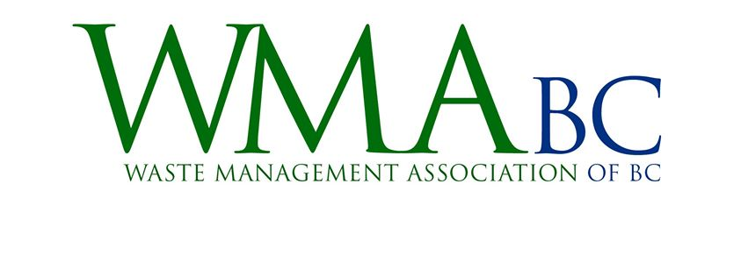
Session 3: Our Circular Economy
Chris Howorth, Business Developer, Veolia

Slide 2
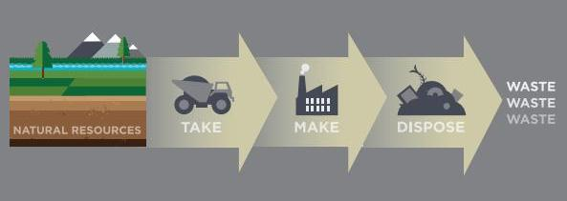
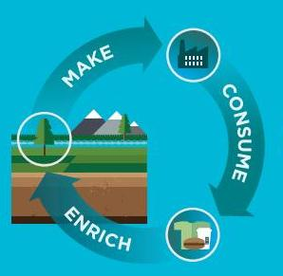


Circular Economics
Linear
Economy
Circular
Economy
Source: Ingenious.com
Notes:
Circular = closed loop, cradle to cradle

Slide 3

Veolia Environnement
>250,000 employees worldwide
Present in >100 countries
  >250 Canadian Employees
Technologies and Operations

Slide 4
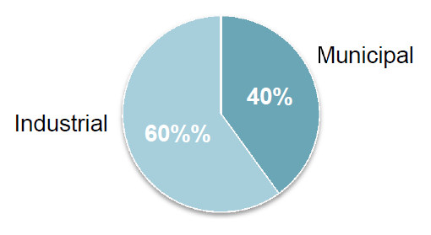
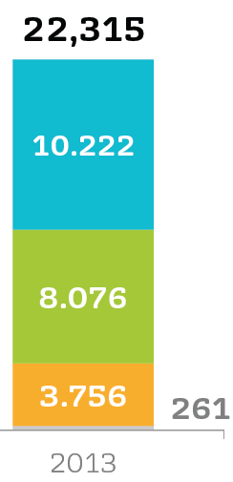




2013 Financials
WASTE

Slide 5
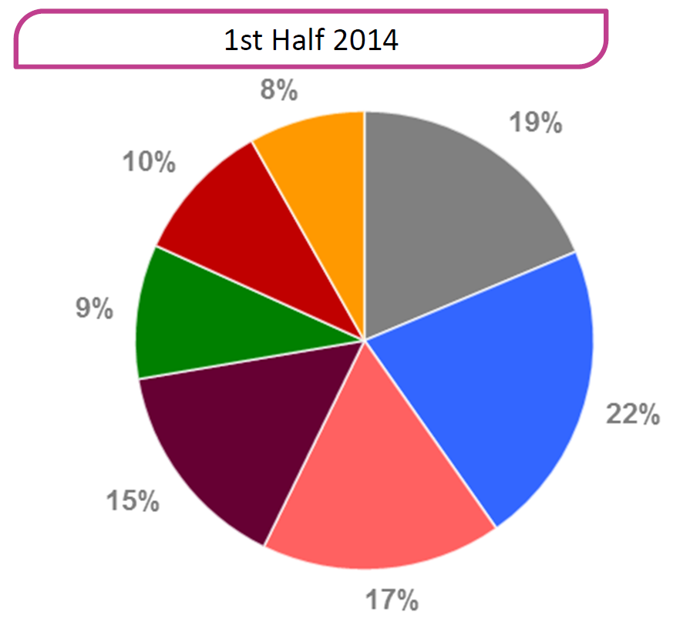
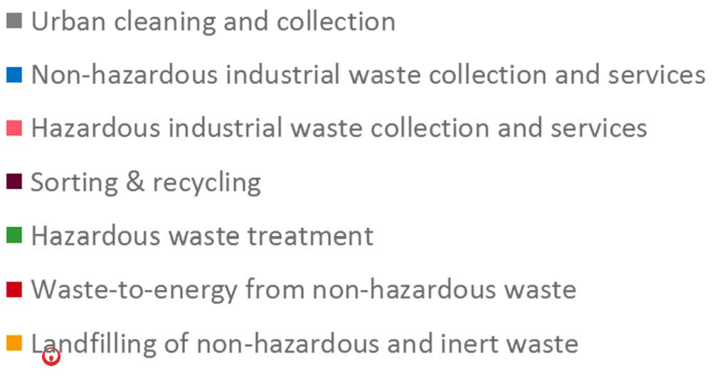
Waste Revenues by Activity

Slide 6
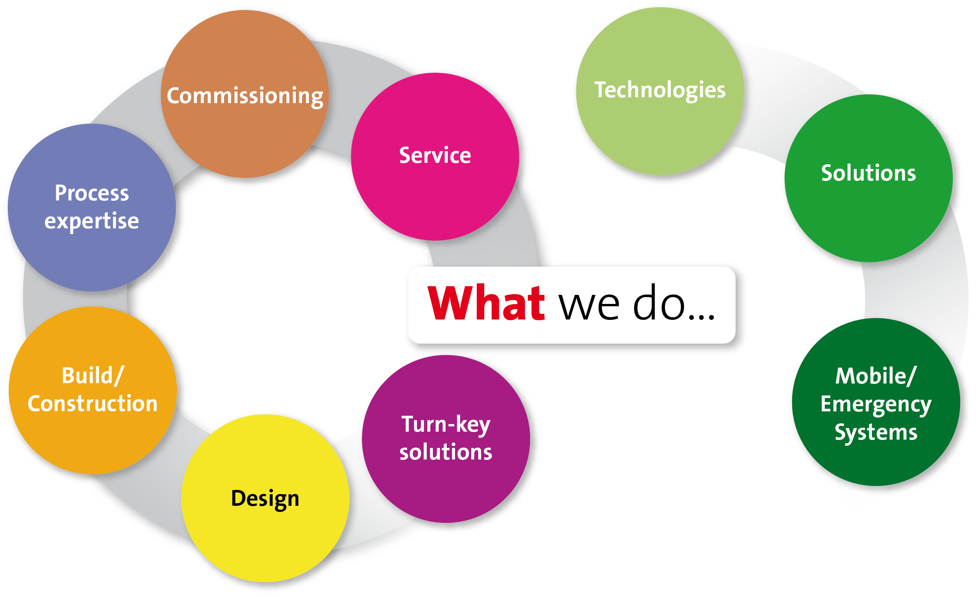
Our Expertise
R&D
Systems
Equipment
Consumables
Flexible Delivery Models
Design
Build
Operation
Operations
System
Integration

Slide 7
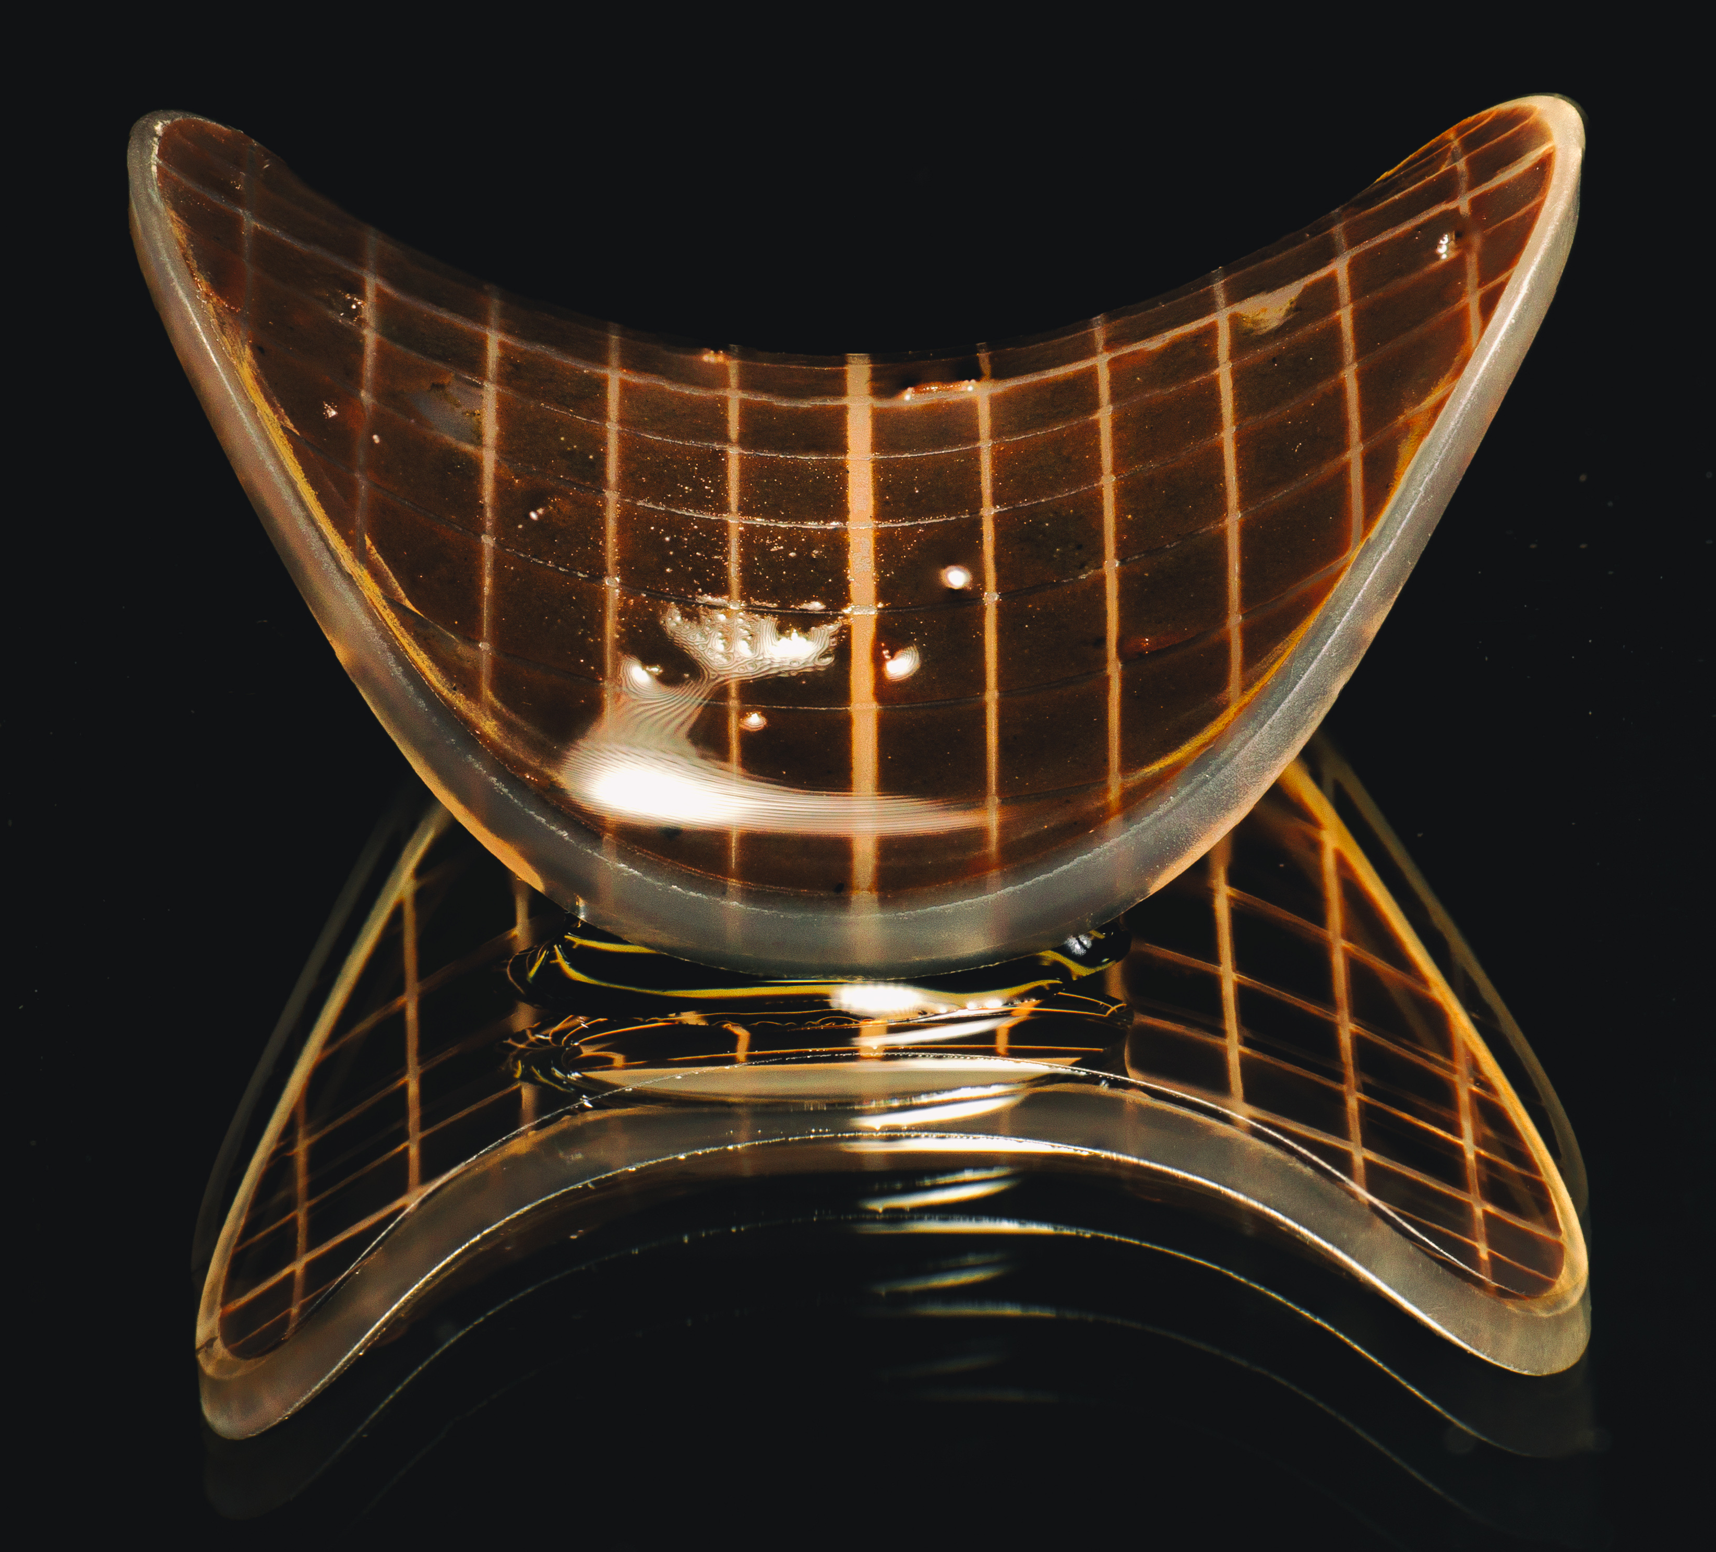
Technology

Slide 8
Solid Waste Focus Areas
Compliant
Discharge
Landfill Leachate
Reuseable
Products
Organics

Slide 9
Organic Waste Processes
Pre-Treatment
Biological Treatment
Aerobic/Anaerobic
Fertilizer
Post Processing
Power Generation
Gas Upgrading
District Heating
Landfill
Fertilizer

Slide 10
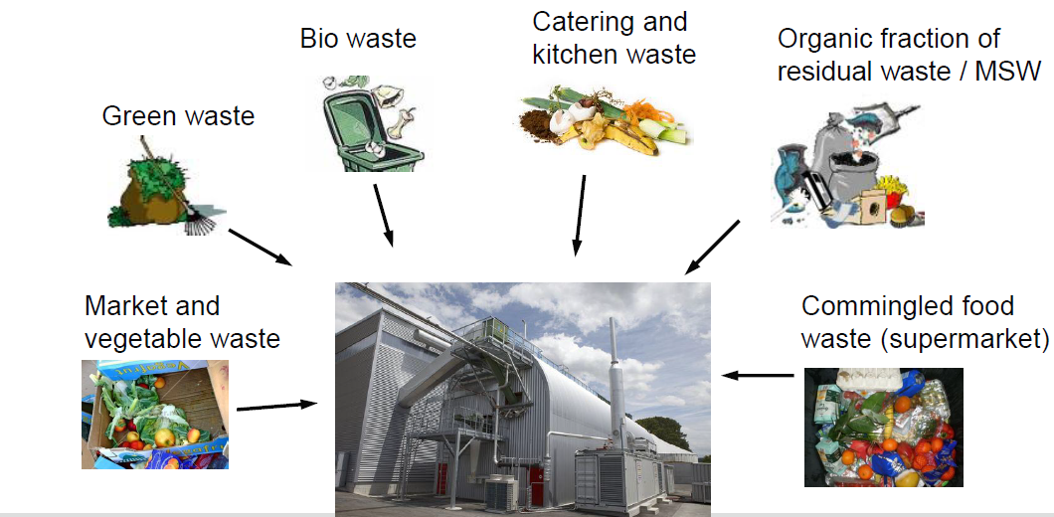
Anaerobic Digestion Applications

Slide 11

Dry vs. Wet Anaerobic Digestion
Many Advantages:
No settling or flotation
Compact
Better energy balance
Higher biogas production
Can process green waste
But:
Potential for contaminants in final product
Economies of scale (~10,000 T/yr and up)

Slide 12
Types of Dry AD
Plug Flow
Percolation

Slide 13
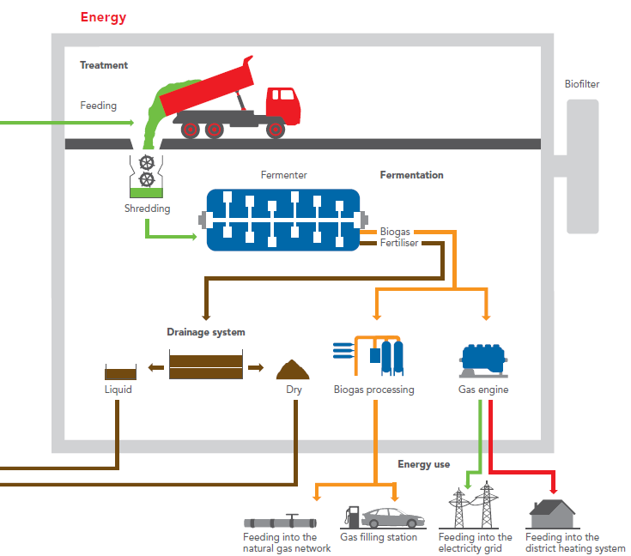
Input
Fertilizer

Slide 14
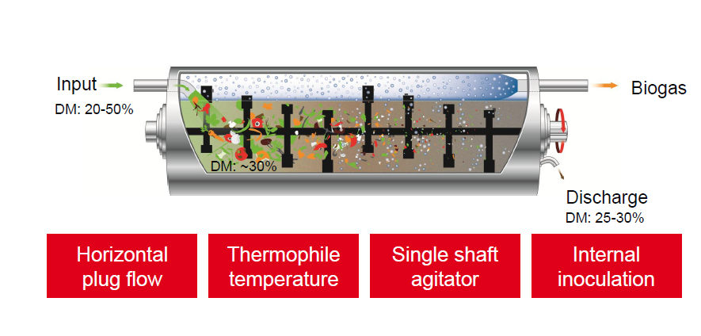


Kompogas Process Features
High Efficiency
Thermophilic
Low Energy
Robust

Slide 15
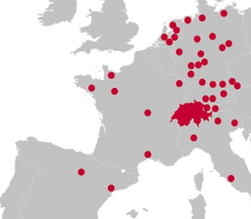
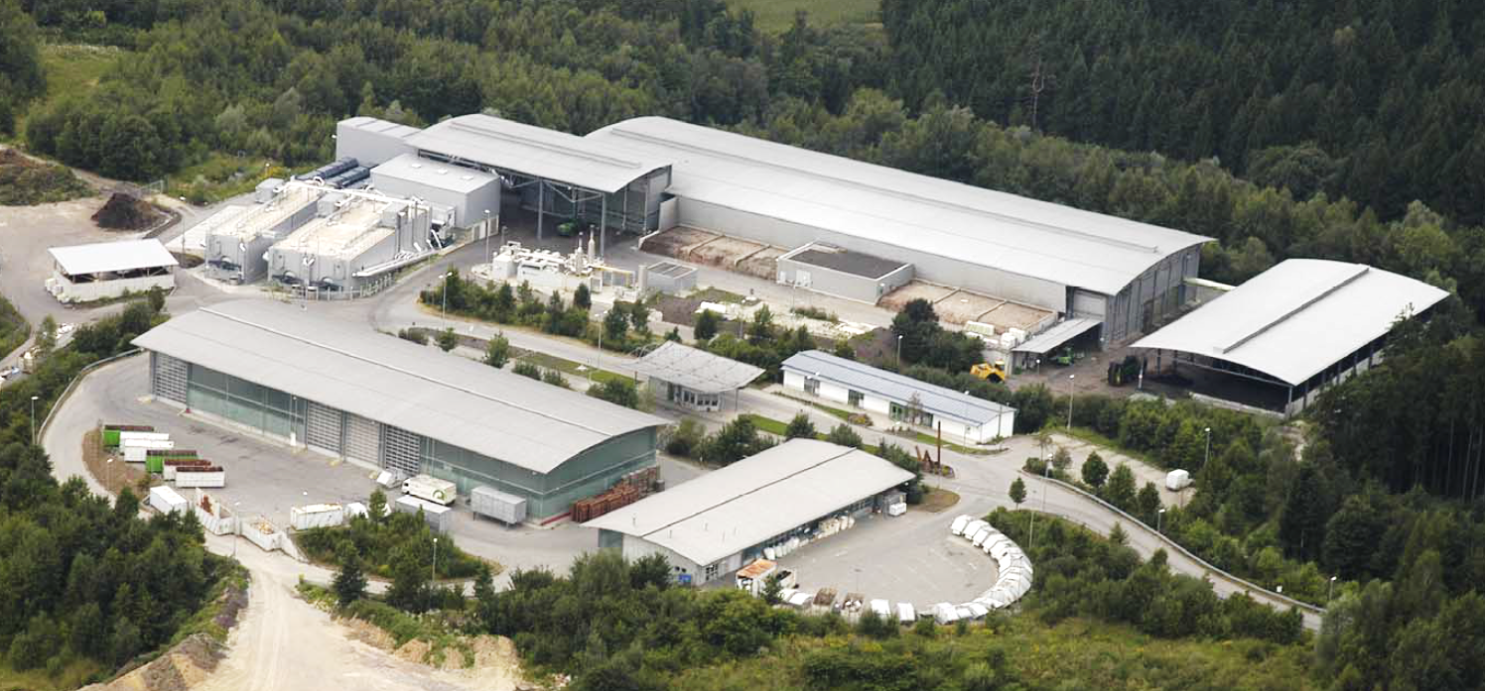
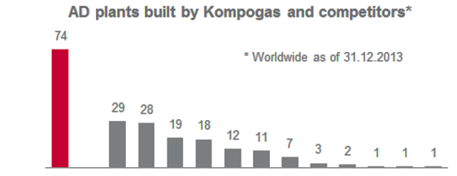
Many Installations

Slide 16
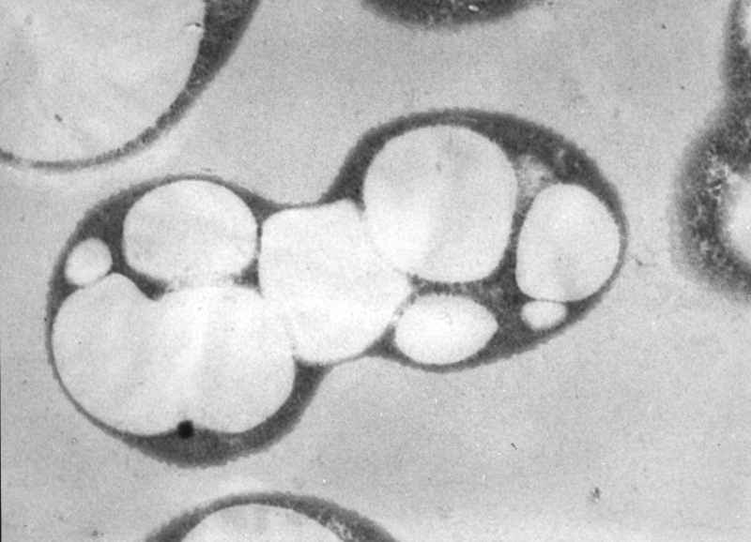
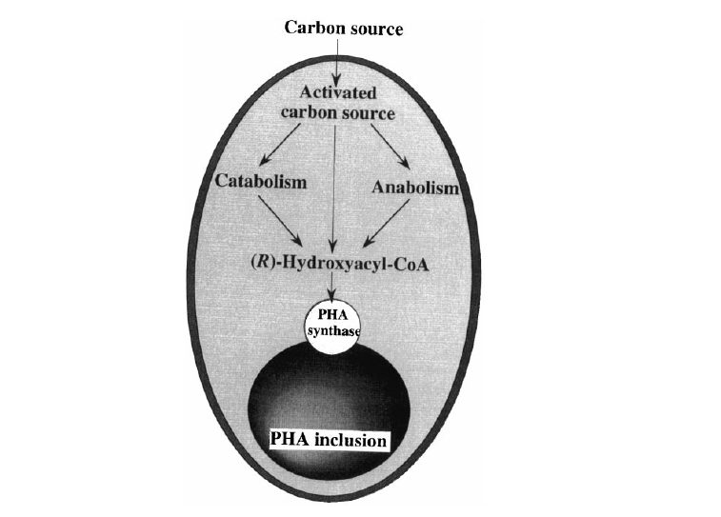
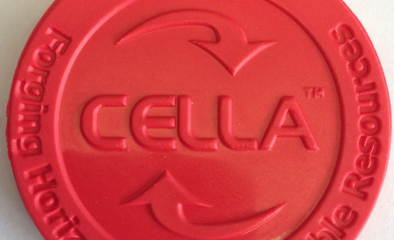
The Future
Alcaligenes latus loaded with PHA granules

