Slide 1
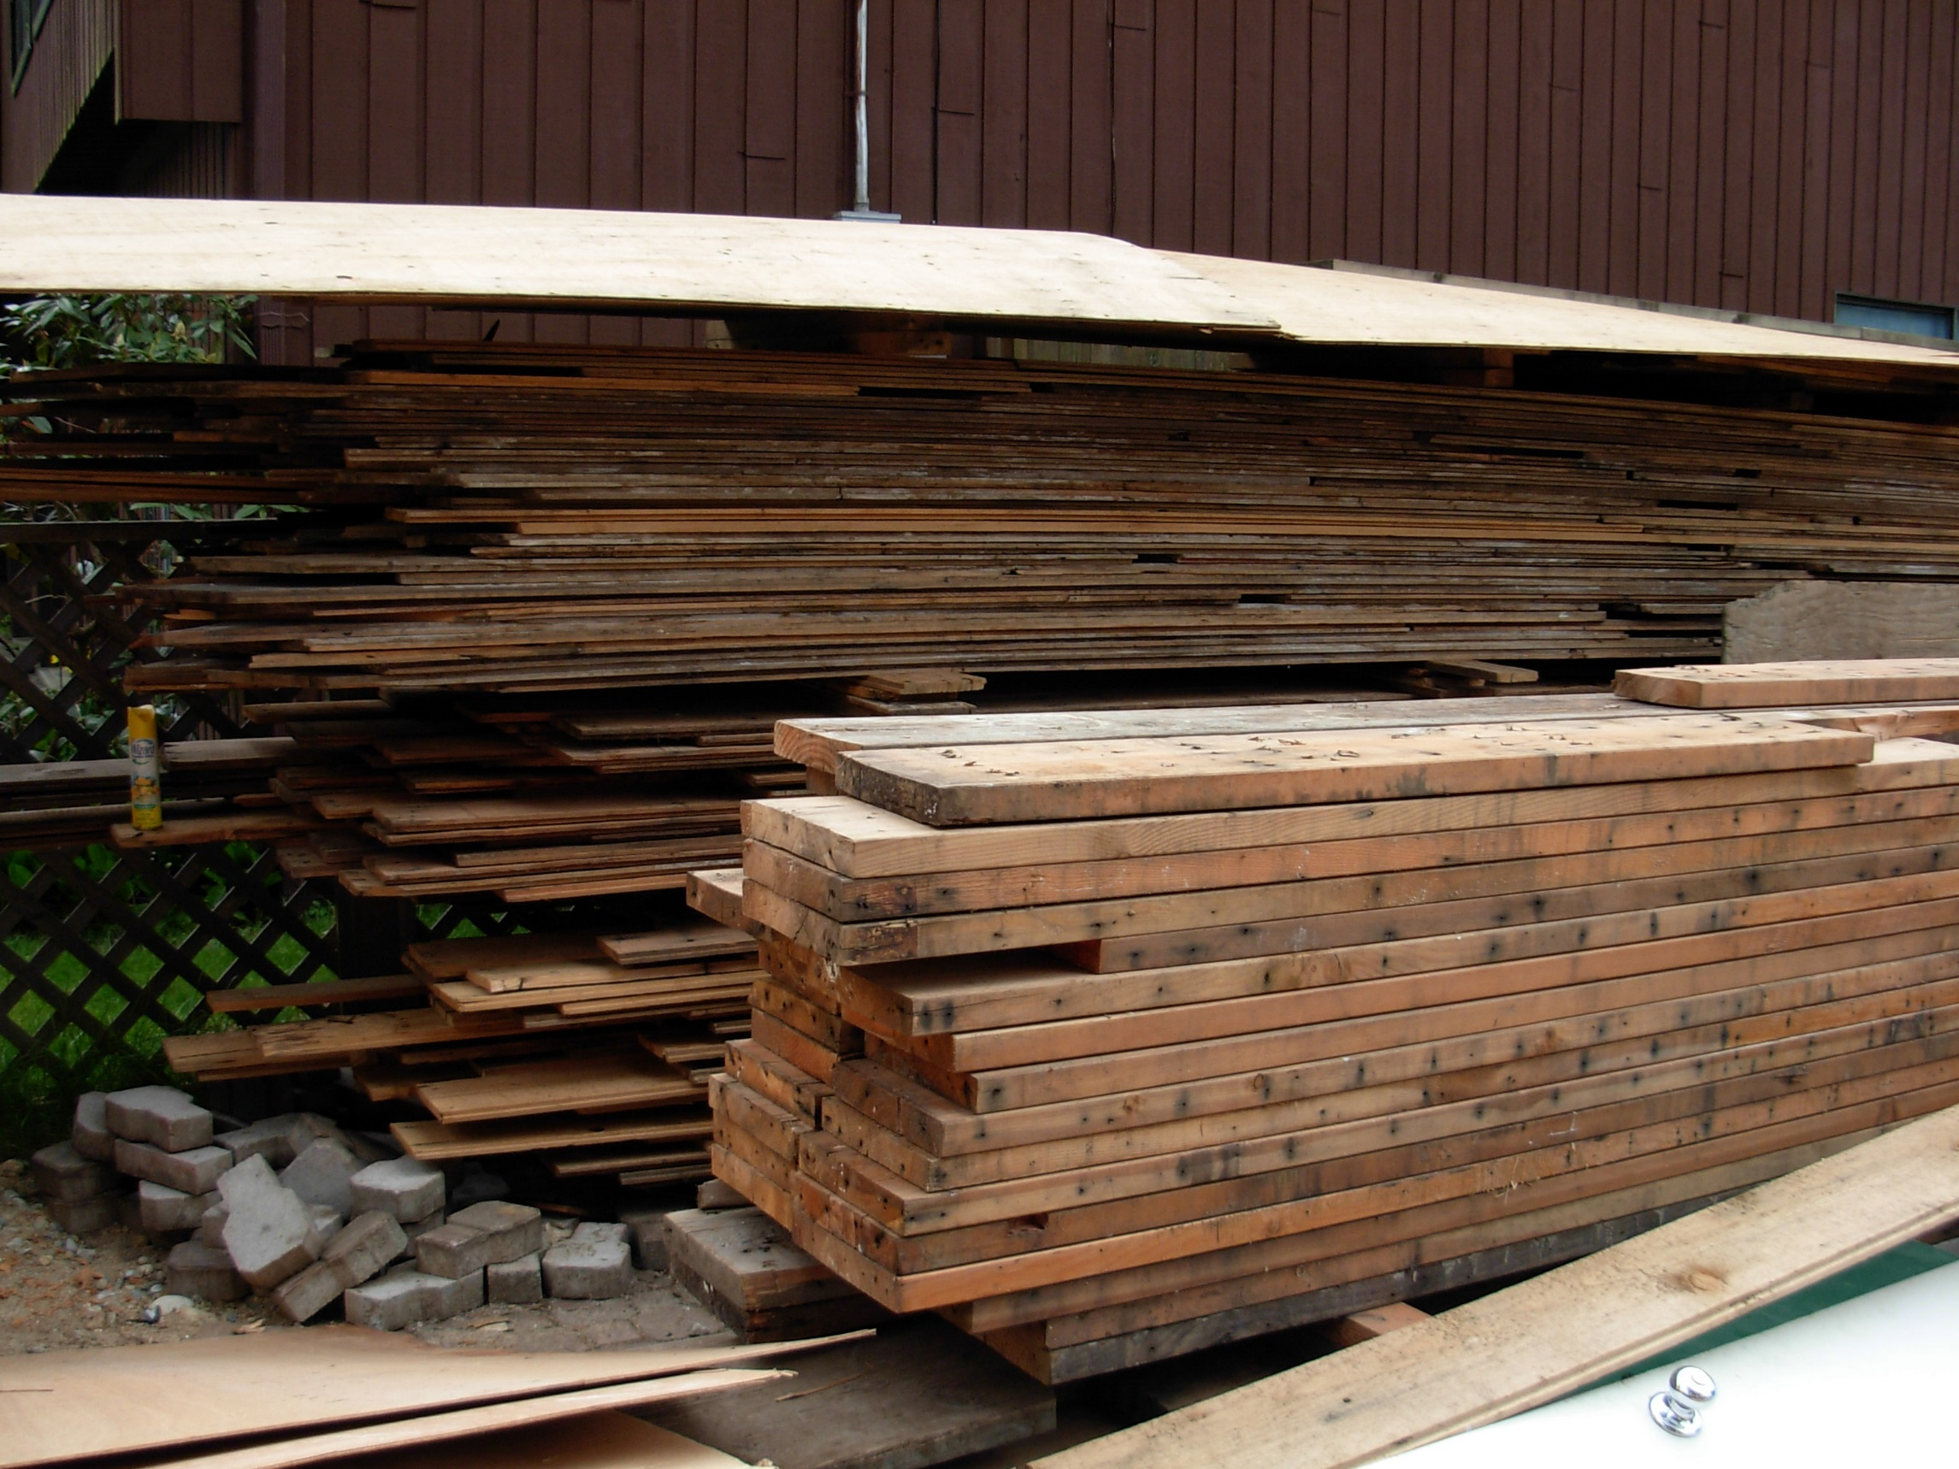
Metro Vancouver’s Clean Wood Disposal Ban
WMABC January 29, 2015
Paul Henderson, General Manager
Solid Waste Services

Slide 2
Keeping Clean Wood out of our Garbage
Why recycle clean wood?
Cost savings - the disposal fee for clean wood is less than the fee for garbage
Clean wood can be used for landscaping mulch, composting or alternative industrial fuels
You’ll help the region reach its recycling goal of 80% by 2020, by keeping clean wood out of the landfill or waste-to-energy facility
When does the ban take effect?
January 1, 2015
Six month education period
Surcharges start July 1, 2015
Notes:
Over 40 notices issued for Clean Wood Disposal Ban as of late January
2

Slide 3
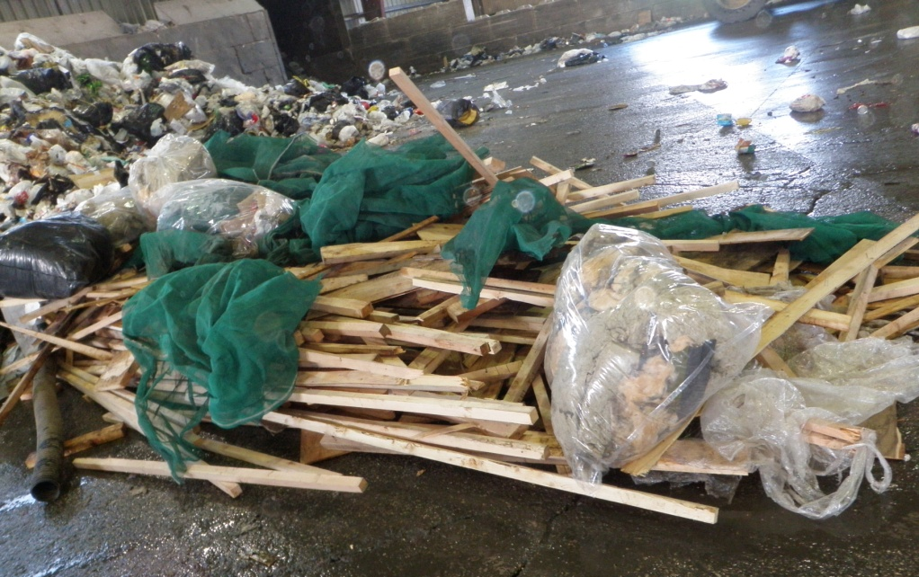
Definition of Clean Wood
Solid wood, lumber, and pallets
Rotten clean wood OK
No paint, stains, glue, treatment
Can be pierced with metal fasteners (nails, etc.)
Notes:
3

Slide 4
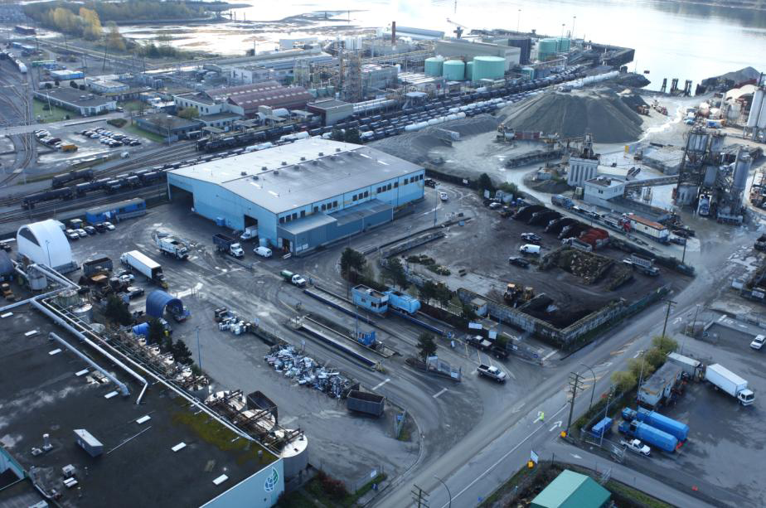
Enforcement
Disposal loads with too much clean wood by visual inspection pay 50% more for disposal
No surcharge if clean wood pulled out
Recycle in Green Waste area
NSTS →

Slide 5
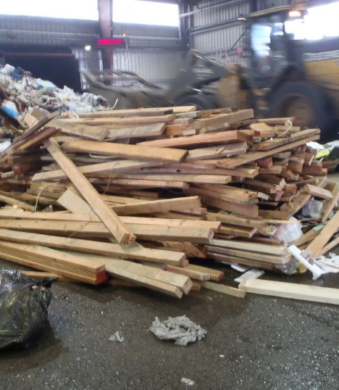
Enforcement
First week of January 2015:
23 educational notices issued for loads exceeding 10% clean wood
January 17-23, 2-15:
65 educational notices issued
Notes:
23 warnings for clean wood: 6 commercial and 17 residential
Photo of clean wood load in garbage – taken January 8, 2015 at North Shore Transfer Station

Slide 6
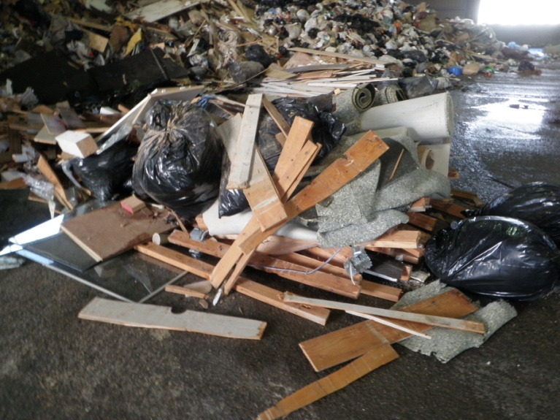
Phasing of Tolerance Level
2015: Garbage can contain up to 10% clean wood
2016: Plan for maximum 5% clean wood

Slide 7
Scope of Clean Wood Disposal Ban
All loads at Metro Vancouver and City of Vancouver transfer stations and disposal facilities
Except large construction and demolition loads tandem or tridem trailer at Vancouver Landfill
Does not apply at private licensed facilities
Notes:
Large construction and demolition loads are being encouraged to recycle through municipal recycling requirements with building and demolition permits (e.g. City of Vancouver, Port Moody, New Westminster, City of North Vancouver, and others under development)
7

Slide 8
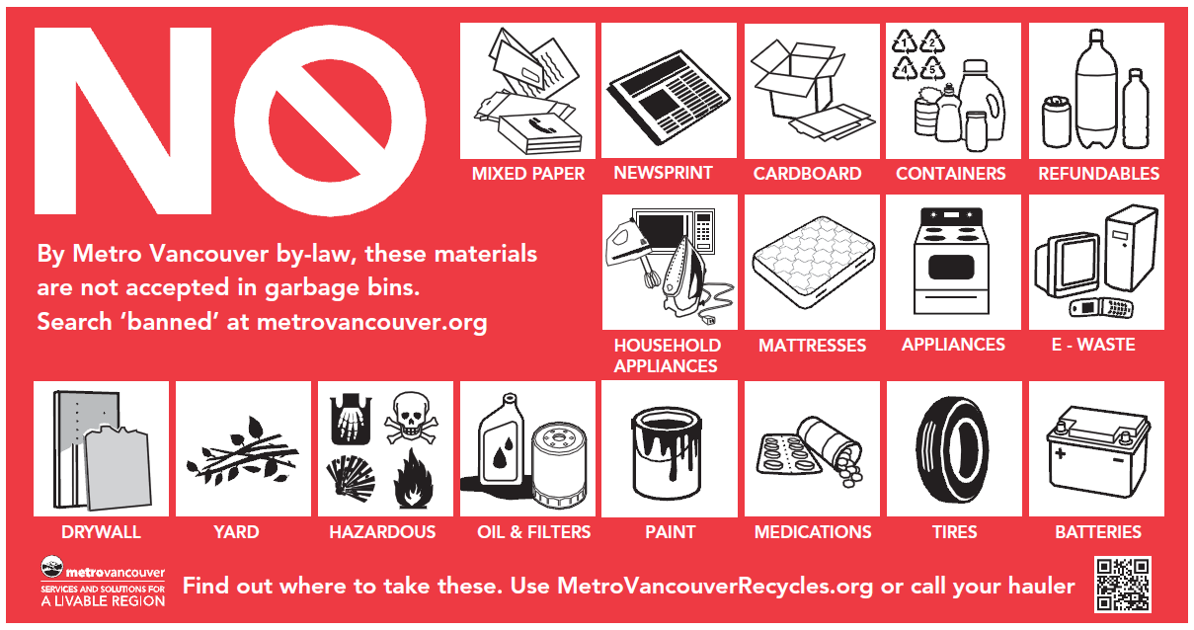
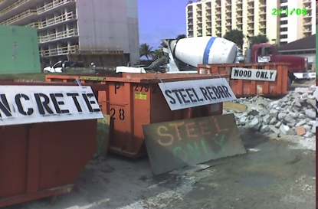
Transition Initiatives
DLC Waste Management Toolkit – online, print
Rack card with list of recycling facilities
Education campaigns at Regional Facilities
Standard signage / stickers
Notes:
8

Slide 9
Additional Information
Email
icentre@metrovancouver.org
Phone
604-REC-YCLE (RCBC Hotline)
http://www.metrovancouver.org
Search: “Clean Wood”
Notes:
9

