Slide 1

ReThink Waste:
The Need for Change in Ontario
January 29, 2015
WMABC AGM
1

Slide 2

Who We Are
2
OWMA is non-profit industry trade association
Represent over 300 private & public sector members
Members manage roughly 85% of the province’s waste
OWMA
Private members
Public members
Driving Goal:
Create a sustainable economic model for waste management

Slide 3
Overview
3
Ontario Statistics
Keys to Building the Right Framework
WDA - Wasted Opportunities
New Legislation
Other Work

Slide 4
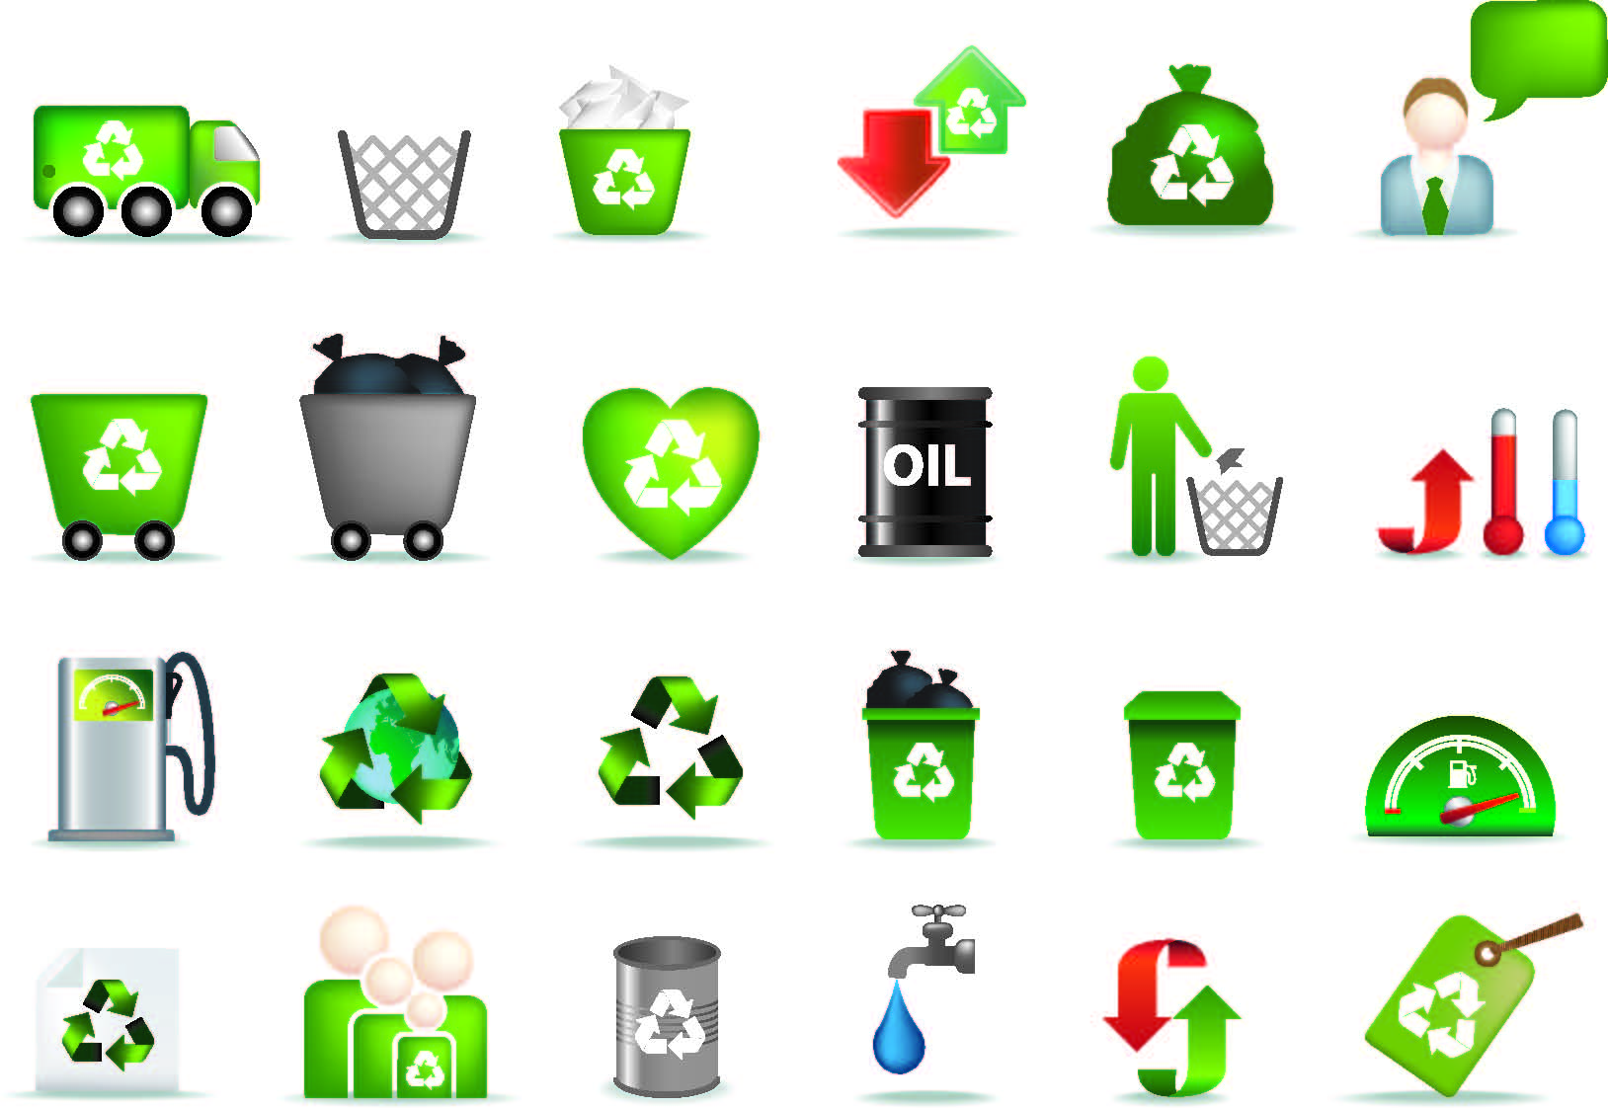


State of Waste in Ontario
4
4
Ontarians generate 12 million tonnes of waste per year - about 1 tonne per person

Slide 5
State of Waste in Ontario
5
5
Overall diversion rate is about 25%

Slide 6
Data – A Limitation
  Important to understand data limitations.
  Certain material streams and industries that likely have high diversion rates:
    Materials with high value – corrugated cardboard, scrap metals (white goods, vehicles)
    Large manufacturers – economies of scale
    68% of IC&I waste is generated by Small Business < 5 employees (Owen Sound 2008).
  Better data for residential waste but almost none for non-residential.
  Statistics Canada while not perfect provides the best on-going snapshot of waste management activities.

Slide 7



7
7
Disposal vs. Recycling
$40 - $50/T
$10 /T
Total Cost –
$45-$55/T
Transportation
Disposal
* Not including collection. Based on sending waste to the US. Transportation and tipping cost would be inverted for Ontario landfills.
$10 - $15/T
$70 - $80/T
$10 Value
Total Cost –
$70-$85/T
Transportation
Processing
End Product
* Fictional example based on SW Ontario

Slide 8
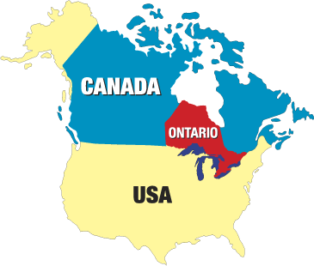
Disposal vs. Recycling
8
  Cheap landfill (especially in the US) becomes the default choice
    Over $100 million in tipping fees
    Threats of border closures
    Impacts disposal & diversion capacity
    End markets slow to develop
    Lack of accurate data on waste management within Ontario
Export 4 million tonnes of waste to the U.S. each year

Slide 9




State of Waste in Ontario
9
9
Over the last two decades, diversion has been focused in the residential sector through:
  Municipal blue box programs
  Municipal leaf and yard waste collection
  Recycling programs under Waste Diversion Act
No concerted effort to deal with IC&I waste (13% diversion rate) despite making up 60% of the waste stream:
  Regs. under Environmental Protection Act capture a small # of facilities - owners required to make best efforts to recycle
  Recycling costs more than disposal – what’s the incentive?

Slide 10



Ongoing Issues with EPR
10
  Current framework under the Waste Diversion Act (WDA) represents an enormous loss of resources and economic opportunity
  Overall diversion rate remains low at 25%
$100s of millions and substantial political will focused on 15% of waste stream
Continually experience problems around surprise eco-fees, market control and oversight.
WDA Programs
Waste Electrical & Electronic Equipment (WEEE)
Blue Box
Used Tires
Municipal Hazardous or Special Waste (MHSW)

Slide 11






11
11
EPR in Ontario
WDA forces producers of certain waste materials into a collective agency (OTS, SO and OES) or purchasing monopoly.
Oversight / Enforcement ineffective
Competition Act doesn’t apply - regulated conduct defense.
Causes problems in the marketplace for all stakeholders
Service Providers
Notes:
Competition Act doesn’t apply as it is considered a regulated conduct.
HST issue ($22 million annually)
Provides the ability to set single fee and pass directly onto consumers.

Slide 12
Issues with EPR (Ontario)
12
Service Providers and Municipalities:
Move from 1000s of customers to one.
One organization has almost complete control and dictates the rules & relationships.
Consumers:
Provides the ability to set single fee and pass directly onto consumers.
Eco-fee externalizes costs and inhibits innovation (product and process).
Producers:
Producers forced to join the collective even if they have a separate program.
Onerous to leave collective.
Focus on process rather than outcomes.
Rules dictated in collective.
Notes:
This act is aimed to clarify the roles and responsibilities in regulating and monitoring waste diversion programs
Also intended to protect consumers from “surprise” eco-fees

Slide 13


13
13
EPR - Individual Producer Responsibility
Makes individual producers legally responsible and accountable for meeting outcomes set by the government, which would include waste diversion standards, service standards, promotion and education requirements and penalties.
Collectives (intermediaries) would be permitted but Competition Act would apply to them.
Producers flexible on how outcomes achieved.
Focus on outcomes rather than process.
Producers
Service Providers

Slide 14




Benefits of Waste Diversion
Environmental Benefits | Economic Benefits
Lowers greenhouse gas (GHG) emissions – Ontario’s diversion programs avoided 2.2 million T of GHGs globally in 2007 (ON MOE, Waste Reduction Strategy – 2013) | Every 1,000 T of materials diverted generates: 7.3 full-time equivalent jobs $711,000 in GDP $360,000 in wages
Reduces pollution | Economic benefits are four times greater than the net cost to recycle
Minimizes environmental impacts | Jobs in waste diversion pay above the provincial average
Conserves valuable resources | If we reached 50% diversion rate, Ontario could increase investment by $1B & increase total jobs by over 20,000
Economic benefits based on a study commissioned by the Ontario Ministry of the Environment which looked at waste diverted through the Blue Box, MHSW, and WEEE programs. Approximately 1 million tonnes of material.

Slide 15
Conference Board of Canada
15
The Conference Board confirms what we have known for a long time: Waste diversion is a net benefit to our environment and our economy.
A conservative estimate of recent studies on recycling indicates that if Ontario increased waste diversion to 60% it could create 13,000 jobs and increase GDP by $1.5 billion.
For a province looking to increase employment this represents a significant opportunity.
It is however important for policy-makers to consider various factors to maximize economic potential:
  What materials yield greater economic multipliers;
  How policy tools would affect costs and economic efficiency;
  How processing and re-manufacturing might be promoted within Ontario;
  How better could be better captured to inform decision -making
Goal should be driving value not simply diversion from disposal.

Slide 16
Information / Oversight / Enforcement
16
16
  Cannot manage what you can not measure.
  Need for better data capture system – investment decisions, risk analysis, policy development.
  Government IT investments can’t keep up in managing data (HWIN, Approvals)
  Data capture project – Retrac
  Oversight & Enforcement needs to be properly resourced have teeth and either be government or third party managed.
  Especially important for EPR programs

Slide 17
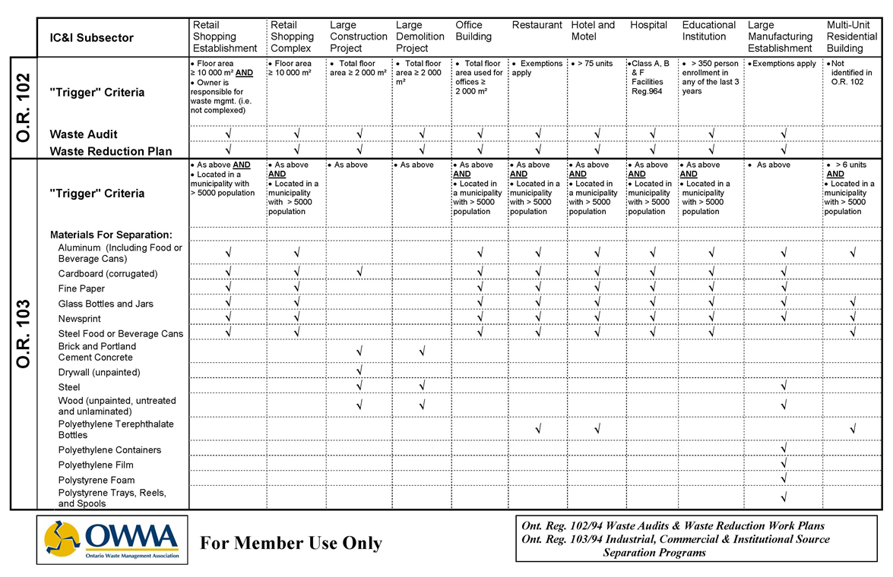
17
17

Slide 18
Oversight & Enforcement
18
  Single stream – collection approach outdated
  Materials collection – approach outdated
  New facilities & technologies – targeted materials outdated
  Outcomes vs process (ie Pharma aproach
  *** discussion on what is diversion?; LDR and soils (ie lack of oversight & enforcement), Environmental Standards (ELV approach & CSA Guideline)
Sector Group | Fiscal Year | Total Inspections | Non Compliance | Sites with only Reg. 102 Non Compliance (Waste Audits) | Sites with only Reg. 103 Non Compliance (Source Separating) | Sites with both Reg. 102 and Reg. 103 Non Compliance
Construction & Demolition | 2008-09 | 84 | 73 | 57 | 0 | 16
Construction & Demolition | 2009-10 | 63 | 49 | 32 | 0 | 17
Construction & Demolition | 2010-11 | 93 | 75 | 61 | 0 | 14
Construction & Demolition | 2011-12 | 87 | 61 | 50 | 0 | 11

Slide 19
Need for Environmental Standards
19
OWMA position on environmental standards for recycling:
  “Without a common set of environmental standards for processors those who have invested in operating to high environmental standards whether operating as service providers to EPR programs or generally operating in the waste diversion service market are put at a competitive disadvantage to those that have not made such investment but are still allowed to receive waste (and in some cases simply dispose of that waste while claiming it as diverted).”
  Consistent framework needed in to ensure accountability, transparency and accuracy as well as a level playing field.

Slide 20
CSA Guideline Process & Purpose
20
Engaged the Canadian Standards Association to establish a balanced process to develop a guideline.
Purpose:
Ensure facilities have a rigorous, transparent and accountable materials management system.
Focus is on Ontario but could be applicable elsewhere.
Not about choosing one technology over another but allows a purchaser/government to make informed decisions.
Applicable to anyone purchasing or overseeing waste management services.
Understanding that material specific requirements may be necessary to add.

Slide 21
Other Work
21
Conference Board of Canada Report.
Supportive of IC&I waste diversion – right tool.
Working on Organic Waste Diversion strategy.
Study w/ RCO tracking & applying economic model for PPP & tires (one-window reporting?)
HWIN proposal – move to a alternative service delivery model to allow for IT investments on a cost recovery basis
Draft CSA TECHNICAL GUIDE: Recycling process, audit and verification Guideline for Ontario
Competition Bureau of Canada advocacy.
Work by OWMA on financial assurance models.

Slide 22
Other Work
22
Canada-wide waste sector interaction.

Slide 23
Thank you
23
For more information contact:
Rob Cook, CEO
Rcook@owma.org
or
Peter Hargreave, Director of Policy
Phargreave@owma.org
905-791-9500
www.owma.org

